Slide 1
From Principles to Metrics to Evaluation, Increasing TRUST in Data Repositories
RDA/WDS Certification of Digital Repositories IG
RDA’s 17th Plenary Meeting
15:00 - 16:30 UTC (21 April, 2021) | Breakout 5
https://creativecommons.org/licenses/by/4.0/

Slide 2
Housekeeping
RDA/WDS Certification of Digital Repositories IG
The session is being recorded and will be made available on the RDA website
Please mute yourself and turn off the video when not talking
We mainly communicate via the chat function. Use it to raise your hand, add comments, ask questions
Engage in the session by asking questions (using the chat or the collaborative notes) and taking part in the discussion
Collaborative Notes Link: http://bit.ly/certrepoIG17
Twitter hashtag: #RDAtrust17
Sign in under Participants List!

Slide 3
Meeting Objectives
RDA/WDS Certification of Digital Repositories IG
To continue discussions on the overview and recommendations for effective implementation of certification of digital repositories. For this plenary these discussions will focus on current questions and towards implementing TRUST Principles to build a trustworthy repository ecosystem:
Sharing applications and perspectives from repositories and certification standards.
Thinking about the metrics for measuring the trustworthiness of a repository, following the TRUST principles.
Exploring next steps to raise the awareness of certification and improve the trustworthiness of data repository ecosystem.
Engagement Group?
Work Groups of mapping exercise among major efforts?
Additional ideas and directions, including more co-chairs.

Slide 4
Agenda
RDA/WDS Certification of Digital Repositories IG
Introduction and Welcome (5 min) co-chairs
TRUST Principles as an aspirational goal for a digital repository ecosystem (7 min) W. Hugo
Application of the TRUST principles to repository development - J. Behnke, A. Lazić (10 min)
Challenges to make TRUST trusted (7 min). M. Lindar
Metrics towards making a repository trustworthy: case study from a survey of biomedical repositories (10 min). M. Wang, K. Pruitt

Slide 5
Agenda (continued)
RDA/WDS Certification of Digital Repositories IG
How TRUST principles and repository certification apply to a generalist repository (10 min). T. Teal
Discussion: Engagement groups to promote and implement TRUST Principles within various communities, including but not limited to generalist repositories, technology and service providers, publishers, professional societies, and repository certification standards (35 min)
Next steps and closures (5 min) - IG co-chair

Slide 6
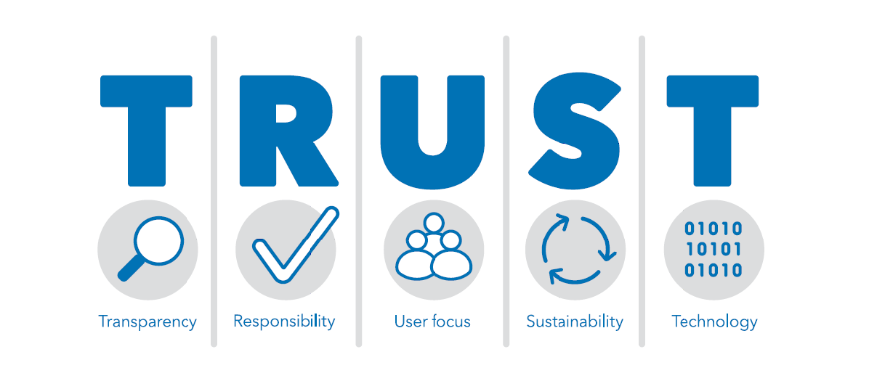
RDA/WDS Certification of Digital Repositories IG
https://www.nature.com/articles/s41597-020-0486-7

Slide 7
TRUST Roadmap
RDA/WDS Certification of Digital Repositories IG
Public
comments
Public
comments
Public
comments
Endorsement/Implementation/Improvement
TRUST mini
Symposium
White Paper
V0.01
White Paper
V0.02
White Paper
V0.03
Journal Publication
Blogs, social media,
citations
4/2019
11/2019
1/2020
5/2020
7/2020
RDA
RDA
RDA
Nature Scientific Data

Slide 8
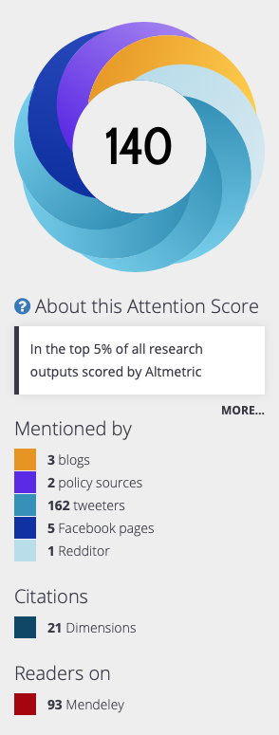
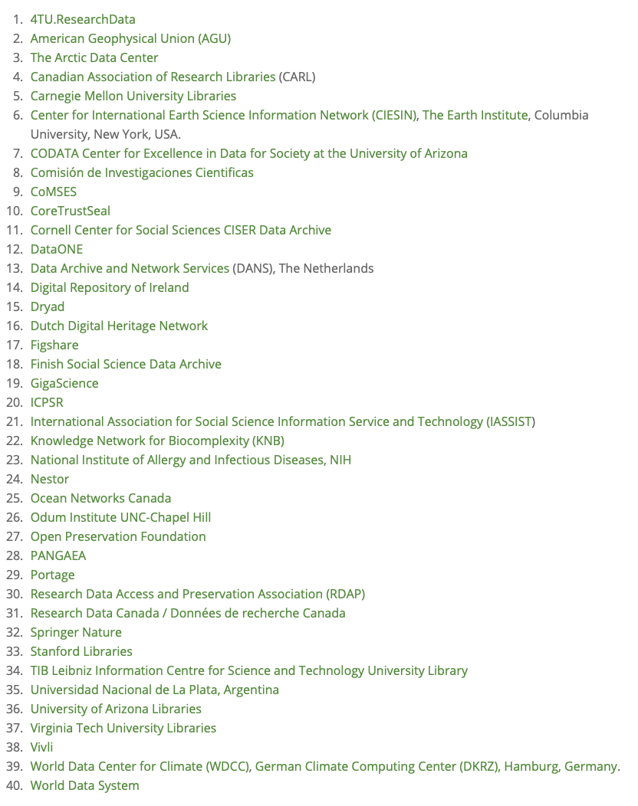
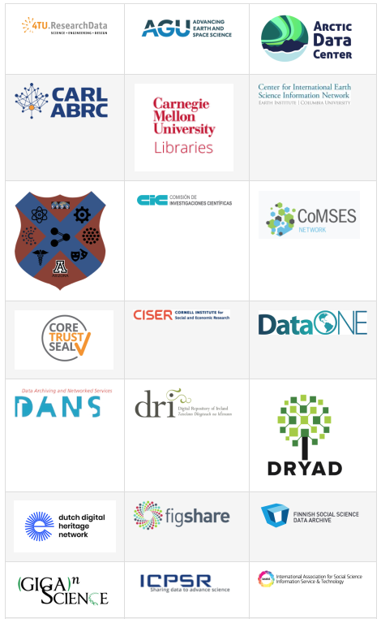
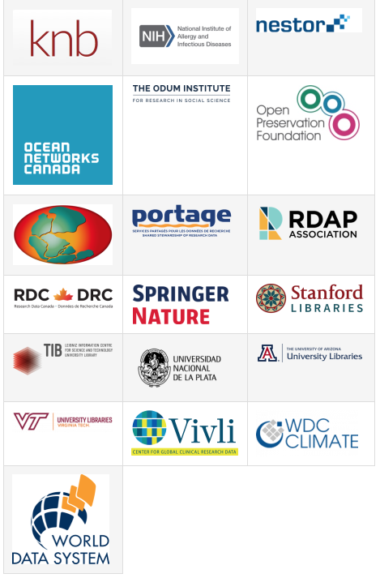
Endorsement and Citations
RDA/WDS Certification of Digital Repositories IG
15K+ Views, 35 citations
As of April 18, 2021

Slide 9
TRUST Principles as an aspirational goal for a digital repository ecosystem W. Hugo, DANS Video, 7 min
RDA/WDS Certification of Digital Repositories IG

Slide 10
Application of the TRUST principles to repository development Jeanne Behnke, NASA/EOSDIS Video, 5 min
RDA/WDS Certification of Digital Repositories IG

Slide 11
Application of the TRUST principles to repository development Aleksandra Lazić, University of Belgrade, REPOPSI Video, 5 min
RDA/WDS Certification of Digital Repositories IG

Slide 12
Challenges to make TRUST trusted Micky Lindlar, TIB/nestor Video, 7 min
RDA/WDS Certification of Digital Repositories IG

Slide 13
Metrics towards making a repository trustworthy: case study from a survey of biomedical repositories M. Wang, K. Pruitt, NIH Video, 10 min
RDA/WDS Certification of Digital Repositories IG

Slide 14
How TRUST principles and repository certification apply to a generalist repository T. Teal, Dryad Video, 10 min
RDA/WDS Certification of Digital Repositories IG

Slide 15
Discussion
RDA/WDS Certification of Digital Repositories IG
Promote TRUST to stakeholders
Enhance and bridge gaps, especially transparency and sustainability
Guide the certification process
Help the growth of repositories that are not ready for certifications yet
Align with the existing practices (standards, criteria, characteristics)

