Slide 1
The Research Data Alliance in a nutshell
October 2020

Slide 2
THE RESEARCH DATA ALLIANCE
www.rd-alliance.org
building the social and technical bridges that enable open sharing and re-use of data
50 FLAGSHIP OUTPUTS
including 8 ICT Technical Specifications
100+ ADOPTION CASES
across multiple disciplines, organisations & countries
Vision
Researchers and innovators openly share and re-use data across technologies, disciplines, and countries to address the grand challenges of society.
Mission
RDA builds the social and technical bridges that enable open sharing and re-use of data.
94 GROUPS WORKING ON GLOBAL DATA INTEROPERABILITY CHALLENGES
37 Working Groups
57 Interest Groups
11,154 INDIVIDUAL MEMBERS FROM 146 COUNTRIES
69% Academia & Research
14% Public Administration
11% Enterprise & Industry
52 ORGANISATIONAL MEMBERS
11 AFFILIATE MEMBERS

Slide 3
What is RDA?
RDA is an international member-based organization focused on the development of infrastructure and community activities that reduce barriers to data sharing and exchange, and the acceleration of data-driven innovation worldwide. With more than 11K members globally representing 146 countries, RDA includes researchers, scientists and data science professionals working in multiple disciplines, domains and thematic fields and from different types of organisations across the globe.
RDA is building the social and technical bridges that enable open sharing of data to achieve its vision of researchers and innovators openly sharing data across technologies, disciplines, and countries to address the grand challenges of society.

Slide 4
What does RDA do?
Members come together through self-formed, volunteer and focused Working Groups and exploratory Interest Groups to exchange knowledge, share discoveries, discuss barriers and potential solutions, explore and define policies and test as well as harmonise standards to enhance and facilitate global data sharing & re-use.
RDA members collaborate together across the globe to tackle numerous infrastructure & data sharing challenges related to:
Reproducibility
Data preservation
Best practices for domain repositories
Legal interoperability
Data citation
Data type registries
Metadata
and so many more!

Slide 5
Who Can Join RDA?
Any individual or organisation, regardless of profession or discipline, with an interest in reducing the barriers to the sharing and re-use of data and who agrees to RDA’s guiding principles of:
Openness
Consensus
Balance
Harmonization
Community-driven
Non-profit and technology-neutral
Individual Membership is free at https://www.rd-alliance.org/user/register

Slide 6
Why Join RDA as an Individual Member?
Individual Member Benefits
Contribute to acceleration of data infrastructure development
Work and share experiences with collaborators throughout the world
Access to extraordinary network of colleagues with various levels of experience, perspectives and practices
Gain greater expertise in data science regardless of whether one is a student, early or seasoned career professional
Enhance the quality and effectiveness of personal work and activities
Improve one’s competitive advantage professionally and positioning oneself for leadership within the broader research community
Individual RDA Members 11,154

Slide 7
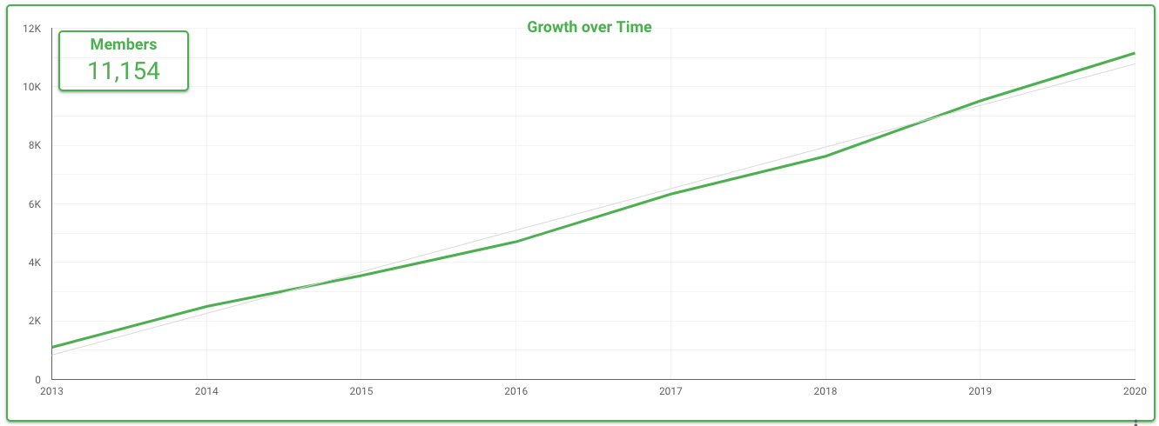
Who is RDA – Worldwide Growth

Slide 8
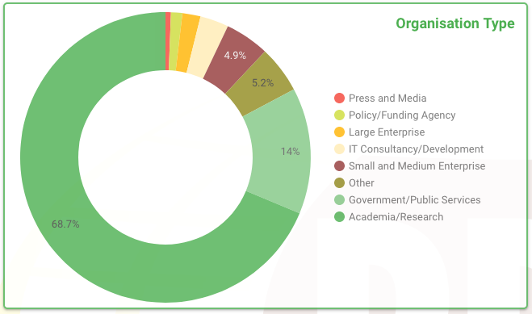
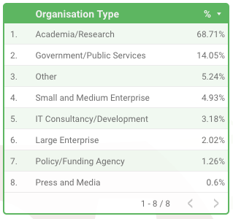
Who is RDA – Organisation type

Slide 9
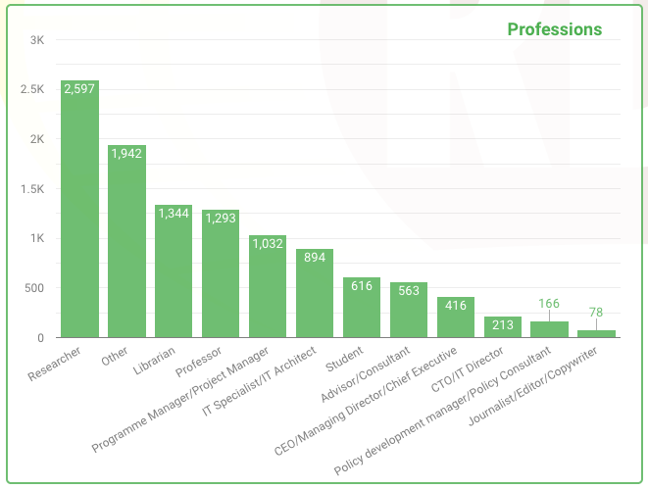
Who is RDA – Professional Title

Slide 10
Who is RDA – Geographical Distribution
11,154 RDA members from 146 different countries

Slide 11
Why Join RDA as an Organisational Member?
Organisational Member Benefits
Provide an organisational perspective on the work of RDA and ability to influence RDA’s direction
Assist in implementation & adoption of RDA Recommendations & Outputs
Participate in all RDA Organisational Forums
Receive regular updates on the work of the RDA
Attend Organisational Assembly meetings and vote on proposed policies for consideration by the RDA Council and for members of the Organisational Advisory Board
Provide advice to RDA Council through the Organisational Advisory Board
Be recognized on the RDA Website and at RDA Meetings as a supporter of data interoperability
Communicate open job positions in your organisation to entire RDA community (Exclusive to Organisational Members)
Reduced RDA Plenary meeting registration fee (Exclusive to Organisational Members)
53 Organisational & 11 Affiliate Members
Join as an Organisational Member! →

Slide 12
RDA Organisational Members
53 RDA Organisational Members
AARNet Pty Ltd (APL), Australia
American Geophysical Union (AGU), USA
American University Library, USA
Australian Research Data Commons (ARDC), Australia
Battelle - National Ecological Observatory Network (NEON), USA
Blackfynn Inc., USA
California Institute of Technology, USA
CANARIE, Canada
CAP Digital, France
Carnegie Mellon University, USA
Consortium of European Social Science Data Archives (CESSDA)
Columbia University Libraries/Information Services, USA
Corporation for National Research Initiatives (CNRI)
Danish e-Infrastructure Cooperation
DANS, Data Archiving and Networked Services, The Netherlands
Data Observation Network for Earth - DataONE
Digital Curation Centre (DCC), UK
Digital Repository of Ireland (DRI), Ireland
Earth Science Information Partners (ESIP)
EGI Foundation
ELSEVIER, The Netherlands
European Parliamentary Research Service (EPRS)
European Data Infrastructure (EUDAT project)
German Data Forum, Germany
Global Biosocial Complexity Initiative, Arizona State University, USA
Helmholtz Association, Germany
IASSIST - International Association for Social Science Information Services and Technology
Indiana University Pervasive Technology Institute, USA
Information Technology Research Insititute (ITRI)- National Institute of Advanced Industrial Science and Technology (AIST), Japan
Integrated Digitized Biocollections (iDigBio)
Interdisciplinary Centre for Mathematical and Computational Modelling (ICM), University of Warsaw, Poland
International Association of STM Publishers
International Federation of Data Organizations for Social Sciences
KAUST - King Abdullah University of Science and Technology, Saudia Arabia
LIBER - Association of European Research Libraries
Max Planck Computing and Data Facility (MPCDF), Germany
Massachusetts Institute of Technology Libraries (MIT Libraries), USA
National Center for Supercomputing Applications, University of Illinois at Urbana-Champaign, USA
National Library of Ireland, Ireland
Netherlands e-Science Center
NSD - Norwegian Centre for Research Data
NZ eScience Infrastructure, New Zealand
Purdue University Libraries, USA
Research Data Canada, Canada
Scholarly Publishing and Academic Resources Coalition (SPARC), USA
Science & Technology Facilities Council (STFC), UK
The Alan Turing institute, UK
TMF – Technology, Methods, and Infrastructure for Networked Medical Research, Germany
Université de Lorraine, France
University of Strasbourg, France
Washington University in St. Louis Libraries, USA
Web Science Trust, UK
John Wiley & Sons Ltd., UK
RDA Organisational Member details https://www.rd-alliance.org/get-involved/organisational-membership/rda-organisational-affiliate-members

Slide 13
RDA Affiliate Members
11 RDA Affiliate Members
The Consortia Advancing Standards in Research Administration Information - CASRAI
Confederation of Open Access Repositories (COAR)
Committee on Data for Science and Technology (CODATA)
DataCite
GIDA - The Global Indigenous Data Alliance
Group on Earth Observations (GEO)
Global Open Data for Agriculture & Nutrition (GODAN)
International Council for Scientific and Technical Information (ICSTI)
Connecting Research and Researchers (ORCID)
Research Software Alliance (ReSA)
World Data System (WDS)
RDA Affiliate Member details - https://www.rd-alliance.org/get-involved/organisational-membership/rda-organisational-affiliate-members

Slide 14
RDA active Interest Groups (IG) & Working Groups (WG): Discipline-focused and Partnerships
Total 94 groups:
37 Working Groups & 57 Interest Groups
Discipline focus
Working Groups
Agrisemantics WG
Capacity Development for Agriculture Data WG
Rice Data Interoperability WG
Reproducible Health Data Services WG
Preserving Scientific Annotation WG
Blockchain Applications in Health WG
InteroperAble Descriptions of Observable Property Terminology WG (I-ADOPT WG)
RDA-COVID19-Legal-Ethical
RDA-COVID19-Software
RDA-COVID19-Clinical WG
RDA-COVID19-Community-participation WG
RDA-COVID19-Epidemiology WG
RDA-COVID19-Omics WG
RDA-COVID19-Social-Sciences WG
RDA-COVID19 WG
Raising FAIRness in health data and health research performing organisations (HRPOs) WG
Empirical Humanities Metadata Working Group
Interest Groups
Agricultural Data IG (IGAD)
Biodiversity Data Integration IG
Chemistry Research Data IG
Digital Practices in History and Ethnography IG
ESIP/RDA Earth, Space, and Environmental Sciences IG
Geospatial IG
Global Water Information IG
Health Data IG
Linguistics Data IG
RDA/CODATA Materials Data, Infrastructure & Interoperability IG
Research data needs of the Photon and Neutron Science community IG
Small Unmanned Aircraft Systems’ Data IG
Social Sciences Research Data IG
Research Data Management in Engineering IG
RDA for the Sustainable Development Goals IG
Partnerships
Working Groups
RDA/TDWG Metadata Standards for attribution of physical and digital collections stewardship WG
RDA/World Data System (WDS) Scholarly Link Exchange WG
Interest Groups
ELIXIR Bridging Force IG
RDA/National Information Standards Organization (NISO) Privacy Implications of Research Data Sets IG

Slide 15
RDA active Interest Groups (IG) & Working Groups (WG): Focus on Reference/Sharing and Community Needs
Total 94 groups:
37 Working Groups & 57 Interest Groups
Reference and Sharing
Working Groups
International Materials Resource Registries WG
Research Data Collections WG
Research Data Repository Interoperability WG
Data Usage Metrics WG
Interest Groups
Data Discovery Paradigms IG
National Data Services IG
RDA/CODATA Legal Interoperability IG
Sharing Rewards and Credit (SHARC) IG
Community Needs
Working Groups
Interest Groups
CODATA/RDA Research Data Science Schools for Low and Middle Income Countries
Archives & Records Professionals for Research Data IG Data for Development IG
Early Career and Engagement IG
Education and Training on handling of research data IG
Ethics and Social Aspects of Data IG
International Indigenous Data Sovereignty IG
Surveying Open Data Practices IG
Data for Development IG
Research Funders & Stakeholders on Open Research and Data Management Policies and Practices IG
Global Open Research Commons IG

Slide 16
RDA active Interest Groups (IG) & Working Groups (WG): Focus on Data Stewardship and Infrastructures
Total 94 groups:
37 Working Groups & 57 Interest Groups
Data Stewardship and Services
Working Groups
Brokering Framework WG
World Data System (WDS)/RDA Assessment of Data Fitness for Use WG
Data Versioning WG
FAIR Data Maturity Model WG
DMP Common Standards WG
Exposing Data Management Plans WG
CURE-FAIR WG
Discipline-specific Guidance for Data Management Plans WG
Interest Groups
Active Data Management Plans IG
Data in Context IG
Domain Repositories IG
Virtual Research Environments IG
Libraries for Research Data IG
Physical Samples and Collections in the Research Data Ecosystem IG
Preservation Tools, Techniques, and Policies IG
RDA/World Data System (WDS) Certification of Digital Repositories IG
Repository Platforms for Research Data IG
Research Data Architectures in Research Institutions IG
Data policy standardisation and implementation IG
GO FAIR IG
Open Science Graphs IG
Engaging Researchers with Data IG
Professionalising Data Stewardship IG
Base Infrastructure
Working Groups
Data Type Registries WG
PID Kernel Information WG
Research Metadata Schemas WG
FAIR 4 Research Software (FAIR4RS) WG
RDA/FORCE11 Software Source Code Identification WG
Persistent Identification of Instruments WG
Interest Groups
Data Fabric IG
Data Foundations and Terminology IG
Disciplinary Interoperability Framework IG
Big Data IG
Metadata IG
PID IG
Software Source Code IG
Vocabulary Services IG
Federated Identity Management IG
Data Economics IG
Social Dynamics of Data Interoperability IG

Slide 17
Retired Working and Interest Groups (Groups that have completed their work within RDA)
Historical Groups
Brokering Governance WG
Metadata Standards Directory WG
PID Information Types WG
Practical Policy WG
RDA/World Data System (WDS) Publishing Data Bibliometrics WG
RDA/World Data System (WDS) Publishing Data Services WG
Repository Audit and Certification DSA–WDS Partnership WG
Data Foundations and Terminology WG
Provenance Patterns WG
Empirical Humanities Metadata WG
On-Farm Data Sharing (OFDS) WG
Persistent Identification of Instruments WG
RDA/World Data System (WDS) Publishing Data Cost Recovery for Data Centres WG
Mapping the Landscape IG
Preservation e-Infrastructure IG
Quality of Urban Life IG
Development of Cloud Computing Capacity and Education in Developing World Research IG
Weather, Climate and Air quality IG
Structural Biology IG
RDA/World Data System (WDS) Publishing Data Cost Recovery for Data Centres IG
Marine Data Harmonization IG
RDA/World Data System (WDS) Publishing Data IG
Brokering IG
Research Data Provenance IG
Long tail of research data IG
Data Rescue IG
Reproducibility IG

Slide 18
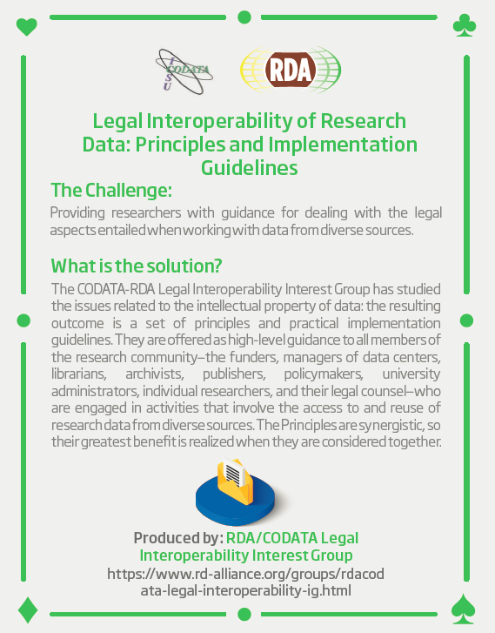
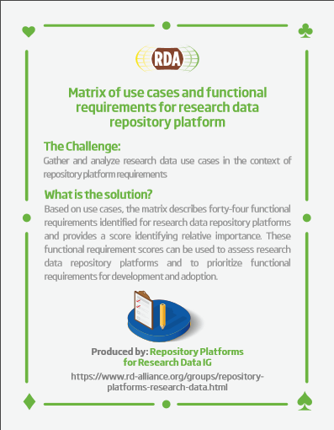
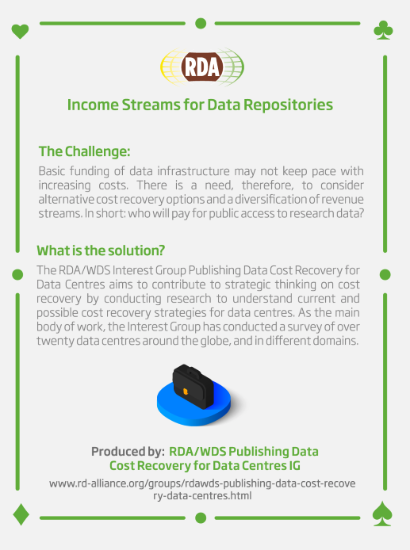
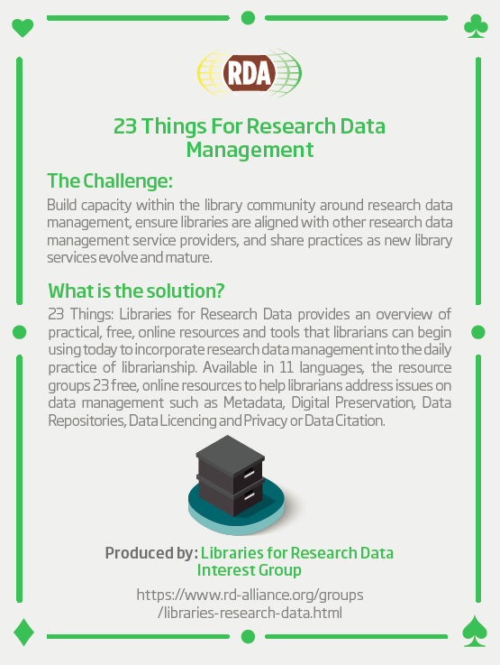
RDA Recommendations that Make Data Work
“Create - Adopt - Use”
Adopted code, policy, specifications, standards, or practices that enable data sharing
“Harvestable” efforts for which 12-18 months of work can eliminate a roadblock
Efforts that have substantive applicability to groups within the data community but may not apply to all
Efforts that can start today
50 flagship Recommendations & Outputs
More than 100 cases of Adoption in Different Domains, Organisations and Countries

Slide 19
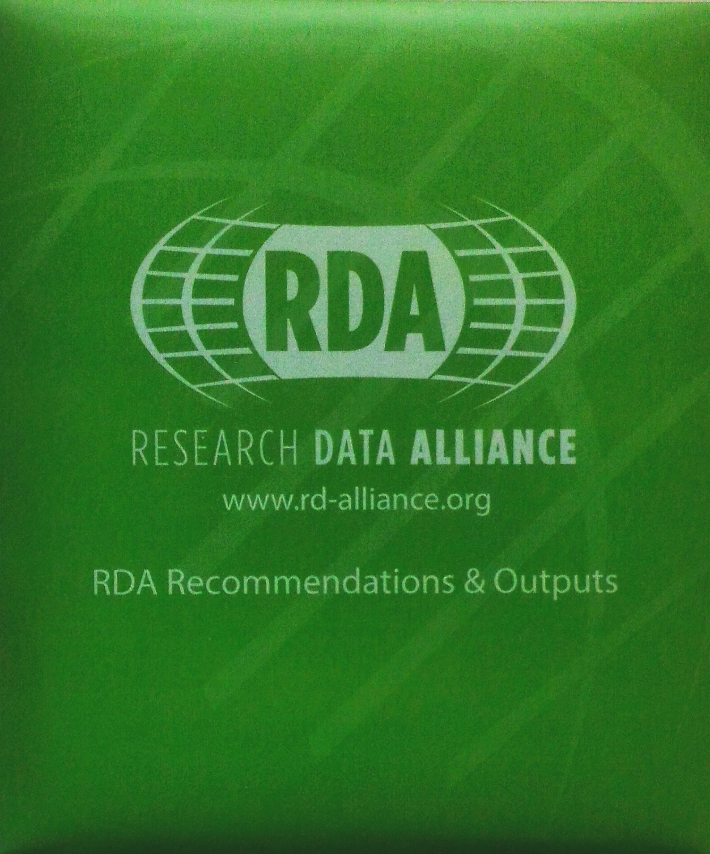
RDA Recommendations & Outputs
CATEGORIES OF RECOMMENDATIONS & OUTPUTS
Recommendations: RDA’s flagship outputs and the equivalent of “specifications” or “standards” that other organisations create and endorse.
Supporting Outputs: RDA outputs that originate from the work of RDA groups, but not always adoptable by other organisations. “Upon request” by RDA groups, these outputs are reviewed by the RDA member community and if no major objections or gaps are identified, they are approved to use the RDA Brand.
Other Outputs: These are workshop reports, published articles, survey results, etc. produced by RDA groups. Upon request by the groups, these outputs are posted on the RDA website but have no level of endorsement.
21 RDA Recommendations - of which 8 ICT Technical Specifications - & 23 Supporting Outputs currently in the RDA Catalogue:
https://www.rd-alliance.org/recommendations-and-outputs/catalogue

Slide 20
ENDORSED RECOMMENDATIONS
Data Type Model and Registry - Data Type Registries (DTR) WG Recommendations Published by the Data Type Registries WG providing machine-readable and researcher-accessible registries of data types that support the accurate use of data → ICT Tech specification
Machine Actionable Policy Templates - Practical Policy WG Recommendations Defining best practices of how to deal with data automatically and in a documented way with computer actionable policy → ICT Tech specification
PID Information Types (PIT) WG Recommendations Persistent Identifier Type Registry produced by the PID Information Types WG, a conceptual model for structuring typed information to better identify PIDs, common interface for access to this information. → ICT Tech specification

Slide 21
ENDORSED RECOMMENDATIONS
RDA Research Data Collections WG Recommendations: A comprehensive model for actionable collections and a technical interface specification to enable client-server interaction.
Recommendation on PID Kernel Information: A set of guiding principles, architectural considerations, use cases and a fundamental metadata schema to manage information in Persistent Identifier records for scalable middleware infrastructure and automated processes.
Research Data Repository Interoperability WG Final Recommendations: Provides recommendations with respect to an interoperable packaging and exchange format for digital content
The FAIRsharing Registry and Recommendations: Interlinking Standards, Databases and Data Policies: Guide for citation and its implementation in a registry of standards, databases and data policies

Slide 22
ENDORSED RECOMMENDATIONS
The final version of the RDA COVID-19 Recommendations and Guidelines for Data Sharing, published 30 June 2020
The Research Data Alliance (RDA) COVID-19 Working Group members bring various, global expertise to develop a body of work that comprises how data from multiple disciplines inform response to a pandemic combined with guidelines and recommendations on data sharing under the present COVID-19 cicumstances.

Slide 23
RDA Endorsement in Process
RDA DMP Common Standard for Machine-actionable Data Management Plans: Allows representing Data Management Plans in a machine-actionable way, to enable exchange of information between systems acting on behalf of stakeholders involved in the research life cycle, such as, researchers, funders, repository managers, ICT operators, data stewards, etc
FAIR Data Maturity Model: specification and guidelines: This document describes a maturity model for FAIR assessment with assessment indicators, priorities and evaluation methods. This is useful for the normalisation of assessment approaches to enable comparison of their results.
Recommendations and Capacity Development Resource Kit: These documents include an overview about available and free training resources in the area of agricultural data management. A detailed description is provided for resources that are related to RDA. Other free resources that are available online are listed as well.

Slide 24
SUPPORTING OUTPUTS
Matrix of use cases and functional requirements for research data repository platforms: Based on use cases, matrix describes forty-four functional requirements identified for research data repository platforms and provides a score identifying relative importance.
Persistent identifiers: Consolidated assertions: Set of assertions about the nature, creation and usage of Persistent Identifiers (PIDs). It is not meant to produce another comprehensive document on PIDs, but to identify agreements across documents that have been suggested to be included by experts.

Slide 25
SUPPORTING OUTPUTS
Results of an Analysis of Existing FAIR Assessment Tools: First result of the FAIR Data Maturity Model WG, based on the analysis of existing approaches related to FAIR self-assessment tools. Questions and options stemming from theses different approaches were classified according to the FAIR principles/facets.
Summary of Virtual Layer Recommendations: Provides a high-level conceptual framework to support Digital Object management and service development.
Engaging Researchers with Data Management: The Cookbook: Provides examples of 24 innovative, searchable and re-usable case studies on how institutions can effectively engage with researchers about research data.

Slide 26
SUPPORTING OUTPUTS
23 Things: Libraries for Research Data: An overview of practical, free, online resources and tools that users can immediately take advantage of to incorporate research data management into the practice of librarianship.
Addressing the Gaps: Recommendations for Supporting the Long Tail of Research Data: Seven recommendations applicable to various stakeholders - including governments, funders, research institutions and researchers - to help improve the current approach to managing long tail data.
Data Discovery Paradigms: User Requirements and Recommendations for Data Repositories: Output helps data repositories improve search and discovery of data.

Slide 27
SUPPORTING OUTPUTS
Tromsø recommendations for citation of research data in linguistics: For the use of researchers and scholars in the field working with datasets, we propose components of data citation for referencing language data, both in the bibliography and in the text of linguistics publications.
Compilation of Data Versioning Use cases from the RDA Data Versioning Working Group: Data versioning is a fundamental element to ensuring the reproducibility of research. Work in other RDA groups on data provenance and data citation, as well as the W3C Dataset Exchange Working Group, have highlighted that definitions of data versioning concepts and recommended practices are still missing.
RDA-COVID19 WG Zotero Library: The RDA-COVID19 WG Zotero Library was created by the RDA-COVID19 WG to support development of the RDA-COVID19 Recommendations and Guidelines.

Slide 28
SUPPORTING OUTPUTS
Data Sharing in Epidemiology: There is a pressing need for a coordinated global system encompassing preparedness, early detection, and rapid response to newly emergent threats such as SARS-CoV-2 virus and the COVID- 19 disease that it causes. The intended audience for the epidemiology recommendations and guidelines are government and international agencies, policy and decision makers, epidemiologists and public health experts, disaster preparedness and response experts, funders, data providers, teachers, researchers, clinicians, and other potential users.
Principles and best practices in data versioning for all data sets big and small: The demand for better reproducibility of research results is growing. More and more data is becoming available online. In some cases, the datasets have become so large that downloading the data is no longer feasible.
Persistent Identification of Instruments: two tested approaches for persistent identification of instruments.

Slide 29
SUPPORTING OUTPUTS
Matrix of use cases and functional requirements for research data repository platforms:
Based on use cases, matrix describes forty-four functional requirements identified for research data repository platforms and provides a score identifying relative importance.
Data Sharing in Epidemiology: There is a pressing need for a coordinated global system encompassing preparedness, early detection, and rapid response to newly emergent threats such as SARS-CoV-2 virus and the COVID- 19 disease that it causes. The intended audience for the epidemiology recommendations and guidelines are government and international agencies, policy and decision makers, epidemiologists and public health experts, disaster preparedness and response experts, funders, data providers, teachers, researchers, clinicians, and other potential users.
RDA-COVID19 WG Zotero Library: The RDA-COVID19 WG Zotero Library was created by the RDA-COVID19 WG to support development of the RDA-COVID19 Recommendations and Guidelines.

Slide 30
ENDORSED RECOMMENDATIONS
The FAIRsharing Registry and Recommendations: Interlinking Standards, Databases and Data Policies: In this data-driven age, governments, funders and publishers expect greater transparency and reuse of research data, as well as greater access to and preservation of the data that supports research findings. This requires greater researcher responsibility for the produced data, which should result in greater confidence in, and the reuse of, existing data.
The final version of the RDA COVID-19 Recommendations and Guidelines for Data Sharing, published 30 June 2020: The Research Data Alliance (RDA) COVID-19 Working Group members bring various, global expertise to develop a body of work that comprises how data from multiple disciplines inform response to a pandemic combined with guidelines and recommendations on data sharing under the present COVID-19 cicumstances.

Slide 31
RDA ENDORSED IN PROCESS
Recommendations and Capacity Development Resource Kit: These documents include an overview about available and free training resources in the area of agricultural data management. A detailed description is provided for resources that are related to RDA. Other free resources that are available online are listed as well.

Slide 32
ENDORSED RECOMMENDATIONS
Repository Audit and Certification DSA–WDS Partnership WG Recommendations: Creates harmonized Common Procedures for certification of repositories at the basic level, drawing from the procedures already put in place by the Data Seal of Approval (DSA) and the ICSU World Data System (ICSU-WDS) → ICT Technical Specification
Research Data Repository Interoperability WG Final Recommendations: Provides recommendations ith respect to an interoperable packaging and exchange format for digital content
Wheat Data Interoperability Recommendations: impacting the discoverability, reusability and interoperability of wheat data by building a common framework for describing, representing linking and publishing wheat data

Slide 33
ENDORSED RECOMMENDATIONS
Basic Vocabulary of Foundational Terminology Query Tool: - Data Foundation and Terminology (DFT) WG Recommendations: produced by the Data Foundation & Terminology WG which ensures researchers use a common terminology when referring to data. →ICT Technical Specification
Data Description Registry Interoperability Model: Interoperability model addressing the problem of cross platform discovery by connecting datasets together → ICT Technical Specification
The final version of the RDA COVID-19 Recommendations and Guidelines for Data Sharing, published 30 June 2020: The Research Data Alliance (RDA) COVID-19 Working Group members bring various, global expertise to develop a body of work that comprises how data from multiple disciplines inform response to a pandemic combined with guidelines and recommendations on data sharing under the present COVID-19 cicumstances.

Slide 34
ENDORSED RECOMMENDATIONS
RDA/TDWG Attribution Metadata Working Group: Final Recommendations: Supports standardized metadata for attributing work and tracking provenance in the curation and maintenance of research collections.
The FAIRsharing Registry and Recommendations: Interlinking Standards, Databases and Data Policies: In this data-driven age, governments, funders and publishers expect greater transparency and reuse of research data, as well as greater access to and preservation of the data that supports research findings. This requires greater researcher responsibility for the produced data, which should result in greater confidence in, and the reuse of, existing data.

Slide 35
ENDORSEMENT IN PROCESS
Metadata Standards Directory Working Group Recommendations: Community curated standards catalogue for metadata interoperability
Recommendations and Capacity Development Resource Kit: These documents include an overview about available and free training resources in the area of agricultural data management. A detailed description is provided for resources that are related to RDA. Other free resources that are available online are listed as well.

Slide 36
SUPPORTING OUTPUTS
Data Discovery Paradigms: User Requirements and Recommendations for Data Repositories: This output helps data repositories improve search and discovery of data.
Eleven Quick Tips for Finding Research Data: Educates and trains research students and early career researchers, and helps researchers more effectively and precisely discover data that meets specific needs.
Matrix of use cases and functional requirements for research data repository platforms: Based on use cases, matrix describes forty-four functional requirements identified for research data repository platforms and provides a score identifying relative importance
Research Data Repository Interoperability Primer: of use cases and an overview of standards, technologies and tools that could be components of an adoptable approach to facilitating interoperability between different research data repository platforms.

Slide 37
SUPPORTING OUTPUTS
Compilation of Data Versioning Use cases from the RDA Data Versioning Working Group: Data versioning is a fundamental element to ensuring the reproducibility of research. Work in other RDA groups on data provenance and data citation, as well as the W3C Dataset Exchange Working Group, have highlighted that definitions of data versioning concepts and recommended practices are still missing.
Data Sharing in Epidemiology: There is a pressing need for a coordinated global system encompassing preparedness, early detection, and rapid response to newly emergent threats such as SARS-CoV-2 virus and the COVID- 19 disease that it causes. The intended audience for the epidemiology recommendations and guidelines are government and international agencies, policy and decision makers, epidemiologists and public health experts, disaster preparedness and response experts, funders, data providers, teachers, researchers, clinicians, and other potential users.
RDA-COVID19 WG Zotero Library: The RDA-COVID19 WG Zotero Library was created by the RDA-COVID19 WG to support development of the RDA-COVID19 Recommendations and Guidelines.

Slide 38
SUPPORTING OUTPUTS
Principles and best practices in data versioning for all data sets big and small: The demand for better reproducibility of research results is growing. More and more data is becoming available online. In some cases, the datasets have become so large that downloading the data is no longer feasible. Data can also be offered through web services and accessed on demand. This means that parts of the data are accessed at a remote source when needed. In this scenario, it will become increasingly important for a researcher to be able to cite the exact extract of the data set that was used to underpin their research publication.
Tromsø recommendations for citation of research data in linguistics: For the use of researchers and scholars in the field working with datasets, we propose components of data citation for referencing language data, both in the bibliography and in the text of linguistics publications.
Persistent Identification of Instruments: two tested approaches for persistent identification of instruments.

Slide 39
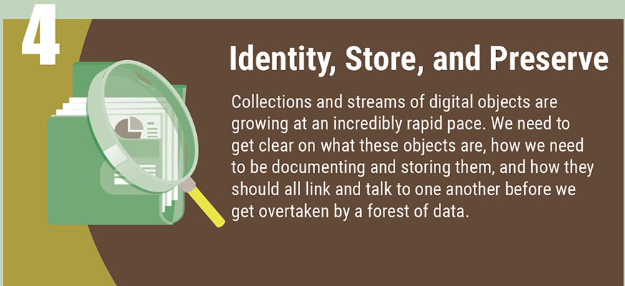
ENDORSED RECOMMENDATIONS
Scalable Dynamic Data Citation Methodology: Supports efficient processing of data and linking from publications →ICT Technical Specification
Machine Actionable Policy Templates - Practical Policy WG Recommendations: Defining best practices of how to deal with data automatically and in a documented way with computer actionable policy → ICT Tech specification
The FAIRsharing Registry and Recommendations: Interlinking Standards, Databases and Data Policies: In this data-driven age, governments, funders and publishers expect greater transparency and reuse of research data, as well as greater access to and preservation of the data that supports research findings. This requires greater researcher responsibility for the produced data, which should result in greater confidence in, and the reuse of, existing data.

Slide 40
ENDORSED RECOMMENDATIONS
Repository Audit and Certification DSA–WDS Partnership WG Recommendations: Creates harmonized Common Procedures for certification of repositories at the basic level, drawing from the procedures already put in place by the Data Seal of Approval (DSA) and the ICSU World Data System (ICSU-WDS) → ICT Technical Specification
39 Hints to Facilitate the Use of Semantics for Data on Agriculture and Nutrition: This document presents the recommendations of the RDA Agrisemantics Working Group (WG) to promote the use of semantics for agricultural data for the purpose of enhancing data interoperability in agriculture. These recommendations are high-level, to encourage researchers and practitioners to extend them according to their area of expertise.

Slide 41
ENDORSED RECOMMENDATIONS
The final version of the RDA COVID-19 Recommendations and Guidelines for Data Sharing, published 30 June 2020: The Research Data Alliance (RDA) COVID-19 Working Group members bring various, global expertise to develop a body of work that comprises how data from multiple disciplines inform response to a pandemic combined with guidelines and recommendations on data sharing under the present COVID-19 cicumstances.

Slide 42
ENDORSEMENT IN PROCESS
SCID WG output: Use cases and identifier schemes for persistent software source code identification (V1.0): This output, with inputs from a broad panel of stakeholders, provides an overview of the current state-of-the-art practice in software identification, including use cases and identifier schemes from different academic domains and in industry.
Recommendations and Capacity Development Resource Kit: These documents include an overview about available and free training resources in the area of agricultural data management. A detailed description is provided for resources that are related to RDA. Other free resources that are available online are listed as well.

Slide 43
SUPPORTING OUTPUTS
Federated Identity Management for Research Collaborations: Common requirements of Research Communities seeking to leverage Identity Federation for Authentication and Authorisation.
Matrix of use cases and functional requirements for research data repository platforms: Based on use cases, matrix describes forty-four functional requirements identified for research data repository platforms and provides a score identifying relative importance.
Compilation of Data Versioning Use cases from the RDA Data Versioning Working Group: Data versioning is a fundamental element to ensuring the reproducibility of research. Work in other RDA groups on data provenance and data citation, as well as the W3C Dataset Exchange Working Group, have highlighted that definitions of data versioning concepts and recommended practices are still missing.

Slide 44
SUPPORTING OUTPUTS
Data Sharing in Epidemiology: There is a pressing need for a coordinated global system encompassing preparedness, early detection, and rapid response to newly emergent threats such as SARS-CoV-2 virus and the COVID- 19 disease that it causes. The intended audience for the epidemiology recommendations and guidelines are government and international agencies, policy and decision makers, epidemiologists and public health experts, disaster preparedness and response experts, funders, data providers, teachers, researchers, clinicians, and other potential users.
Principles and best practices in data versioning for all data sets big and small: The demand for better reproducibility of research results is growing. More and more data is becoming available online. In some cases, the datasets have become so large that downloading the data is no longer feasible.

Slide 45
SUPPORTING OUTPUTS
RDA-COVID19 WG Zotero Library: The RDA-COVID19 WG Zotero Library was created by the RDA-COVID19 WG to support development of the RDA-COVID19 Recommendations and Guidelines.
WDS/RDA Assessment of Data Fitness for Use WG Outputs and Recommendations: A practical process by which CoreTrustSeal certified repositories can evaluate dataset holding for their fitness for use.
Use cases and identifier schemes for persistent software source code identification (V1.0): The goal of this output of the working group is to survey different systems of identifiers for software, and their usage in different use cases, in an harmonized way.

Slide 46
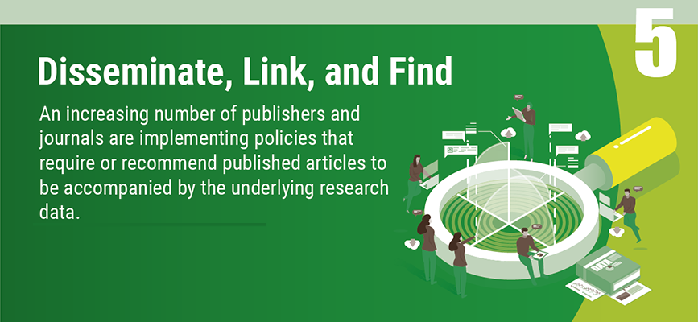
ENDORSED RECOMMENDATIONS
An open, universal literature-data cross-linking service: - RDA/WDS Publishing Data Services WG Recommendations: An open, universal literature-data cross-linking service to improve data visibility, discoverability, re-use and reproducibility
Data Description Registry Interoperability Model: Interoperability model addressing the problem of cross platform discovery by connecting datasets together. →ICT Technical Specification
CODATA/RDA Summer School in Data Science and Cloud Computing in the Developing World WG Recommendations: A framework to run a series of Summer Schools in Data Science and data sharing in low and middle income countries (LMICs).

Slide 47
ENDORSED RECOMMENDATIONS
RDA/WDS Publishing Data Workflows WG Recommendations: A data-publishing reference model assisting research communities in understanding options for data publishing workflows and increases awareness of emerging standards and best practices. →ICT Technical Specification
Repository Audit and Certification DSA–WDS Partnership WG Recommendations: Creates harmonized Common Procedures for certification of repositories at the basic level, drawing from the procedures already put in place by the Data Seal of Approval (DSA) and the ICSU World Data System (ICSU-WDS) → ICT Technical Specification
The FAIRsharing Registry and Recommendations: Interlinking Standards, Databases and Data Policies: Guide for citation and its implementation in a registry of standards, databases and data policies

Slide 48
ENDORSED RECOMMENDATIONS
The final version of the RDA COVID-19 Recommendations and Guidelines for Data Sharing, published 30 June 2020: The Research Data Alliance (RDA) COVID-19 Working Group members bring various, global expertise to develop a body of work that comprises how data from multiple disciplines inform response to a pandemic combined with guidelines and recommendations on data sharing under the present COVID-19 cicumstances.

Slide 49
ENDORSEMENT IN PROCESS
Scholix Metadata Schema for Exchange of Scholarly Communication Links: The goal of the Scholix initiative is to establish a high level interoperability framework for exchanging information about the links between scholarly literature and data. It aims to enable an open information ecosystem to understand systematically what data underpins literature and what literature references data.
FAIR Data Maturity Model: specification and guidelines: This document describes a maturity model for FAIR assessment with assessment indicators, priorities and evaluation methods. This is useful for the normalisation of assessment approaches to enable comparison of their results.
Recommendations and Capacity Development Resource Kit: These documents include an overview about available and free training resources in the area of agricultural data management. A detailed description is provided for resources that are related to RDA. Other free resources that are available online are listed as well.

Slide 50
ENDORSEMENT IN PROCESS
Sustainable Business Models for Brokering Middleware to support Research Interoperability: Discusses the strengths and weakness of five classes of business models in the context of long-term sustainment of brokering middleware

Slide 51
SUPPORTING OUTPUTS
A survey of current practices in data search services: Survey results based on an examination of practices that data repositories employ in helping users search as well as common data discovery issues, such as relevancy.
Data Discovery Paradigms: User Requirements and Recommendations for Data Repositories: Output helps data repositories improve search and discovery of data.
Tromsø recommendations for citation of research data in linguistics: For the use of researchers and scholars in the field working with datasets, we propose components of data citation for referencing language data, both in the bibliography and in the text of linguistics publications.

Slide 52
SUPPORTING OUTPUTS
Eleven Quick Tips for Finding Research Data: Educates and trains research students and early career researchers, and helps researchers more effectively and precisely discover data that meets specific needs.
Matrix of use cases and functional requirements for research data repository platforms: Based on use cases, matrix describes forty-four functional requirements identified for research data repository platforms and provides a score identifying relative importance.
Research Data Repository Interoperability Primer: Set of use cases and an overview of standards, technologies and tools that could be components of an adoptable approach to facilitating interoperability between different research data repository platforms.

Slide 53
SUPPORTING OUTPUTS
RDA-COVID19 WG Zotero Library: The RDA-COVID19 WG Zotero Library was created by the RDA-COVID19 WG to support development of the RDA-COVID19 Recommendations and Guidelines.
Data Sharing in Epidemiology: There is a pressing need for a coordinated global system encompassing preparedness, early detection, and rapid response to newly emergent threats such as SARS-CoV-2 virus and the COVID- 19 disease that it causes. The intended audience for the epidemiology recommendations and guidelines are government and international agencies, policy and decision makers, epidemiologists and public health experts, disaster preparedness and response experts, funders, data providers, teachers, researchers, clinicians, and other potential users.
Principles and best practices in data versioning for all data sets big and small: The demand for better reproducibility of research results is growing. More and more data is becoming available online. In some cases, the datasets have become so large that downloading the data is no longer feasible.

Slide 54
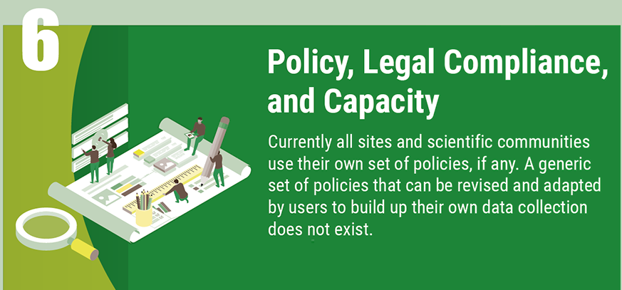
ENDORSED RECOMMENDATIONS
A curriculum for foundational Research Data Science skills for Early Career Researchers: This recommendation describes the curriculum and example materials to give Early Career Researchers (ECR’s) the foundational skills in Data Science to work with their data
The FAIRsharing Registry and Recommendations: Interlinking Standards, Databases and Data Policies: Guide for citation and its implementation in a registry of standards, databases and data policies
Repository Audit and Certification DSA–WDS Partnership WG Recommendations: Creates harmonized Common Procedures for certification of repositories at the basic level, drawing from the procedures already put in place by the Data Seal of Approval (DSA) and the ICSU World Data System (ICSU-WDS) → ICT Technical Specification

Slide 55
ENDORSED RECOMMENDATIONS
The final version of the RDA COVID-19 Recommendations and Guidelines for Data Sharing, published 30 June 2020: The Research Data Alliance (RDA) COVID-19 Working Group members bring various, global expertise to develop a body of work that comprises how data from multiple disciplines inform response to a pandemic combined with guidelines and recommendations on data sharing under the present COVID-19 cicumstances.

Slide 56
RDA ENDORSEMENT IN PROCESS
Recommendations and Capacity Development Resource Kit: These documents include an overview about available and free training resources in the area of agricultural data management. A detailed description is provided for resources that are related to RDA. Other free resources that are available online are listed as well.

Slide 57
SUPPORTING OUTPUTS
Matrix of use cases and functional requirements for research data repository platforms: Based on use cases, matrix describes forty-four functional requirements identified for research data repository platforms and provides a score identifying relative importance.
Income Streams for Data Repositories: The RDA/WDS Interest Group Publishing Data Cost Recovery for Data Centres aims to contribute to strategic thinking on cost recovery by conducting research to understand current and possible cost recovery strategies for data centres.
RDA-COVID19 WG Zotero Library: The RDA-COVID19 WG Zotero Library was created by the RDA-COVID19 WG to support development of the RDA-COVID19 Recommendations and Guidelines.

Slide 58
SUPPORTING OUTPUTS
Data Sharing in Epidemiology: There is a pressing need for a coordinated global system encompassing preparedness, early detection, and rapid response to newly emergent threats such as SARS-CoV-2 virus and the COVID- 19 disease that it causes. The intended audience for the epidemiology recommendations and guidelines are government and international agencies, policy and decision makers, epidemiologists and public health experts, disaster preparedness and response experts, funders, data providers, teachers, researchers, clinicians, and other potential users.
RDA & CODATA Legal Interoperability Of Research Data: Principles And Implementation Guidelines: The possibility to discover, access, and use heterogeneous data seamlessly from different sources and across domains and geographical boundaries is of crucial importance to accelerate progress in all research areas.

Slide 59
ICT Technical Specifications
TS1 Data Foundation & Terminology Model
TS2 PID Information Types API- Persistent Identifier Type Registry
TS3 Data Type Registries Model
TS4 Practical Policies recommendations
TS5 RDA Data Citation of Evolving Data
TS6 RDA Data Description Registry Interoperability Model
TS7 RDA CoreTrustSeal Data Repository Requirements
TS8 RDA RDA/WDS Workflows for Research Data Publishing Model
RDA Technical Specifications https://www.rd-alliance.org/recommendations-outputs/standards
Notes:
TS1 Basic Vocabulary of Foundational Terminology Query Tool -
TS2 PID Information Types (PIT) WG Recommendations
TS3 Data Type Model and Registry - Data Type Registries (DTR) WG Recommendations
TS4 Machine Actionable Policy Templates - Practical Policy WG Recommendations
TS5 Scalable Dynamic Data Citation Methodology
TS6 Data Description Registry Interoperability Model
TS7 Repository Audit and Certification DSA–WDS Partnership WG Recommendations:
TS8 RDA/WDS Publishing Data Workflows WG Recommendations

Slide 60
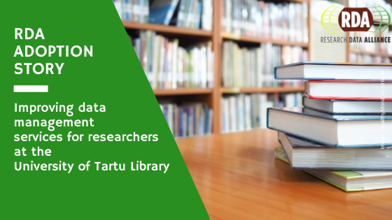
The Story of The University of Tartu Library adoption of “23 Things: Libraries for Research Data”
The University of Tartu Library officially adopted RDA’s “23 Things: Libraries for Research Data” in September 2020; however, we have been offering most of the services described in this recommendation on different levels already for many years.
23 Things helped us to systematize and analyze the knowledge we have already acquired and to identify the still existing gaps. We were surprised to see that libraries have no clear idea about how and with which results the basic data literacy is taught to students and researchers at their universities. ”
Read the full story: https://www.rd-alliance.org/enabling-fair-data-earth-space-and-environmental-sciences

Slide 61
Call for Supporting and Other RDA Outputs
RDA Recommendations and Outputs take the form of technical specifications, code, policies or practices, harmonized standards or reference models. In the widest sense these aim for:
Greater data sharing, exchange, interoperability, usability and re-usability;
Greater discoverability of research data sets;
Better management, stewardship, and preservation of research data;
New data standards or harmonization of existing standards.
Become one of the next RDA adopters!
If you are interested in any of the RDA’s recommendations or would like to share your group's results with our international community, please fill the contact form at https://www.rd-alliance.org/interest-rda-recommendations or write to enquiries@rd-alliance.org.
RDA Adoption & Implementation Stories - Tell us yours!

Slide 62
What are Plenary Meetings?
organised around the world every 6 months;
exciting & productive events bringing together a unique community of data science professionals, from multiple disciplines and domains;
help move the community forward in creating tangible deliverables that improve data sharing across disciplines, technologies, and countries;
heart of the plenaries are working meetings of RDA Working & Interest groups and new potential groups through Birds of a Feather meetings
presentation of new Outputs and Adoption cases.
See 14th Plenary Meeting Highlights video - https://www.youtube.com/watch?v=Xplae800pLM

Slide 63
Plenary Meetings: Benefits of Attending
Exchange knowledge, share discoveries, discuss barriers and potential solutions
Learn about new trends, strategies, research developments, directions and policies
Expand your network and meet new committed and passionate data science professionals, working in multiple disciplines
Contribute to acceleration of data infrastructure development

Slide 64
RDA Virtual Plenary 15
Learn more → https://www.rd-alliance.org/plenaries/rda-15th-plenary-meeting-australia

Slide 65
RDA VP15 in numbers …
2 Keynote addresses
170 registered
90 registered
45 virtual sessions -> 34 unique
of which:
4 Joint meetings
13 Interest Group meetings
8 Working Group meetings
9 BoFs (Birds of a Feather)

Slide 66
and RDC
VP16 Registration Now Open!
https://attendee-rda2020.streampoint.com/
https://www.rd-alliance.org/plenaries/rda-16th-plenary-meeting-costa-rica

Slide 67
https://www.rd-alliance.org/plenaries/rda-17th-plenary-meeting
https://www.rd-alliance.org/plenaries/rda-17th-plenary-meeting

Slide 68
https://www.rd-alliance.org/plenaries/rda-18th-plenary-meeting-part-international-data-week-2021-8%E2%80%9311-november-2021-seoul-south

Slide 69
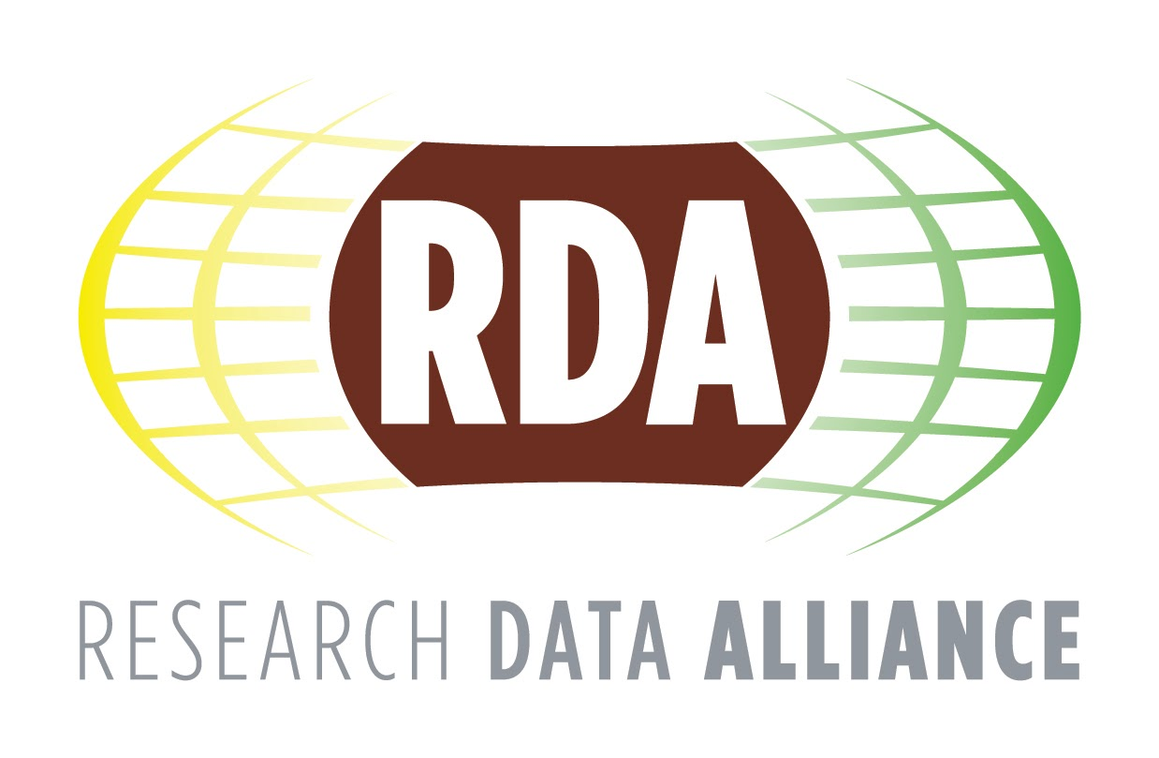
SAVE THE DATE
International Data Week 2023
A Festival of Data
23–26 October 2023
Salzburg, Austria
https://www.rd-alliance.org/plenaries/international-data-week-2023-salzburg
Organised by
Hosted by

Slide 70
RDA Global
Email - enquiries@rd-alliance.org
Web - www.rd-alliance.org
Twitter - @resdatall
LinkedIn - www.linkedin.com/in/ResearchDataAlliance
Slideshare - http://www.slideshare.net/ResearchDataAlliance
RDA in a Nutshell
September 2020 www.rd-alliance.org/ @resdatall
RDA Europe
Email - info@europe.rd-alliance.org
Twitter - @RDA_Europe
RDA US
Twitter - @RDA_US

