Slide 1
February 2024
in a nutshell

Slide 2
Notice: Updates to RDA in a Nutshell
Starting with the February 2021 release, the “RDA in a Nutshell” slide deck will be presented in a new format.
We will post a condensed “RDA in a Nutshell” deck every month containing overview and updated demographic slides.
Once every quarter, we will release a complimentary slide deck containing more in-depth information and updates of Working and Interest Groups, and RDA Outputs.

Slide 3
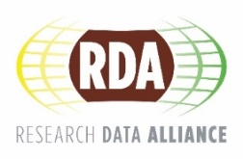
THE RESEARCH DATA ALLIANCE
www.rd-alliance.org
building the social and technical bridges that enable open sharing and re-use of data
Vision
Researchers and innovators openly share and re-use data across technologies, disciplines, and countries to address the grand challenges of society.
Mission
RDA builds the social and technical bridges that enable open sharing and re-use of data.
72 FLAGSHIP OUTPUTS
including 8 ICT Technical Specifications
200+ ADOPTION CASES
across multiple disciplines, organisations & countries
89 GROUPS WORKING ON GLOBAL DATA INTEROPERABILITY CHALLENGES
35 Working Groups
53 Interest Groups
1 Community of Practice
14,251 INDIVIDUAL MEMBERS FROM 152 COUNTRIES
70% Academia & Research
14% Public Administration
13% Enterprise & Industry
67 ORGANISATIONAL MEMBERS
13 AFFILIATE MEMBERS

Slide 4
What is RDA?
RDA is an international member-based organization focused on the development of infrastructure and community activities that reduce barriers to data sharing and exchange, and the acceleration of data-driven innovation worldwide.
With more than 14,000 members globally representing 152 countries, RDA includes researchers, scientists and data science professionals working in multiple disciplines, domains and thematic fields and from different types of organisations across the globe.
RDA is building the social and technical bridges that enable open sharing of data to achieve its vision of researchers and innovators openly sharing data across technologies, disciplines, and countries to address the grand challenges of society.

Slide 5
What does RDA do?
Members come together through self-formed, volunteer and focused Working Groups and exploratory Interest Groups to exchange knowledge, share discoveries, discuss barriers and potential solutions, explore and define policies and test as well as harmonise standards to enhance and facilitate global data sharing & re-use.
RDA members collaborate together across the globe to tackle numerous infrastructure & data sharing challenges related to:
Reproducibility
Data preservation
Best practices for domain repositories
Legal interoperability
Data citation
Data type registries
Metadata
and so many more!

Slide 6
Who Can Join RDA?
  Any individual or organisation, regardless of profession or discipline, with an interest in reducing the barriers to the sharing and re-use of data and who agrees to RDA’s guiding principles of:
Openness
Consensus
Inclusive
Harmonization
Community-driven
Non-profit and technology-neutral
  Individual Membership is free at https://www.rd-alliance.org/user/register

Slide 7
Why Join RDA as an Individual Member?
  Individual Member Benefits
    Contribute to acceleration of data infrastructure development
    Work and share experiences with collaborators throughout the world
    Access to extraordinary network of colleagues with various levels of experience, perspectives and practices
    Gain greater expertise in data science regardless of whether one is a student, early or seasoned career professional
    Enhance the quality and effectiveness of personal work and activities
    Improve one’s competitive advantage professionally and positioning oneself for leadership within the broader research community

Slide 8
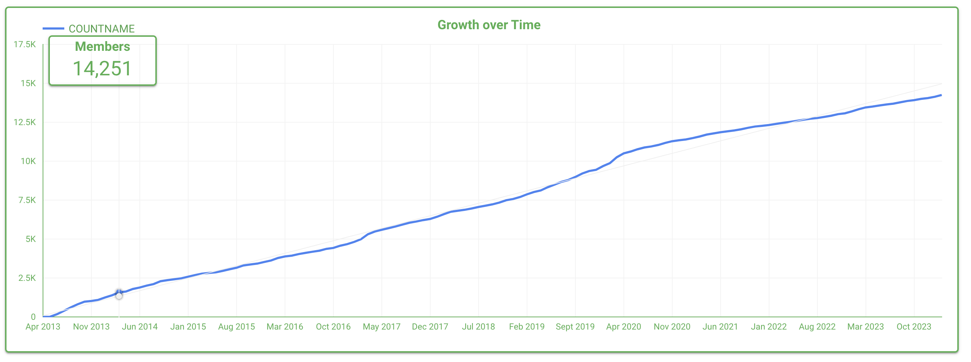
Who is RDA – Worldwide Growth

Slide 9
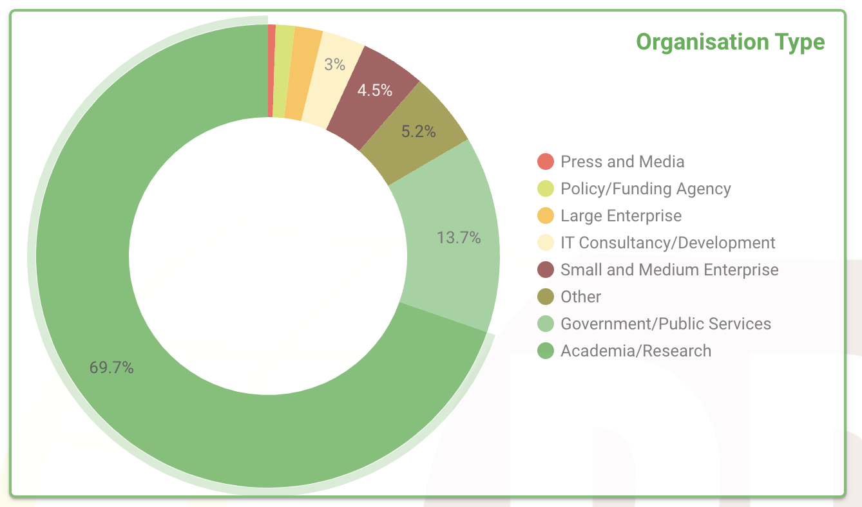
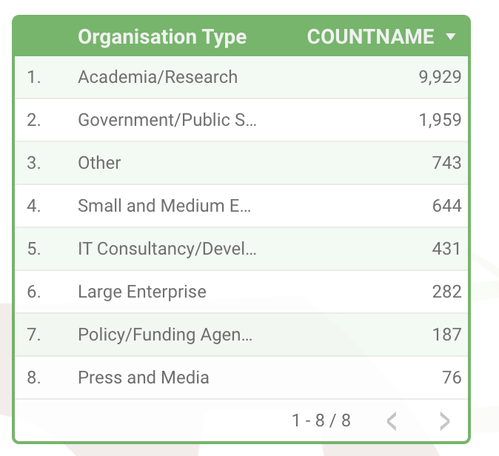
Who is RDA – Organisation type
9

Slide 10
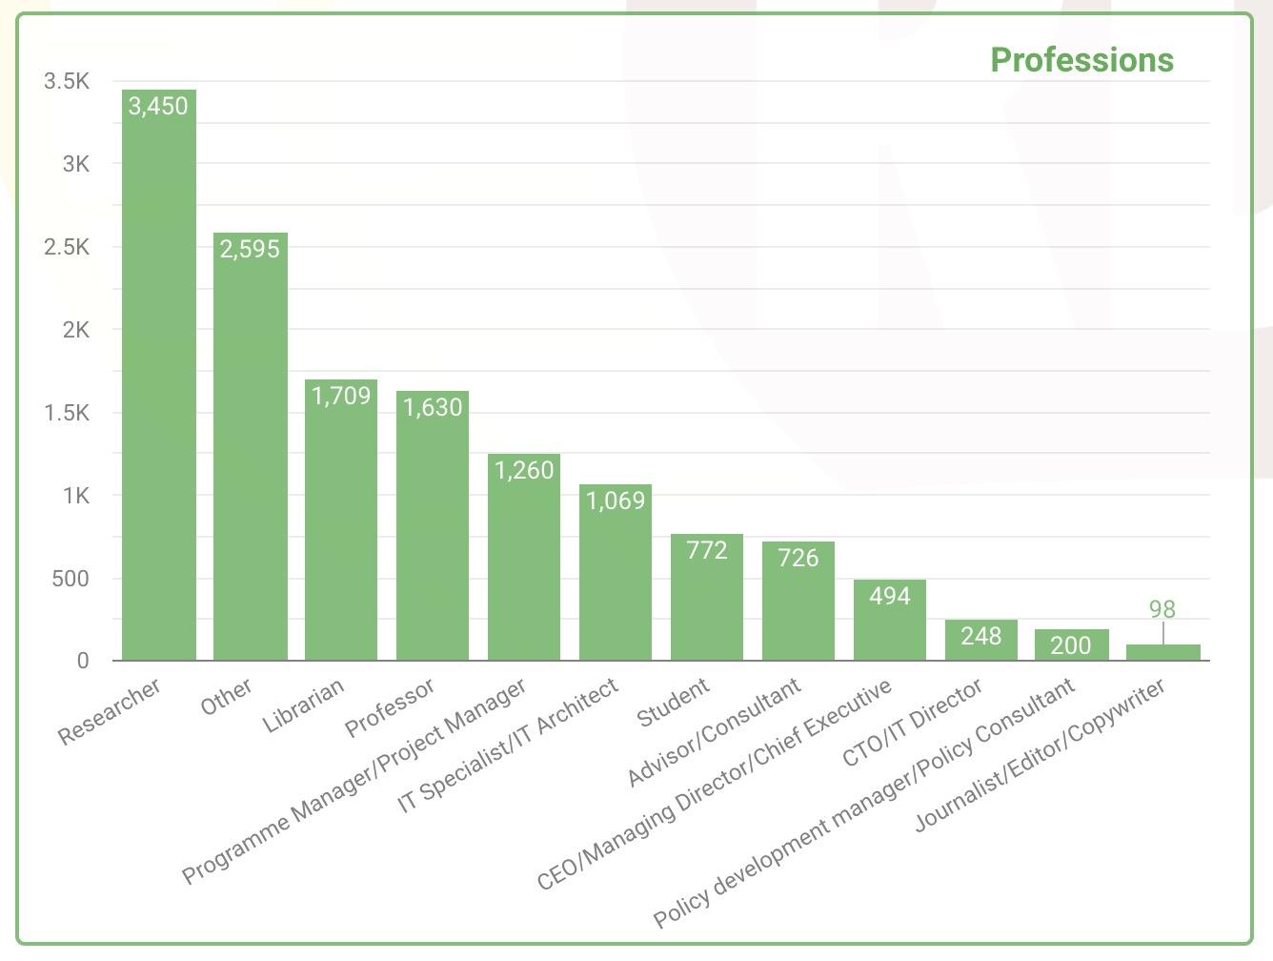
Who is RDA – Professional Title

Slide 11
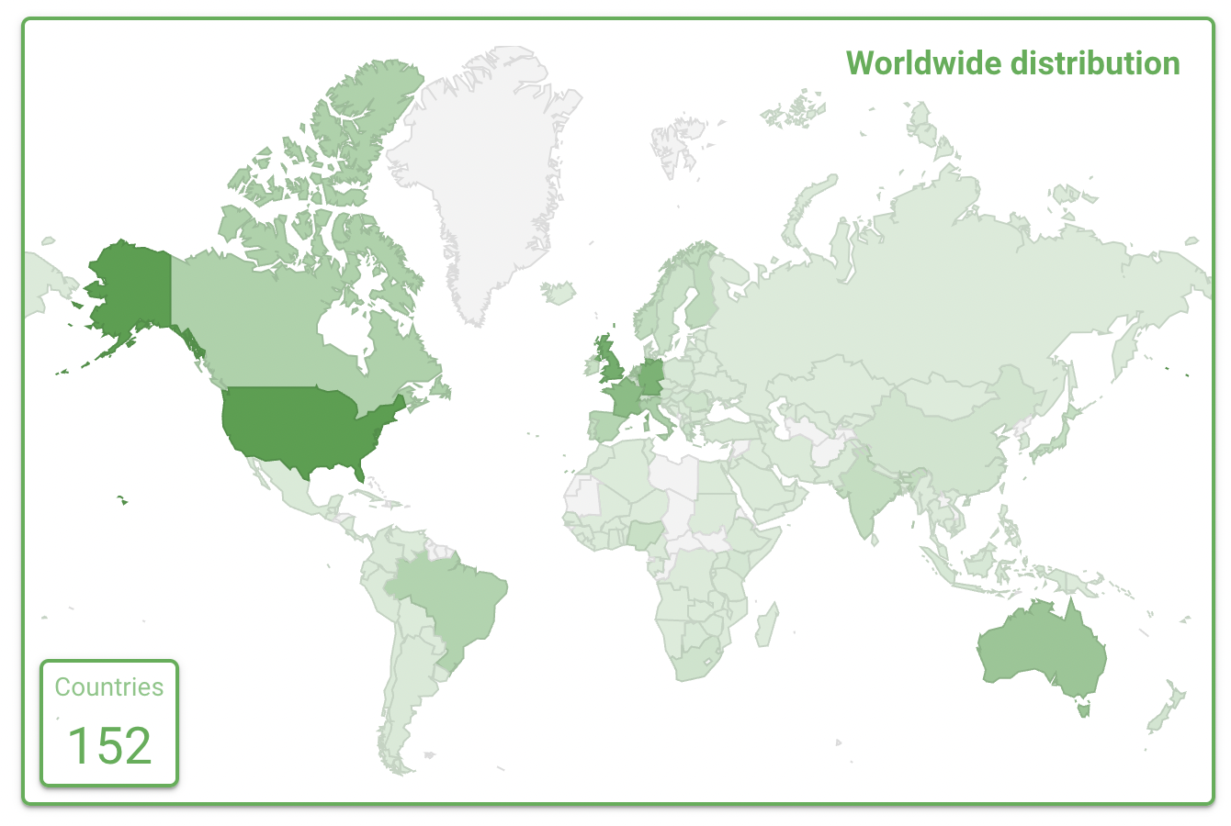
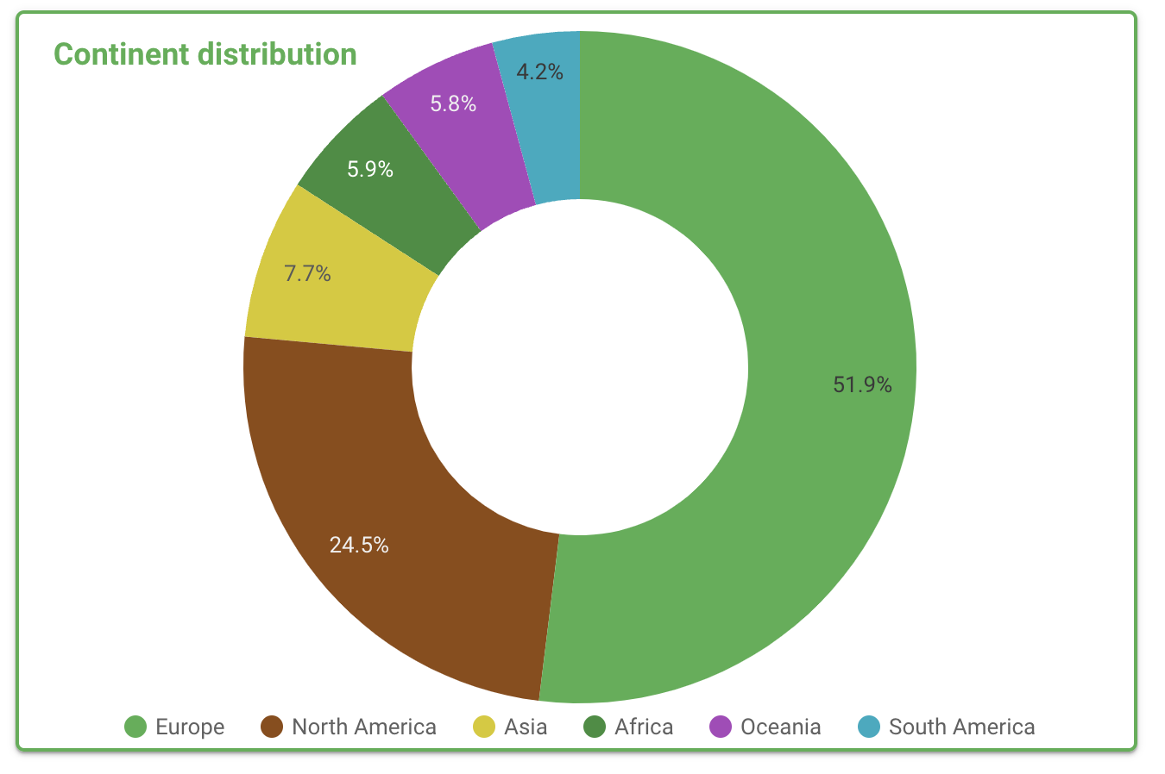
Who is RDA – Geographical Distribution
14,251 RDA members from 152 different countries

Slide 12
Why Join RDA as an Organisational Member?
Organisational Member Benefits
    Provide an organisational perspective on the work of RDA and ability to influence RDA’s direction
    Assist in implementation & adoption of RDA Recommendations & Outputs
    Participate in all RDA Organisational Forums
    Receive regular updates on the work of the RDA
    Attend Organisational Assembly meetings and vote on proposed policies for consideration by the RDA Council and for members of the Organisational Advisory Board
    Provide advice to RDA Council through the Organisational Advisory Board
    Be recognized on the RDA Website and at RDA Meetings as a supporter of data interoperability
    Communicate open job positions in your organisation to entire RDA community (Exclusive to Organisational Members)
    Reduced RDA Plenary meeting registration fee (Exclusive to Organisational Members)
67 Organisational & 13 Affiliate Members
Join as an Organisational Member! →

Slide 13
RDA Organisational Members
67 RDA Organisational Members
Addis Ababa University (AAU), Ethiopia
Alex Ekwueme Federal University Ndufu Alike (AEFUNAI), Nigeria
American Chemical Society Publications (ACS)
American Geophysical Union (AGU), USA
Australian Research Data Commons (ARDC), Australia
Battelle - National Ecological Observatory Network (NEON), USA
California Institute of Technology, USA
Canadian Research Data Centre Network, Canada
CNRS, France
Columbia University Libraries/Information Services, USA
Consortium of European Social Science Data Archives (CESSDA), Norway
Corporation for National Research Initiatives (CNRI), USA
CSC - IT Center for Science, Finland
Danish e-Infrastructure Cooperation, Denmark
DANS - Data Archiving and Networked Services, Netherlands
Digital Curation Centre (DCC), UK
Digital Repository of Ireland (DRI), Ireland
Dryad
Earth Science Information Partners (ESIP), USA
EGI Foundation, Netherlands
ELSEVIER, Netherlands
European Data Infrastructure (EUDAT project), Finland
European Parliamentary Research Service (EPRS), Belgium
Gdańsk University of Technology, Poland
GÉANT, Netherlands
Georgia Institute of Technology Library, USA
German Data Forum, Germany
German National Research Data infrastructure (NFDI)
Grenoble Alpes University, France
Helmholtz Association, Germany
Hindawi
Indiana University Pervasive Technology Institute
Information Technology Research Insititute (ITRI)- National Institute of Advanced Industrial Science and Technology (AIST), Japan
INRAE (Research for Agriculture, Food & Environment), France
Institute for Scientific and Technical Information - TECHNIFORMI of the Georgian Technical University, Georgia
Integrated Digitized Biocollections (iDigBio), USA
International Association of STM (Scientific, Technical & Medical) Publishers
International Federation of Data Organizations for Social Sciences, USA
John Wiley & Sons Ltd., UK
KAUST - King Abdullah University of Science and Technology, Saudia Arabia
KISTI
LIBER - Association of European Research Libraries, Germany
Massachusetts Institute of Technology Libraries (MIT Libraries), USA
Max Planck Computing and Data Facility (MPCDF), Germany
National Center for Supercomputing Applications, USA
National Institutes of Health (NIH), USA
National Library of Ireland, Ireland
New Zealand eScience Infrastructure (NeSI), New Zealand
Norwegian Agency for Shared Services in Education and Research Data (Sikt), Norway
Oracle for Research, USA
Purdue University Libraries, USA
Research Data Canada, Canada
San Diego Supercomputer Center, USA
SciELO (Scientific Electronic Library Online), Brazil
Science & Technology Facilities Council (STFC), UK
Taylor & Francis Group, UK
The Alan Turing institute, UK
TMF – Technology, Methods, and Infrastructure for Networked Medical Research, Germany
TU Delft, Netherlands
United States Geological Society (USGS)
Universidad Nacional, Costa Rica
Université Paris Nanterre, France
University College Dublin Library, Ireland
Université de Lorraine, France
University of Strasbourg, France
Washington University in St. Louis Libraries, USA
Web Science Trust, UK
RDA Organisational Member details https://www.rd-alliance.org/get-involved/organisational-membership/rda-organisational-affiliate-members

Slide 14
RDA Affiliate Members
13 RDA Affiliate Members
Committee on Data for Science and Technology (CODATA)
Confederation of Open Access Repositories (COAR)
Connecting Research and Researchers (ORCID)
Consortia Advancing Standards in Research Administration Information -
CASRAI
DataCite
Data Observation Network for Earth (DataONE), USA
GIDA - The Global Indigenous Data Alliance
Global Open Data for Agriculture & Nutrition (GODAN)
Group on Earth Observations (GEO)
International Council for Scientific and Technical Information (ICSTI)
International COVID-19 Data Alliance (ICODA)
Research Software Alliance (ReSA)
World Data System (WDS)
RDA Affiliate Member details - https://www.rd-alliance.org/get-involved/organisational-membership/rda-organisational-affiliate-members

Slide 15
RDA Governance
The RDA consists of five bodies: RDA Council, Secretariat, Technical Advisory Board, Organisational Advisory Board, and Regional Advisory Board. These bodies, and the relationships between them, are described in the RDA Governance Document.
Technical Advisory Board
Organisational Advisory Board
Regional Advisory Board
Council
Secretariat
Organisational Vision and Strategy
Administration and Operations
Socio-Technical Vision and Strategy
Needs, Adoption, Business Advice
Liaison Between Regions and Council

Slide 16
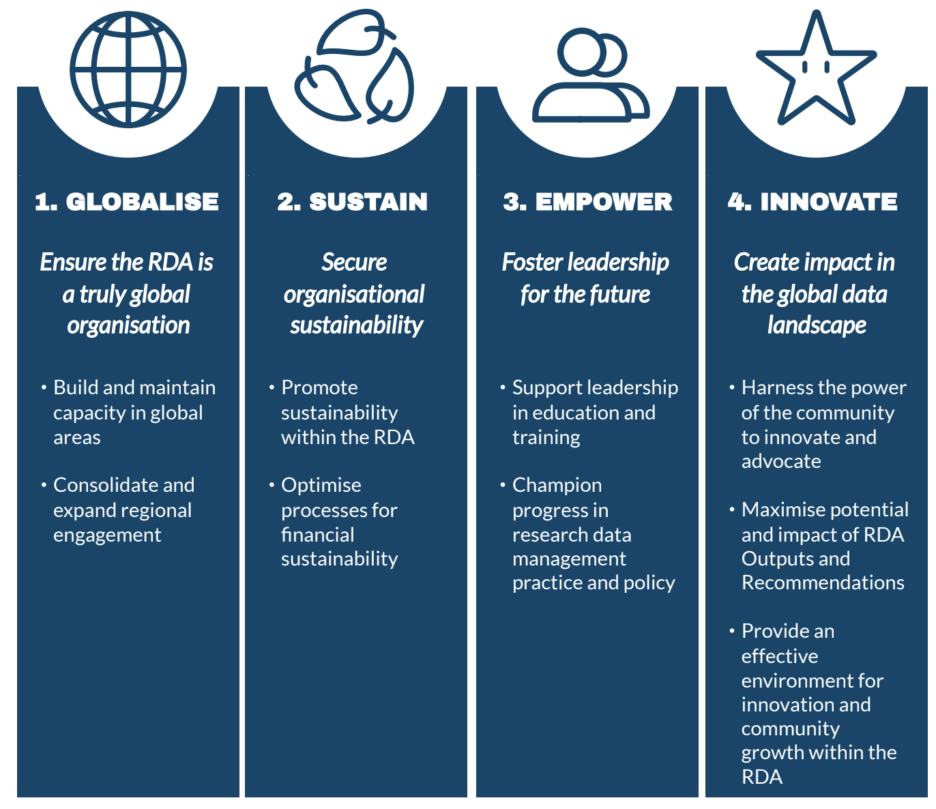

RDA Strategic Plan 2024 – 2028
After a decade of growth and development, the Research Data Alliance (RDA) presents its fifth strategic plan, providing direction and vision for the organization until 2028. This plan, focused on strengthening and widening the organization, is organized into four strategic themes: Globalise, Sustain, Empower, Innovate.
Read more about the RDA Strategic Plan here

Slide 17
RDA Groups - Overview
RDA is a pragmatic and agile organization, and through the work of its Working and Interest Groups, directly and logically tackles numerous data infrastructure challenges.
Working Groups & Interest Groups: what's the difference?
Working Groups
  Working Groups are short-term (18 months) and come together to develop and implement data infrastructure, which could be tools, policy, practices and products that are adopted and used by projects, organizations, and communities. Embedded within these groups are individuals who will use the infrastructure and help in making it broadly available to the public.
Interest Groups
  Interest groups are open-ended in terms of longevity. They focus on solving a specific data sharing problem and identifying what kind of infrastructure needs to be built. Interest Groups can identify specific pieces of work and start up a Working Group to tackle those.
Read more about RDA Groups here

Slide 18
Communities of Practice
Current Communities of Practice:
Communities of Practice (CoP)
  CoPs investigate, discuss and provide knowledge and skills within a specific discipline and/or research domain. These groups are committed to directly or indirectly enabling data sharing, exchange and/or interoperability by serving as THE coordination focal point for RDA in specific disciplines/research domains.
IGAD Community of Practice
Read more about RDA Groups here

Slide 19
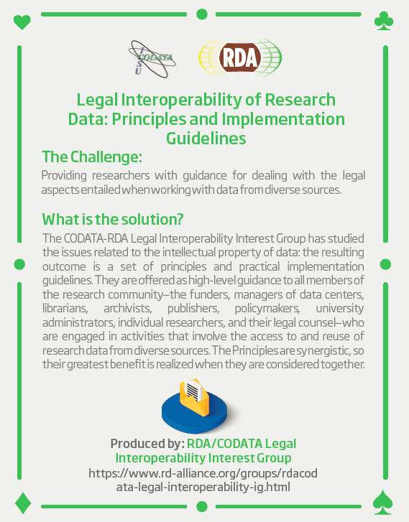
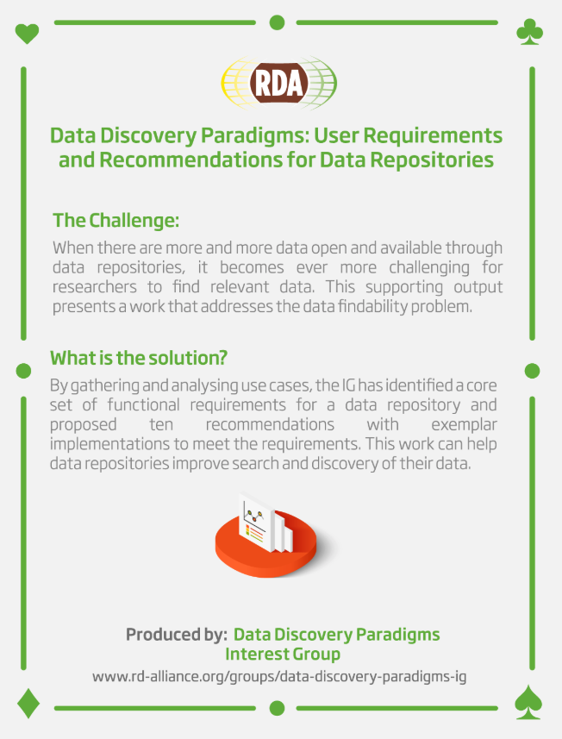
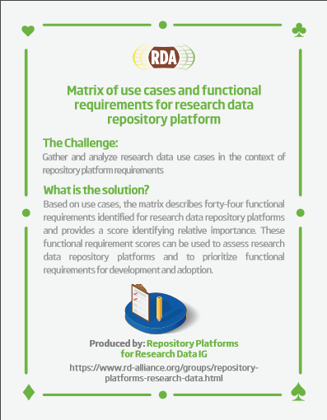
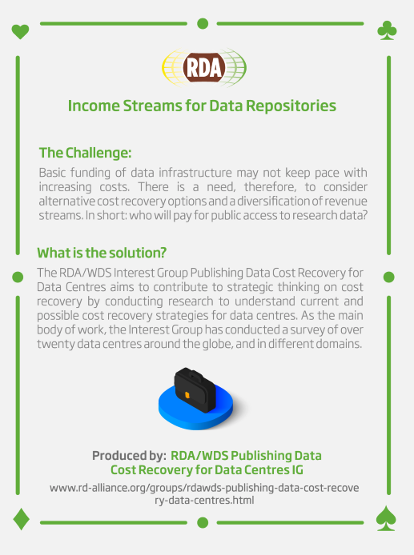
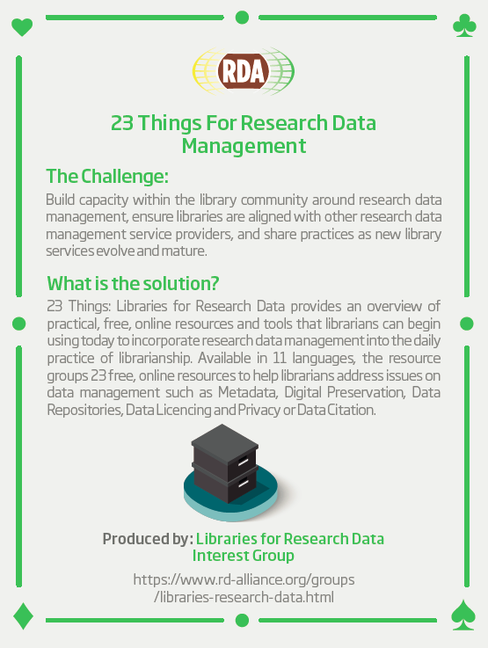
RDA Recommendations that Make Data Work
“Create - Adopt - Use”
Adopted code, policy, specifications, standards, or practices that enable data sharing
“Harvestable” efforts for which 12-18 months of work can eliminate a roadblock
Efforts that have substantive applicability to groups within the data community but may not apply to all
Efforts that can start today
72 flagship Recommendations & Outputs
More than 200 cases of Adoption in Different Domains, Organisations and Countries

Slide 20
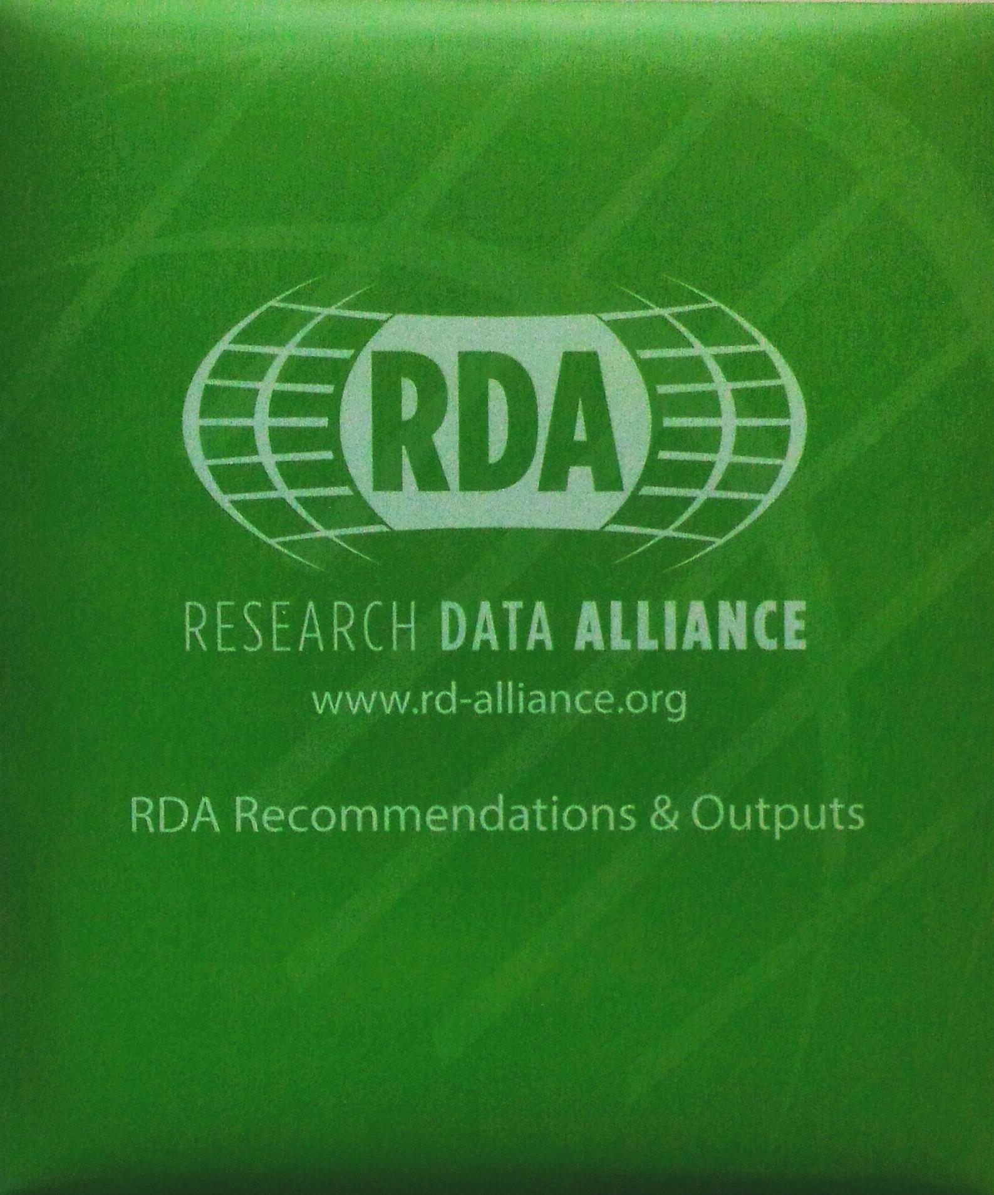
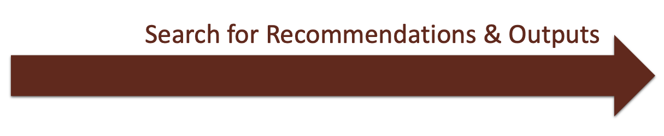
RDA Recommendations & Outputs
CATEGORIES OF RECOMMENDATIONS & OUTPUTS
Recommendations: RDA’s flagship outputs and the equivalent of “specifications” or “standards” that other organisations create and endorse.
Supporting Outputs: RDA outputs that originate from the work of RDA groups, but not always adoptable by other organisations. “Upon request” by RDA groups, these outputs are reviewed by the RDA member community and if no major objections or gaps are identified, they are approved to use the RDA Brand.
Other Outputs: These are workshop reports, published articles, survey results, etc. produced by RDA groups. Upon request by the groups, these outputs are posted on the RDA website but have no level of endorsement.
33 RDA Recommendations - of which 8 ICT Technical Specifications -
& 39 Supporting Outputs currently in the RDA Catalogue:
https://www.rd-alliance.org/recommendations-and-outputs/catalogue

Slide 21
Adoption Stories
RDA Adoption & Implementation Stories - Tell us yours!
RDA Recommendations and Outputs take the form of technical specifications, code, policies or practices, harmonized standards or reference models. In the widest sense these aim for:
Greater data sharing, exchange, interoperability, usability and re-usability;
Greater discoverability of research data sets;
Better management, stewardship, and preservation of research data;
New data standards or harmonization of existing standards.
Become one of the next RDA adopters!
If you are interested in any of the RDA’s recommendations or would like to share your group's results with our international community, please fill the contact form at https://www.rd-alliance.org/interest-rda-recommendations or write to enquiries@rd-alliance.org.

Slide 22
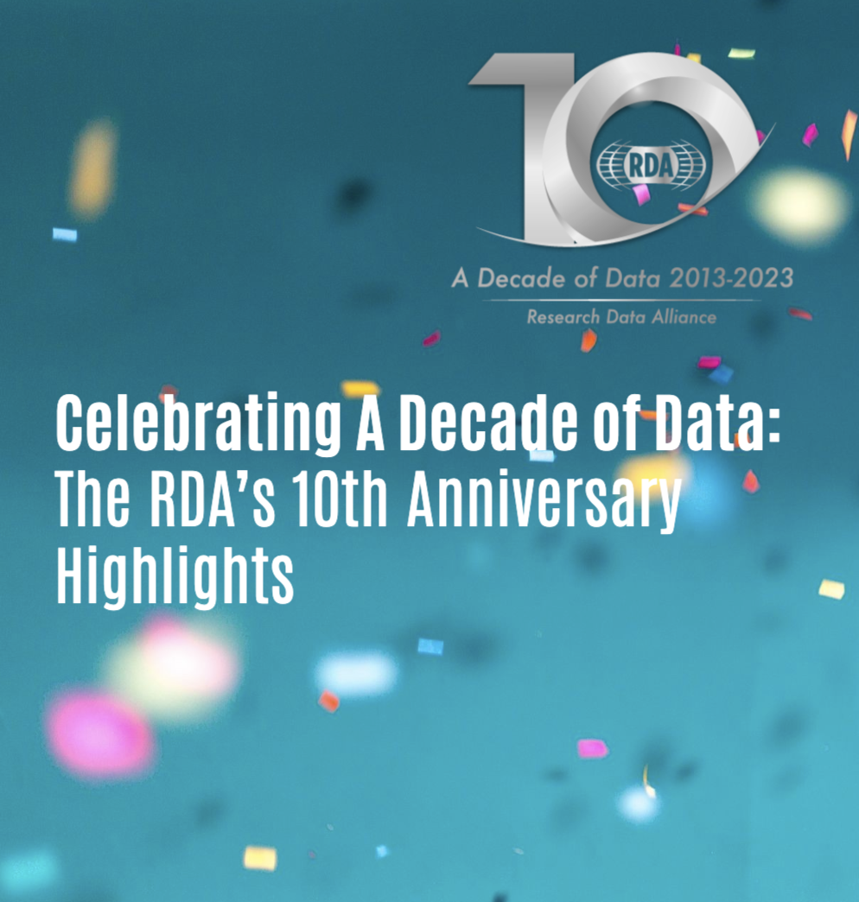
The Looking back on 2023 …
A Decade of Data 2013-2023 Anniversary
Read the summary of the events and activities that took place in 2023 to commemorate the Research Data Alliance’s 10th anniversary year including the community cross-fertilization workshops:
FAIR Data, Software and Hardware
Health and Medical Data
Metadata and Technical Infrastructure
Agriculture and Environmental Data
Research Data Policy
Disciplinary Data
Sustainable Development and Responsible Research
RDM Support and Education

Slide 23
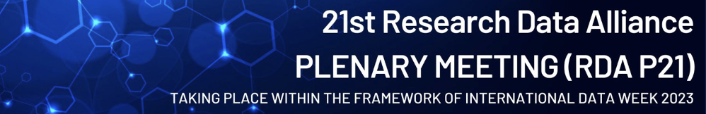
What are Plenary Meetings?
RDA Plenaries are held every six months in different places around the world. They are exciting and productive events that bring together a unique community of data scientists, librarians, computer scientists, and domain scientists.
These working events help move the community forward in creating tangible deliverables that improve data sharing across disciplines, technologies, and countries. Explore past plenaries here.
RDA Plenary 20
Gothenburg, Sweden, March 21-23, 2023

Slide 24




Plenary Meetings: Benefits of Attending
Exchange knowledge, share discoveries, discuss barriers and potential solutions
Learn about new trends, strategies, research developments, directions and policies
Expand your network and meet new committed and passionate data science professionals, working in multiple disciplines
Contribute to acceleration of data infrastructure development

Slide 25
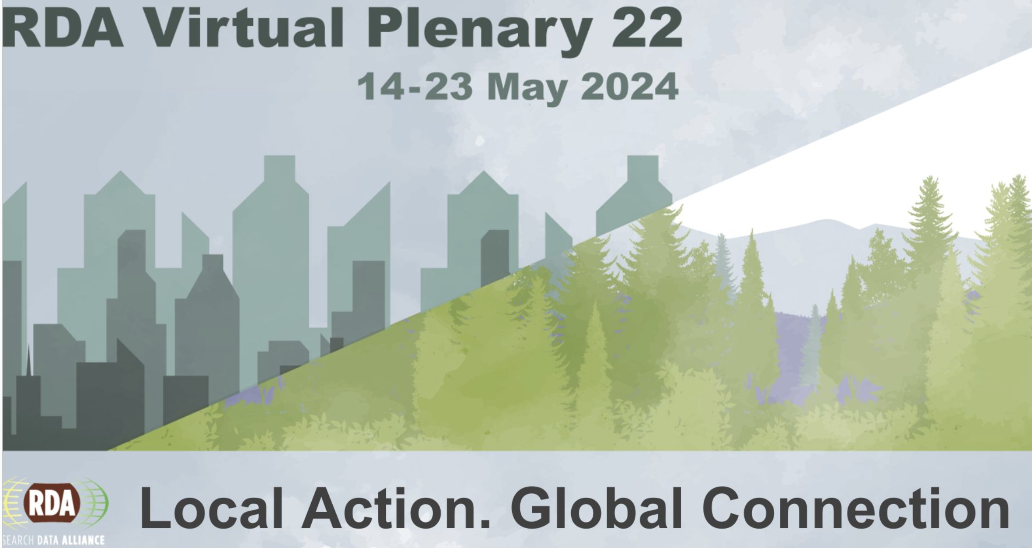
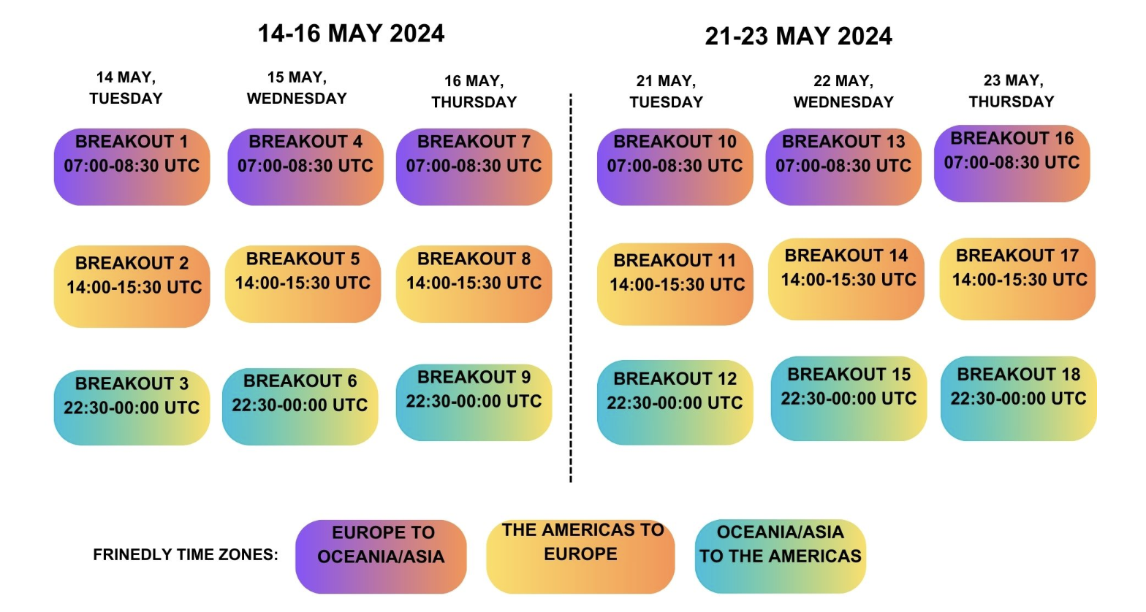
RDA Plenary 22
A fully virtual event organised by the RDA Secretariat
Live breakout sessions taking place over 2 weeks – 3 days per week accommodating all time zones
https://www.rd-alliance.org/plenaries/rda-22nd-plenary-meeting-fully-virtual

Slide 26
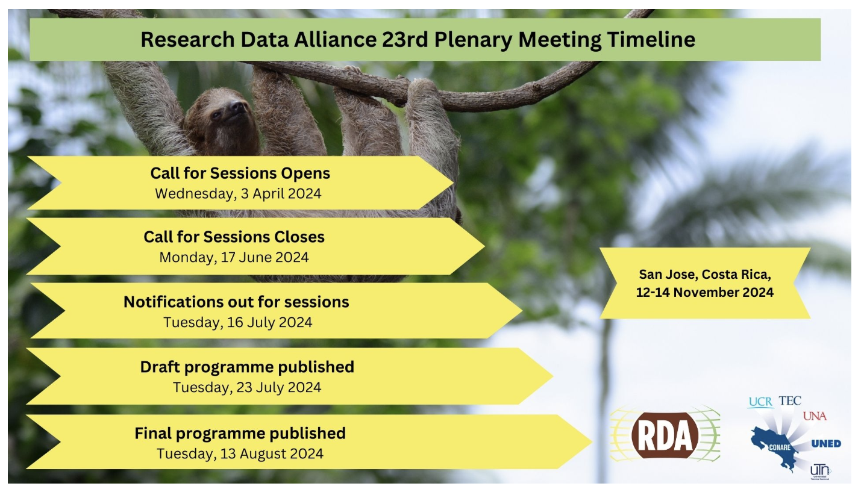
RDA Plenary 23
12-14 November 2024 San José, Costa Rica a hybrid event
https://www.rd-alliance.org/plenaries/rda-23rd-plenary-meeting-san-jos%C3%A9-costa-rica

Slide 27
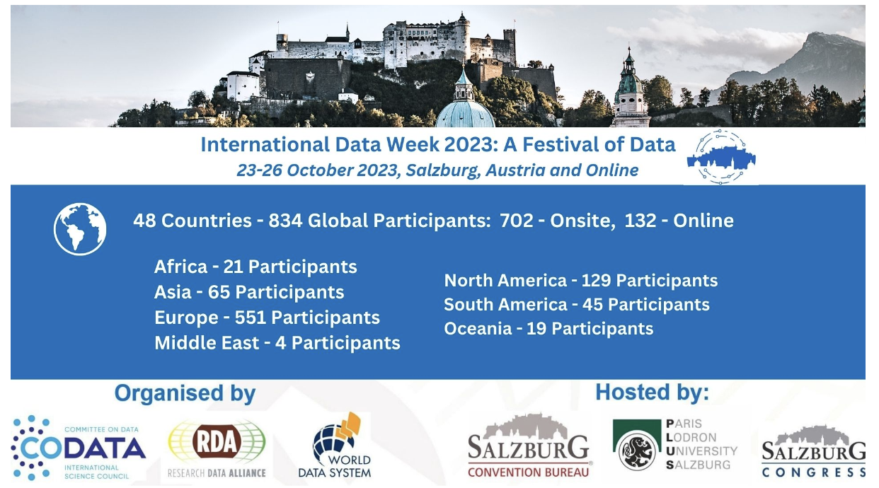
International Data Week 2023
23-26 October, Salzburg, Austria
https://www.rd-alliance.org/plenaries/international-data-week-2023-salzburg

Slide 28
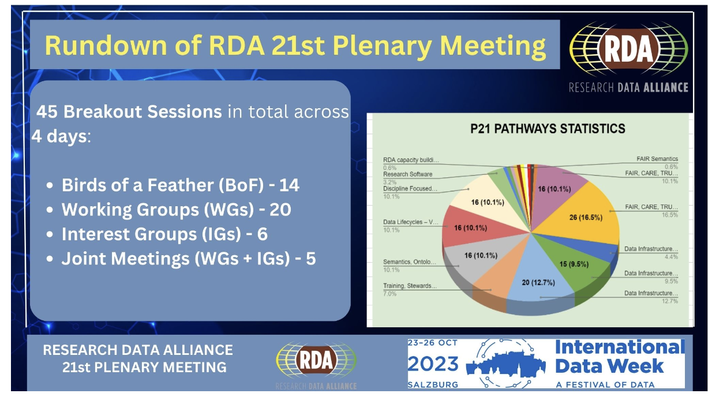
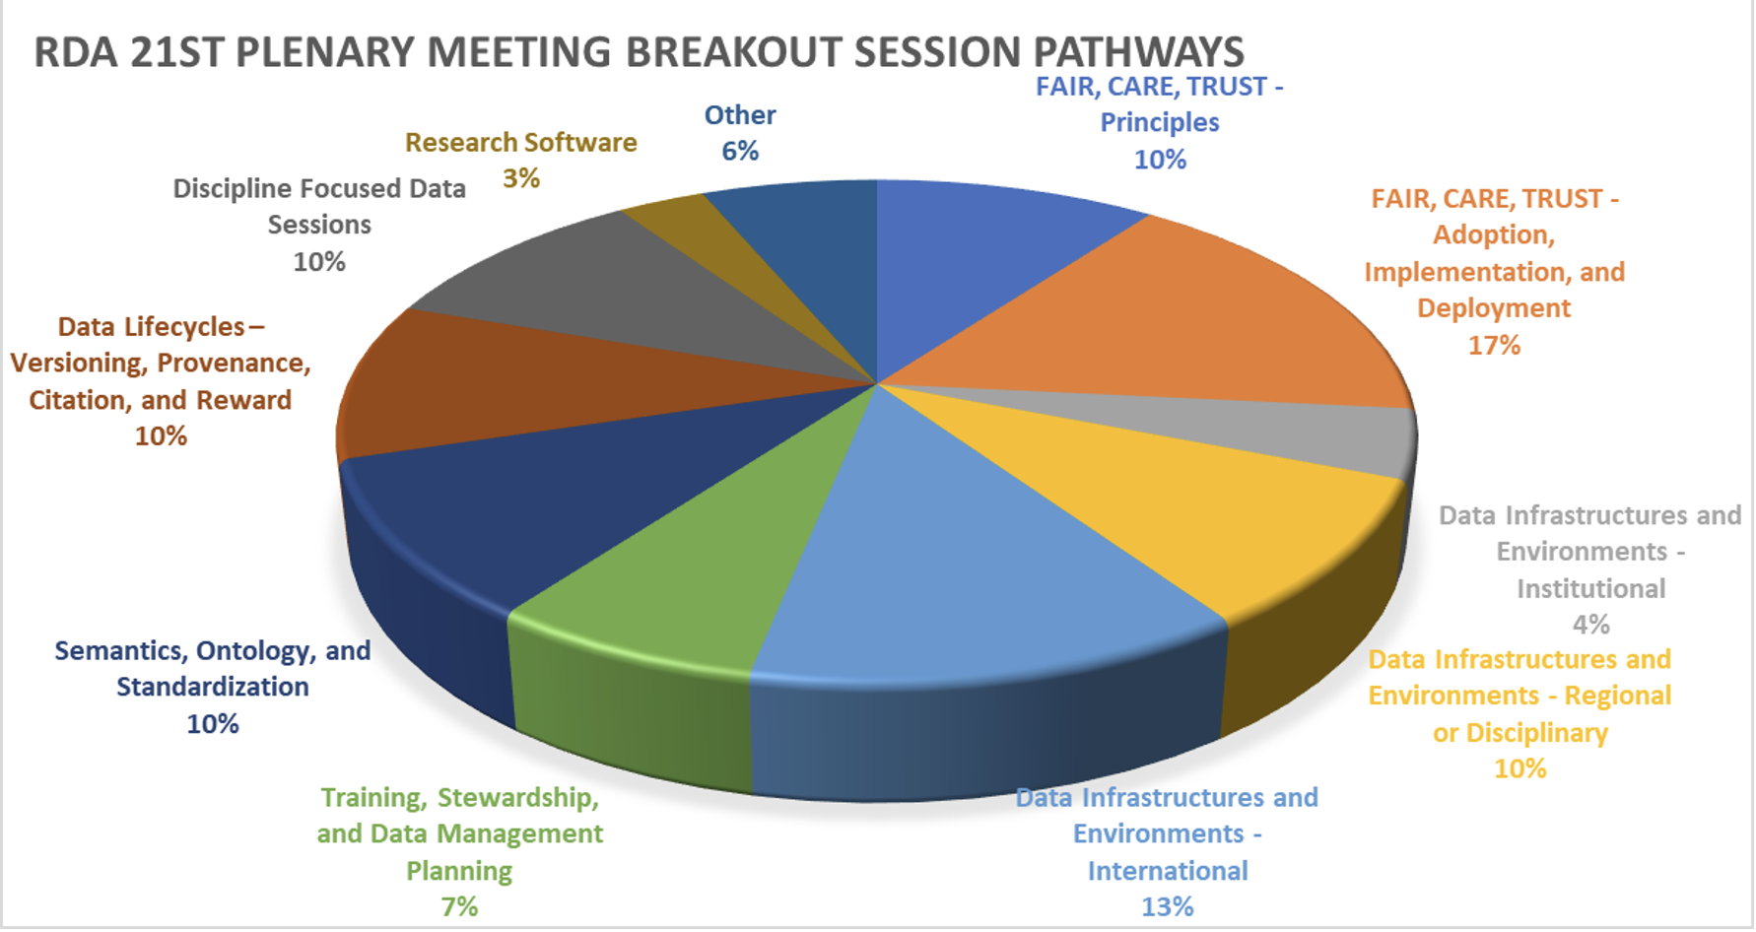
Research Data Alliance’s 21st Plenary Meeting within International Data Week 2023, Salzburg, Austria
The chart outlines the % of sessions per pathway, giving an indication of the current “trends” across the RDA groups and their topics’ focus.
See the P21 Highlights

Slide 29

Check here for updates
Notes:
Small right image - text

Slide 31
Contact
RDA Global
Email - enquiries@rd-alliance.org
Web - www.rd-alliance.org
Twitter - @resdatall
LinkedIn - www.linkedin.com/in/ResearchDataAlliance
Slideshare - http://www.slideshare.net/ResearchDataAlliance
RDA Europe
Twitter - @RDA_Europe
RDA US
Email – rdaus@rda-foundation.org
Twitter - @RDA_US

