Slide 1
January – March 2023
Groups and Outputs Digest

Slide 2
Notice: Updates to RDA in a Nutshell
Starting with the February 2021 release, the “RDA in a Nutshell” slide deck was presented in a new format. We will post a condensed “RDA in a Nutshell” deck every month containing overview and updated demographic slides
The purpose of this slide deck, “RDA Groups and Outputs Digest,” is to serve as a complement to the monthly “RDA in a Nutshell” release.
It includes a list of active RDA Working Groups, Interest Groups, and Communities of Practice as well as more in-depth information on the RDA Endorsed Recommendations and Supporting Outputs.

Slide 3

RDA Groups - Overview
Any RDA member may initiate or join a Working or Interest group. To become a member of the RDA, individuals should register with the RDA online community and affirm their support for the RDA Guiding Principles.
Many of our members propose Birds of a Feather Meetings at the bi-annual RDA Plenary Meetings to gauge interest and gather momentum and consensus for the creation of Working & Interest Groups.
Working Groups (WG)
  Working Groups are short-term (18 months) and come together to develop and implement data infrastructure, which could be tools, policy, practices and products that are adopted and used by projects, organizations, and communities. Embedded within these groups are individuals who will use the infrastructure and help in making it broadly available to the public.
Interest Groups (IG)
  Interest groups are open-ended in terms of longevity. They focus on solving a specific data sharing problem and identifying what kind of infrastructure needs to be built. Interest Groups can identify specific pieces of work and start up a Working Group to tackle those.
Read more about RDA Groups here

Slide 4
Working Groups
Agrisemantics WG
Artificial Intelligence and Data Visitation (AIDV) WG
Brokering Framework Working Group
Capacity Development for Agriculture Data WG
Complex Citations Working Group
CoreTrustSeal Maintenance WG
Data Granularity WG
Data Usage Metrics WG
Data Repository Attributes WG
Discipline-specific Guidance for Data Management Plans WG
DMP Common Standards WG
Exposing Data Management Plans WG
FAIR Data Maturity Model WG
FAIR for Research Software (FAIR4RS) WG
FAIR for Virtual Research Environments WG
GORC International Model WG
International Materials Resource Registries WG
InteroperAble Descriptions of Observable Property Terminology WG (I-ADOPT WG)
National PID Strategies WG
Neuroimaging Data WG
Persistent Identification of Instruments WG
Raising FAIRness in health data and health research performing organisations (HRPOs) WG
RDA / TDWG Metadata Standards for attribution of physical and digital collections stewardship
RDA-COVID19
RDA COVID-19 Epidemiology
RDA-COVID19-Clinical
RDA-COVID19-Community-participation
Read more about RDA Groups here

Slide 5
Working Groups
RDA-COVID19-Legal-Ethical
RDA-COVID19-Omics
RDA-COVID19-Social-Sciences
RDA-COVID19-Software
RDA/WDS Scholarly Link Exchange (Scholix) WG
Reproducible Health Data Services WG
Research Metadata Schemas WG
Read more about RDA Groups here

Slide 6
Interest Groups
Active Data Management Plans IG
Archives and Records Professionals for Research Data IG
Biodiversity Data Integration IG
Chemistry Research Data IG
CODATA/RDA Research Data Science Schools for Low and Middle Income Countries
Data Discovery Paradigms IG
Data Economics IG
Data for Development IG
Data policy standardisation and implementation IG
Data Versioning IG
Domain Repositories IG
Early Career and Engagement IG
Education and Training on handling of research data IG
Engaging Researchers with Data IG
ESIP/RDA Earth, Space, and Environmental Sciences IG
Ethics and Social Aspects of Data IG
FAIR Digital Object Fabric IG
FAIR for Machine Learning (FAIR4ML) IG
FAIR Principles for Research Hardware
Federated Identity Management
Geospatial IG
Global Open Research Commons IG
Global Water Information IG
GO FAIR Liaison IG
Health Data Interest Group
IG for Surveying Open Data Practices
International Indigenous Data Sovereignty IG
Libraries for Research Data IG
Life Science Data Infrastructures IG
Read more about RDA Groups here

Slide 7
Interest Groups
Linguistics Data IG
Metadata IG
Open Science Graphs for FAIR Data IG
Physical Samples and Collections in the Research Data Ecosystem IG
PID IG
Preservation Tools, Techniques, and Policies
Professionalising Data Stewardship IG
Psychological Data IG
RDA for the Sustainable Development Goals IG
RDA/CODATA Legal Interoperability IG
RDA/CODATA Materials Data, Infrastructure & Interoperability IG
RDA Privacy Implications of Research Data Sets IG
RDA/WDS Certification of Digital Repositories IG
Repository Platforms for Research Data IG
Research Data Architectures in Research Institutions IG
Research Data Management in Engineering IG
Research data needs of the Photon and Neutron Science community IG
Research Funders and Stakeholders on Open Research and Data Management Policies and Practices IG
Sensitive Data Interest Group
Sharing Rewards and Credit (SHARC) IG
Small Unmanned Aircraft Systems’ Data IG
Social Dynamics of Data Interoperability IG
Social Science Research Data IG
Software Source Code IG
Virtual Research Environment IG (VRE-IG)
Vocabulary Services IG
Working with PIDs in Tools IG
Read more about RDA Groups here

Slide 8
Communities of Practice
Current Communities of Practice:
Communities of Practice (CoP)
  CoPs investigate, discuss and provide knowledge and skills within a specific discipline and/or research domain. These groups are committed to directly or indirectly enabling data sharing, exchange and/or interoperability by serving as THE coordination focal point for RDA in specific disciplines/research domains.
IGAD Community of Practice
Read more about RDA Groups here

Slide 9
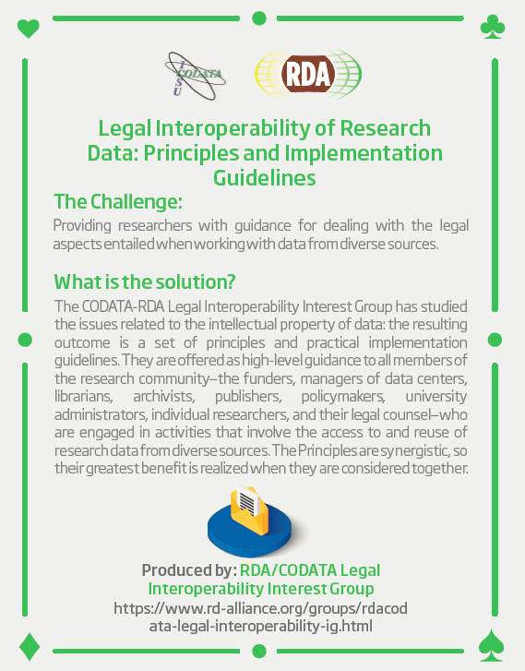
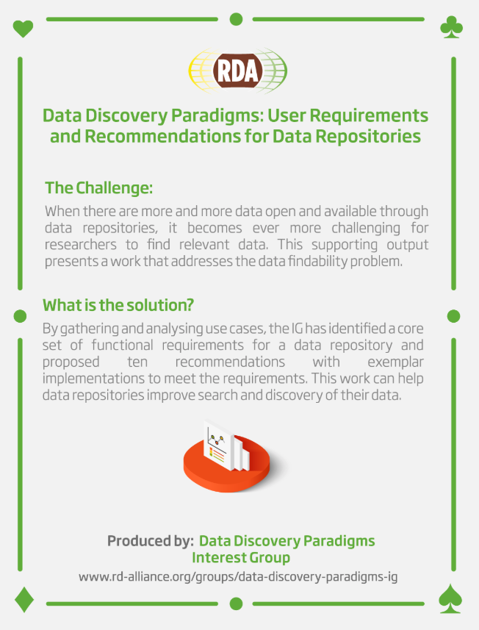
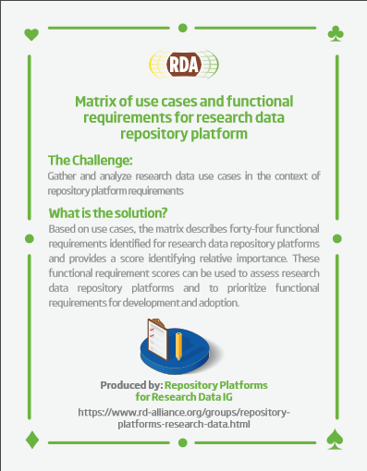
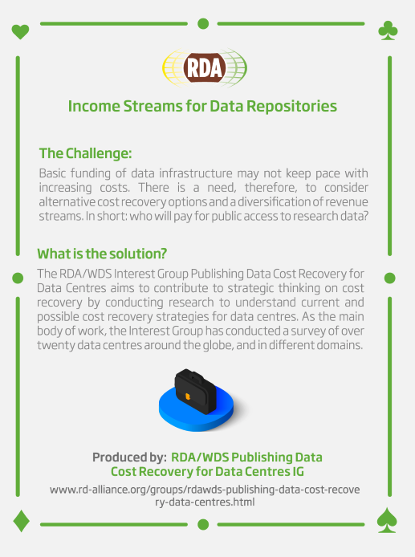
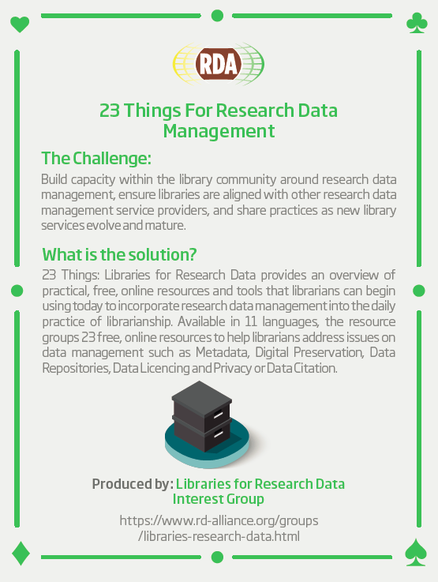
RDA Recommendations that Make Data Work
“Create - Adopt - Use”
Adopted code, policy, specifications, standards, or practices that enable data sharing
“Harvestable” efforts for which 12-18 months of work can eliminate a roadblock
Efforts that have substantive applicability to groups within the data community but may not apply to all
Efforts that can start today
64 flagship Recommendations & Outputs
More than 200 cases of Adoption in Different Domains, Organisations and Countries

Slide 10
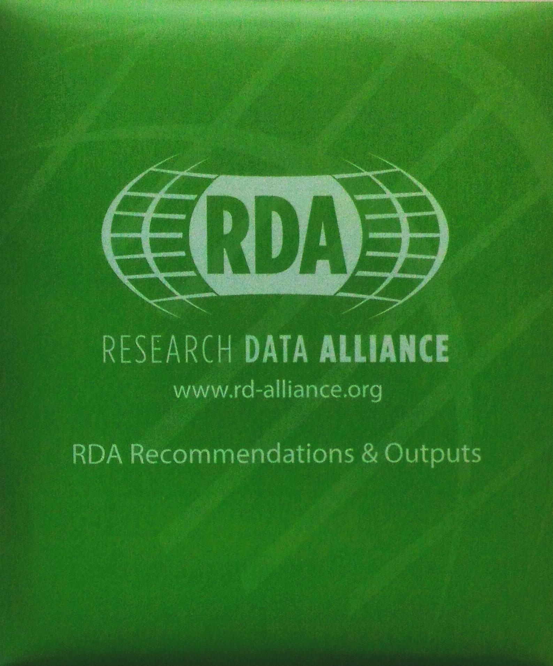

RDA Recommendations & Outputs
CATEGORIES OF RECOMMENDATIONS & OUTPUTS
Recommendations: RDA’s flagship outputs and the equivalent of “specifications” or “standards” that other organisations create and endorse.
Supporting Outputs: RDA outputs that originate from the work of RDA groups, but not always adoptable by other organisations. “Upon request” by RDA groups, these outputs are reviewed by the RDA member community and if no major objections or gaps are identified, they are approved to use the RDA Brand.
Other Outputs: These are workshop reports, published articles, survey results, etc. produced by RDA groups. Upon request by the groups, these outputs are posted on the RDA website but have no level of endorsement.
30 RDA Recommendations - of which 8 ICT Technical Specifications -
& 34 Supporting Outputs currently in the RDA Catalogue:
https://www.rd-alliance.org/recommendations-and-outputs/catalogue

Slide 11
ENDORSED RECOMMENDATIONS
FULL OUTPUT CATALOGUE HERE

Slide 12
Data Description Registry Interoperability Model
Data Description Registry Interoperability (DDRI) WG
Recommendation package DOI: 10.15497/RDA00003
Impact:
ENDORSED RECOMMENDATION
Provides researchers a mechanism to connect datasets in various data repositories based on various models such as co-authorship, joint funding, grants, etc.
Categories: Data Description - Disseminate, Link, and Find
ICT Tech specification: TS6 RDA Data Description Registry Interoperability Model Terminology Model

Slide 13
10 Things for Curating Reproducible and FAIR Research
CURE-FAIR WG
Recommendation package DOI: 10.15497/RDA00074
Impact:
ENDORSED RECOMMENDATION
The "10 Things for Curating Reproducible and FAIR Research" offer a framework for implementing effective curation workflows for achieving greater FAIR-ness and long-term usability of research data and code. Adoption of the guidelines for curating reproducible and FAIR research will improve the prospects for a reproducible scholarly record.
The "10 CURE-FAIR Things" provide guidance for better practices for those entrusted with stewardship of the scholarly record, including repository managers, curators, and preservation and archival experts; the scholarly community, including researchers who generate and use data and code; policy-setting institutions, including research organizations, publishers, and funders; as well as others involved in the production, dissemination, and preservation of research.
The document focuses primarily on research compendia produced by quantitative data-driven social science. It serves as a starting point for the development of curatorial guidelines to extend beyond the specific concerns of the social sciences community and other domains and disciplines that use similar methods, and to the particular curatorial concerns and requirements of an archives or publisher.
Category: Data Management

Slide 14
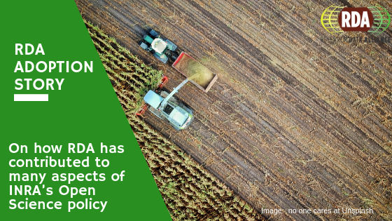
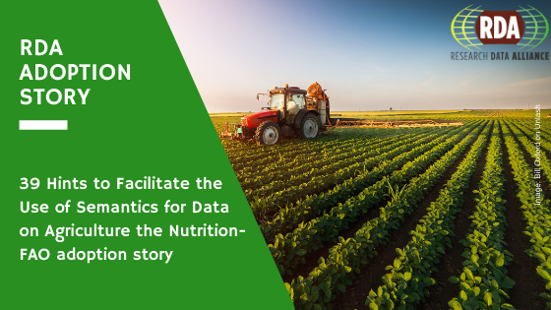
39 Hints to Facilitate the Use of Semantics for Data on Agriculture and Nutrition
Agrisemantics WG
Recommendation package DOI: 10.15497/RDA00036
Impact:
ENDORSED RECOMMENDATION
The document contains a number of highlights on issues to be addressed in order to make the use of semantics more straightforward and widespread. We expect the document to help share awareness about semantics among experts in different areas (eg, SW development, data curation, policy makers) and support strategic allocation of resources in future development.
Category: Identity, Store, and Preserve

Slide 15
A curriculum for foundational Research Data Science skills for Early Career Researchers
RDA/CODATA Summer Schools in Data Science and Cloud Computing in the Developing World WG
Recommendation package DOI: 10.15497/rda00038
Impact:
ENDORSED RECOMMENDATION
This recommendation describes the curriculum and example materials to give Early Career Researchers (ECR’s) the foundational skills in Data Science to work with their data. This curriculum combines technical skills, such as Software Carpentry with responsible research practices such as Open and Responsible Research. In 2016 we ran one school in Trieste, Italy. In 2017 we ran two, Trieste and São Paulo, Brazil. In 2018 we ran three, Trieste, São Paulo and Kigali, Rwanda. In 2019 we will run four schools (Addis Ababa, Ethiopia, Trieste, Abuja, Nigeria and San José in Costa Rica). At the end of this year approximately 400 students will have been taught on four continents using the curriculum developed here.
Category: Policy, Legal Compliance, and Capacity

Slide 16
An Open, Universal Literature-data Cross-linking Service
RDA/WDS Publishing Data Services WG
Recommendation package DOI: 10.15497/RDA00002
Impact:
ENDORSED RECOMMENDATION
Improves visibility, discoverability, re-use and reproducibility by bringing existing article/data links together, normalize them using a common schema, and expose the full set as an open service
Category: Disseminate, Link, and Find

Slide 17
Basic Vocabulary of Foundational Terminology Query Tool
Data Foundation and Terminology WG
Recommendation package DOI: 10.15497/06825049-8CA4-40BD-BCAFDE9F0EA2FADF
Impact:
ENDORSED RECOMMENDATION
Ensures researchers apply a common core data model when organising their data and thus making data accessible and re-usable.
Category: Data Description
ICT Tech specification: TS1 Data Foundation & Terminology Model

Slide 18
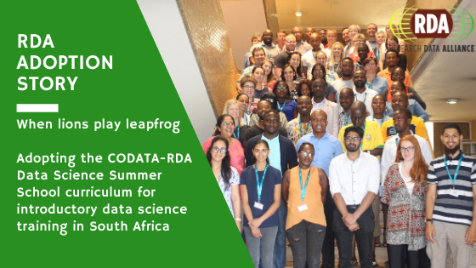
CODATA/RDA Summer School in Data Science and Cloud Computing in the Developing World WG Recommendations
RDA/CODATA Summer Schools in Data Science and Cloud Computing in the Developing World WG
Zenodo
Impact:
ENDORSED RECOMMENDATION
A framework to run a series of Summer Schools in Data Science and data sharing in low and middle income countries (LMICs).
Category: Disseminate, Link, and Find

Slide 19
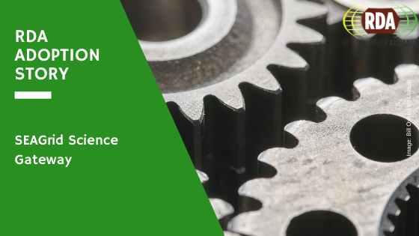
Data Type Model and Registry
Data Type Registries Working Group
Recommendation package DOI: 10.15497/A5BCD108-ECC4-41BE-91A7-20112FF77458
Impact:
ENDORSED RECOMMENDATION
Ensures data producers classify their data sets in standard data types, allowing data users to automatically identify instruments to process and visualise the data.
Category: Data Management
ICT Tech specification: TS3 Data Type Registries Model

Slide 20
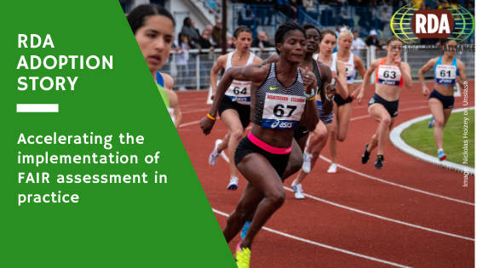
FAIR Data Maturity Model: specification and guidelines
FAIR Data Maturity Model WG
Recommendation package DOI: 10.15497/rda00050
Impact:
ENDORSED RECOMMENDATION
This document describes a maturity model for FAIR assessment with assessment indicators, priorities and evaluation methods. This is useful for the normalisation of assessment approaches to enable comparison of their results.
Categories: Data Management - Disseminate, Link, and Find

Slide 21
FAIR Principles for Research Software (FAIR4RS Principles)
FAIR for Research Software (FAIR4RS) WG
Recommendation package DOI: 10.15497/RDA00068
Impact:
ENDORSED RECOMMENDATION
Adoption and implementation of the FAIR for Research Software principles will create significant benefits for many stakeholders, including increased research reproducibility for research organizations, better practices and more software usage for its developers, clarity for funders around their own policies and requirements for software investments, and guidelines for publishers on sharing requirements.
This work will be of value to software project owners, researchers, users of research data and software, the scientific community, research software engineers, software developers who publish their software, software catalog maintainers, repository managers, software preservation and archival experts, policymakers who are responsible for defining digital policies, and organizations that create, modify, manage, share, protect, and preserve research software, funders of research, and others with an interest in the FAIR principles for research software.
Categories: Disseminate, Link, and Find - Policy, Legal Compliance, and Capacity

Slide 22
Guidelines for publishing structured metadata on the Web
Research Metadata Schemas WG
Recommendation package DOI: 10.15497/RDA00066
Impact:
ENDORSED RECOMMENDATION
Data repositories would benefit greatly from the
recommendations that guide the process of implementing
structured metadata. The consistent implementation across
data repositories enhances both semantic and syntactic
metadata interoperability on the web, which not only makes
FAIRer metadata but also enables the creation of better data
aggregation and data discovery applications to realise the full
potential of open data.
Categories: Disseminate, Link, and Find

Slide 23
InteroperAble Descriptions of Observable Property Terminologies (I-ADOPT) WG Outputs and Recommendations
InteroperAble Descriptions of Observable Property Terminology WG (I-ADOPT WG)
Recommendation package DOI: 10.15497/RDA00071
Impact:
ENDORSED RECOMMENDATION
By proposing a common way of decomposing variable descriptions according to a systematic approach that clearly identifies essential atomic components of these variables (for example the property measured, the chemical substance targeted, the medium in which the observation was made), the I-ADOPT Interoperability Framework addresses not only the I (interoperability) of the FAIR data principles but it will also benefit both the Findability and Reusability of data. The output from the I-ADOPT WG will help research communities by enabling domain scientists, ontology engineers, data providers, data curators to create and reuse complex unambiguous variable descriptions in a machine and human readable format. Well defined variables make data easier to find and reuse. Users and developers of software that are needed to create, search, manipulate, aggregate, and publish data will thus be able to design and build tools based on this common framework, facilitating the design process, fostering collaboration and improving the user experience. When broadly adopted, the I-ADOPT Framework and Recommendations will improve the efficiency and the specificity of cross-catalogue federated searches. It will also facilitate the automation or semi-automation of data workflows and enable faster, more reliable and more reproducible data aggregation steps. In addition, the components of the I-ADOPT Framework could be used by data curators to standardise the ‘mandatory’ metadata elements that should be submitted by data authors in order to identify the variables held in datasets.
Categories: Data Management, Data Description

Slide 24
Machine Actionable Policy Templates
Practical Policy WG
Recommendation package DOI: 10.15497/83E1B3F9-7E17-484A-A466-B3E5775121CC
Impact:
ENDORSED RECOMMENDATION
Can be used to enforce management, automate administrative tasks, validate assessment criteria, and automate scientific analyses.
Categories: Data Management - Identity, Store, and Preserve
ICT Tech specification: TS4 Practical Policies recommendations

Slide 25
Metadata Schema for the Persistent Identification of Instruments
Persistent Identification of Instruments WG
Recommendation package DOI: 10.15497/RDA00070
Impact:
ENDORSED RECOMMENDATION
This PIDINST Schema is the recommended schema for the persistent identification of instruments by institutions or bodies using or managing instruments. The Schema is PID provider independent and has been tested with ePIC and DataCite by numerous institutions including Helmholtz-Zentrum Berlin für Materialien und Energie GmbH, British Oceanographic Data Centre, EUDAT.
Category: Data Management, Data Description

Slide 26
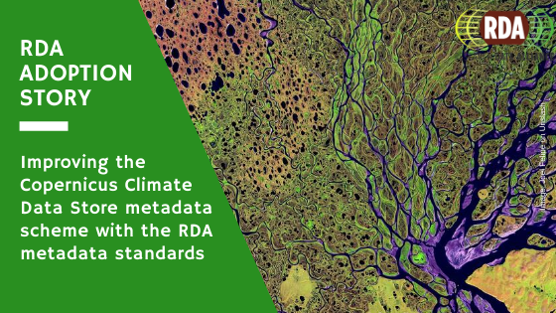
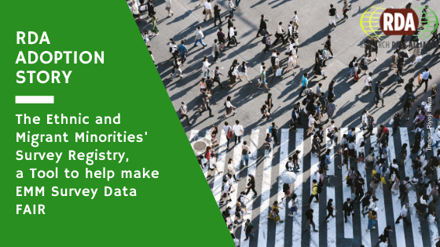
Metadata Standards Directory Working Group Recommendations
Metadata Standards Directory WG
Recommendation package DOI: 10.15497/RDA00070
Impact:
ENDORSED RECOMMENDATION
Metadata Standards Catalogue was built to guide researchers towards the metadata standards and tools relevant for their discipline. The directory drives up adoption of those standards, improving the chances of future researchers finding, accessing, and reusing the associated data.
By raising awareness of existing standards, the directory reduces the proliferation of ad hoc metadata formats and helps direct future standards development efforts towards those areas that most need it.
Category: Data Description

Slide 27
PID Information Types (PIT) WG Recommendations
PID Information Types WG
Recommendation package DOI: 10.15497/FDAA09D5-5ED0-403D-B97A-2675E1EBE786
Impact:
ENDORSED RECOMMENDATION
Defines standard core PID information types to enable simplified verification of data identity and integrity.
Category: Data Management
ICT Tech specification: TS2 PID Information Types API- Persistent Identifier Type Registry

Slide 28
RDA Data Usage Metrics WG Recommendations
Data Usage Metrics WG
Recommendation package DOI: 10.15497/RDA00062
Impact:
ENDORSED RECOMMENDATION
This document outlines next steps and recommendations for widespread adoption of normalized data usage practices, as well as hurdles and limitations to be prioritized going forward. Repositories that utilize these recommendations will help drive a better understanding of data usage and contribute towards the development of research data assessment metrics.
Category: Policy, Legal Compliance, and Capacity

Slide 29
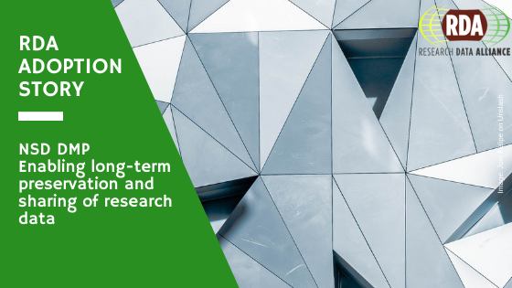
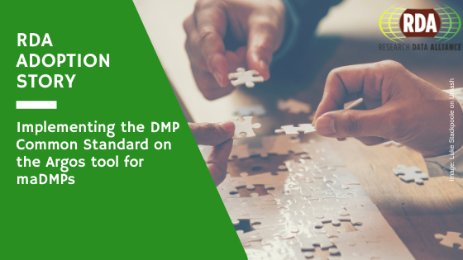
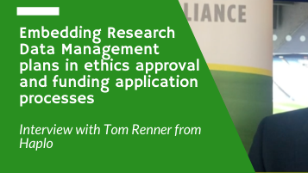
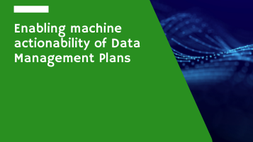
RDA DMP Common Standard for Machine-actionable Data Management Plans
DMP Common Standards WG
Recommendation package DOI: 10.15497/rda00039
Impact:
ENDORSED RECOMMENDATION
Allows representing Data Management Plans in a machine-actionable way, to enable exchange of information between systems acting on behalf of stakeholders involved in the research life cycle, such as, researchers, funders, repository managers, ICT operators, data stewards, etc. It also helps in automating typical data management tasks, thus contributes to a reduction of workload imposed on the stakeholders.
Category: Data Management

Slide 30
RDA Research Data Collections WG Recommendations
Research Data Collections WG
Recommendation package DOI: 10.15497/RDA00022
Impact:
ENDORSED RECOMMENDATION
Provides a comprehensive model for actionable collections and a technical interface specification to enable client-server interaction for research data collections.
Category: Data Management

Slide 31
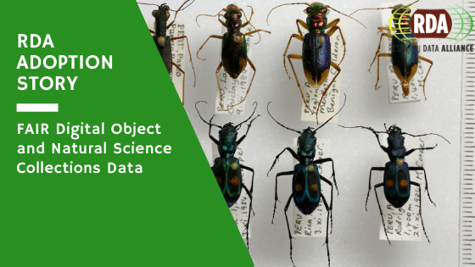
RDA/TDWG Attribution Metadata Working Group: Final Recommendations
RDA / TDWG Metadata Standards for attribution of physical and digital collections stewardship
Recommendation package DOI: 10.15497/RDA00029
Impact:
ENDORSED RECOMMENDATION
Supports standardized metadata for attributing work and tracking provenance in the curation and maintenance of research collections.
Category: Data Description

Slide 32
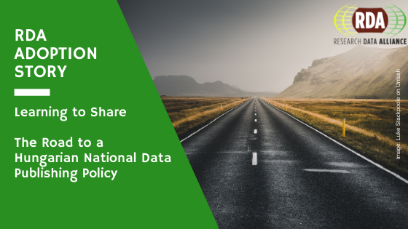
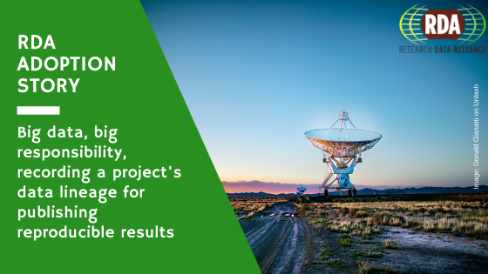
RDA/WDS Publishing Data Workflows WG Recommendations
RDA/WDS Publishing Data Workflows WG
Recommendation package DOI: 10.15497/RDA00004
Impact:
ENDORSED RECOMMENDATION
Assists research communities in understanding options for data publishing workflows and increases awareness of emerging standards and best practices. Partnership with the Data Seal of Approval (DSA) and the ICSU World Data System (ICSU­WDS).
Category: Disseminate, Link, and Find
ICT Tech specification: TS8 RDA RDA/WDS Workflows for Research Data Publishing Model

Slide 33
Recommendation on PID Kernel Information
PID Kernel Information Profile Management WG
Recommendation package DOI: 10.15497/rda00031
Impact:
ENDORSED RECOMMENDATION
A set of guiding principles, architectural considerations, use cases and a fundamental metadata schema to manage information in Persistent Identifier records for scalable middleware infrastructure and automated processes.
Category: Data Management

Slide 34
Recommendations and Capacity Development Resource Kit
Capacity Development for Agriculture Data WG
Recommendation package DOI: 10.15497/RDA00054
Impact:
ENDORSED RECOMMENDATION
These documents include an overview about available and free training resources in the area of agricultural data management. A detailed description is provided for resources that are related to RDA. Other free resources that are available online are listed as well.
Categories: Data Management – Data Collection - Data Description - Identity, Store, and Preserve - Disseminate, Link, and Find - Policy, Legal Compliance, and Capacity

Slide 35
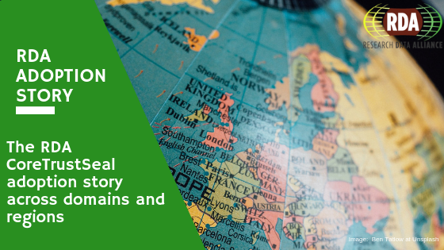
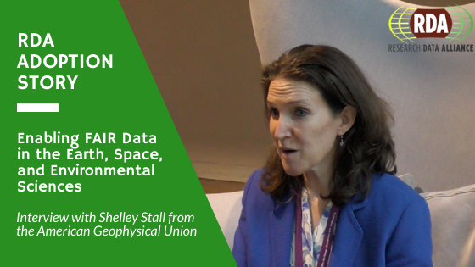
Repository Audit and Certification DSA–WDS Partnership WG Recommendations
Repository Audit and Certification DSA–WDS Partnership WG
Recommendation package DOI: 10.15497/RDA00019
Impact:
ENDORSED RECOMMENDATION
Creates harmonized Common Procedures for certification of repositories at the basic level, drawing from the procedures already put in place by the Data Seal of Approval (DSA) and the ICSU World Data System (ICSU­WDS).
Categories: Data Description - Identity, Store, and Preserve - Disseminate, Link, and Find - Policy, Legal Compliance, and Capacity
ICT Tech specification: TS7 RDA CoreTrustSeal Data Repository Requirements

Slide 36
Research Data Repository Interoperability WG Final Recommendations
Research Data Repository Interoperability WG
Recommendation package DOI: 10.15497/RDA00025
Impact:
ENDORSED RECOMMENDATION
This output provides recommendations with respect to an interoperable packaging and exchange format for digital content.
Once implemented, compliant packages can be used to migrate or replicate digital content between research data repository platforms or for preservation purposes.
Categories: Data Management - Data Description

Slide 37
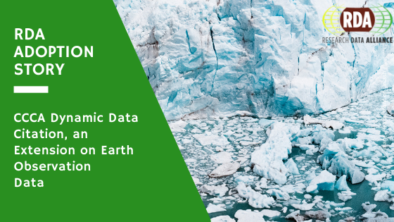
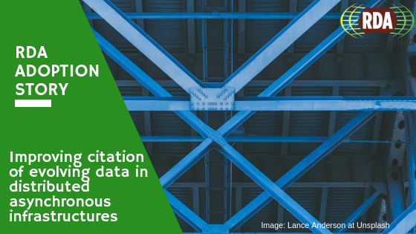
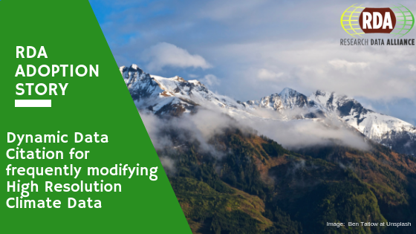
Scalable Dynamic Data Citation Methodology
Data Citation WG
Recommendation package DOI: 10.15497/RDA00016
Impact:
ENDORSED RECOMMENDATION
Supports accurate citation of data subjected to change, for the efficient processing of data and linking from publications.
Category: Identity, Store, and Preserve
ICT Tech specification: TS5 RDA Data Citation of Evolving Data

Slide 38
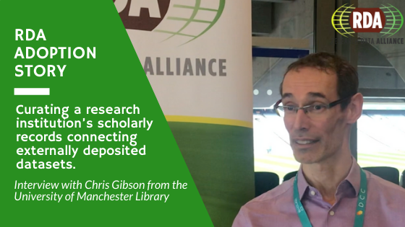
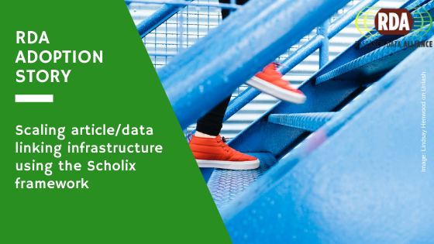
Scholix Metadata Schema for Exchange of Scholarly Communication Links
RDA/WDS Scholarly Link Exchange (Scholix) WG
Recommendation package DOI: 10.5281/zenodo.1120265
Impact:
ENDORSED RECOMMENDATION
Scholix is the “wholesaler to wholesaler” exchange framework, to be implemented by existing hubs or global aggregators of data-literature link information such as DataCite, CrossRef, OpenAIRE, or EMBL-EBI. These hubs in turn work with their natural communities of data centres or literature publishers to collect the information through existing community-specific workflows and standards. Scholix thus enables interoperability between a smaller number of large hubs and leverages the existing exchange arrangements between those hubs and their natural communities (eg between CrossRef and journal publishers). Scholix is a technical solution to wholesale information aggregation; it will need to be complemented by other policy, practice and cultural change advocacy initiatives.
Category: Disseminate, Link, and Find

Slide 39
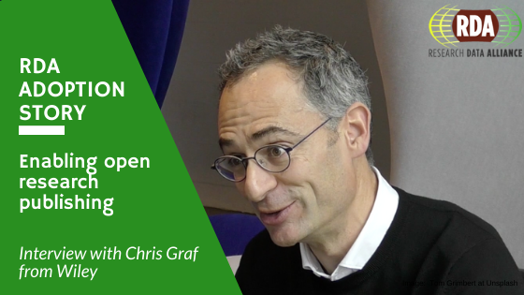

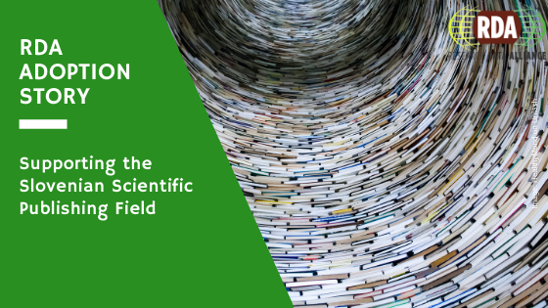
The FAIRsharing Registry and Recommendations: Interlinking Standards, Databases and Data Policies
FAIRsharing Registry WG: connecting (meta)data standards, repositories and policies
Recommendation package DOI: 10.15497/RDA00030
Impact:
ENDORSED RECOMMENDATION
As of March 2018, we have 1168 standards, 1050 databases and 111 policies. Our aim is to ensure quality rather than quantity. A key part of this is working directly with the community, engaging the maintainers of each standard, database and policy to actively update the record for their resource on FAIRsharing. FAIRsharing has already been used and adopted by a number of journal publishers (e.g. PLOS, Springer Nature, F1000), research data management programmes (e.g. ELIXIR and NIH), community and infrastructure groups (e.g. Biodiversity TDWG), and research and funding programmes (e.g. JISC) (see more at fairsharing.org/communities).
Categories: Data Management - Data Collection - Data Description - Identity, Store, and Preserve - Disseminate, Link, and Find - Policy, Legal Compliance, and Capacity

Slide 40
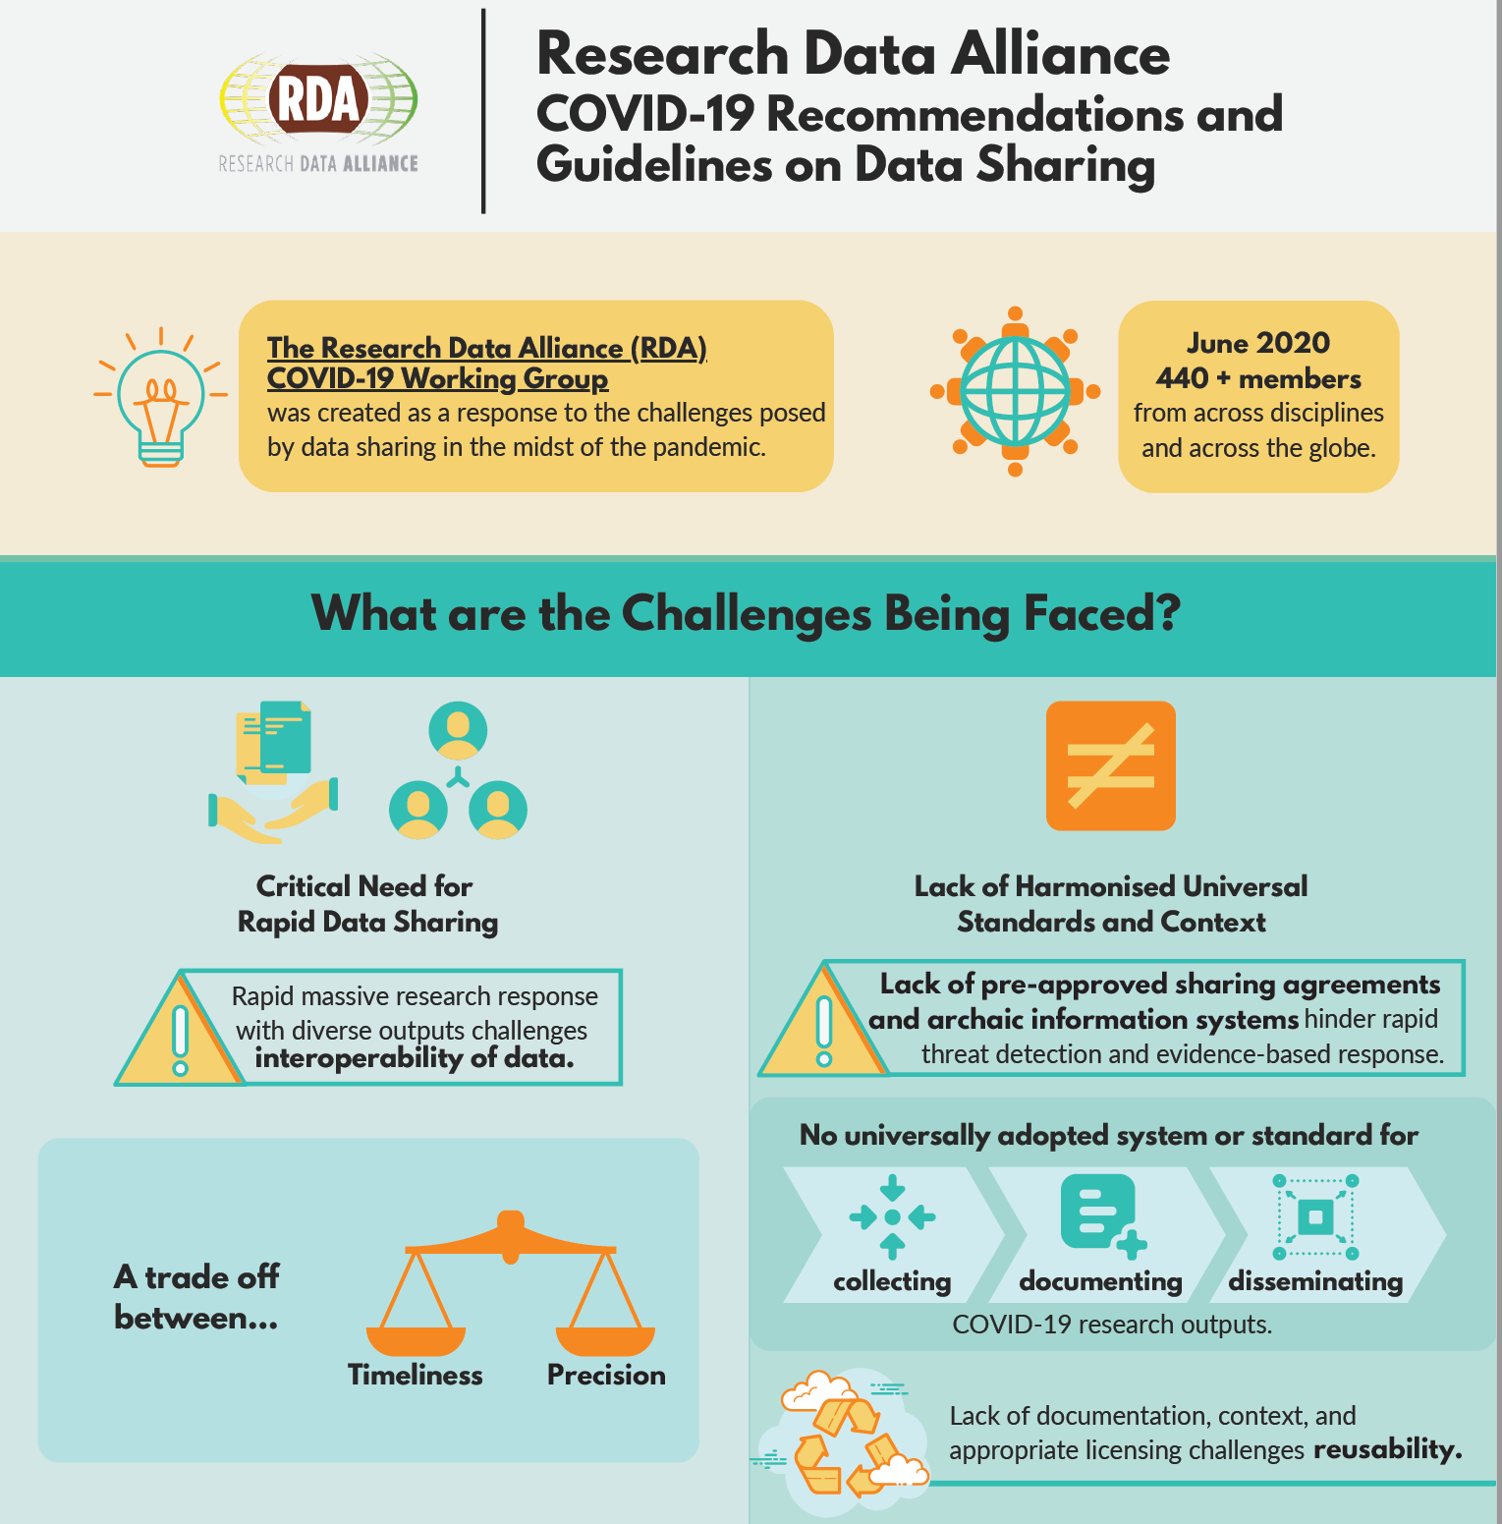
The Final Version of the RDA COVID-19 Recommendations and Guidelines for Data Sharing
RDA-COVID19
Recommendation package DOI: 10.15497/rda00052
Impact:
ENDORSED RECOMMENDATION
The Research Data Alliance (RDA) COVID-19 Working Group members bring various, global expertise to develop a body of work that comprises how data from multiple disciplines inform response to a pandemic combined with guidelines and recommendations on data sharing under the present COVID-19 cicumstances. This extends to research software sharing, in recognition of the key role in software in analysing data. The work has been divided into four research areas (namely, clinical, omics, epidemiology, social sciences) with four cross cutting themes (namely, community participation, indigenous data, legal and ethical considerations, research software), as a way to focus the conversations, and provide an initial set of guidelines in a tight timeframe. The detailed guidelines are aimed to help stakeholders follow best practices to maximise the efficiency of their work, and to act as a blueprint for future emergencies. The recommendations in the document are aimed at helping policymakers and funders to maximise timely, quality data sharing and appropriate responses in such health emergencies.
Categories: Data Management - Data Collection - Data Description - Identity, Store, and Preserve - Disseminate, Link, and Find - Policy, Legal Compliance, and Capacity

Slide 41
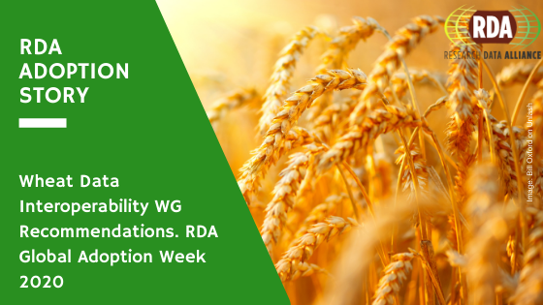
Wheat Data Interoperability Recommendations
Wheat Data Interoperability WG
Recommendation package DOI: 10.15497/RDA00018
Impact:
ENDORSED RECOMMENDATION
Helps researchers create, manage and exchange wheat data.
Category: Data Description

Slide 42
SUPPORTING OUTPUTS
FULL OUTPUT CATALOGUE HERE

Slide 43
23 Things Physical Samples
Physical Samples and Collections in the Research Data Ecosystem IG
Recommendation package DOI: 10.15497/RDA00067
Impact:
SUPPORTING OUTPUT
The ‘23 Things Physical Samples’ output will be of value to anyone working with samples and specimens, as well as others interested in this topic. The output provides an overview of resources centered on physical sample management and sharing. Resources included are applicable to any scientific discipline working with sample or specimen data. The output highlights examples and resources from the following research domains: Archaeology, Earth Sciences, Biomedical Sciences, Life Sciences, Biology, Genomics, Environmental Science, and Natural Sciences. The output increases awareness of the various initiatives that focus on physical samples and specimens, ultimately facilitating cross disciplinary data exchange and interoperability.
Category: Data Management

Slide 44
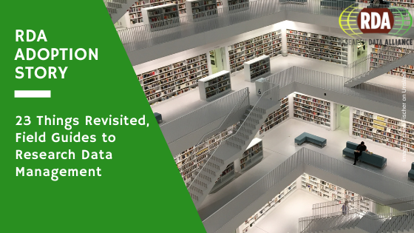
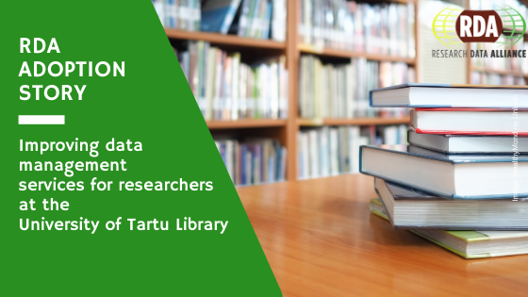
23 Things: Libraries for Research Data
Libraries for Research Data IG
Recommendation package DOI: 10.15497/rda00005
Impact:
SUPPORTING OUTPUT
23 Things: Libraries for Research Data provides an overview of practical, free, online resources and tools that you can begin using today to incorporate research data management into your practice of librarianship from the Libraries for Research Data Interest Group of the Research Data Alliance.
Category: Data Management

Slide 45
A Collection of Crosswalks from Fifteen Research Data Schemas to Schema.org
Research Metadata Schemas WG
Recommendation package DOI: 10.15497/RDA00069
Impact:
SUPPORTING OUTPUT
The collection of crosswalks provides an important insight into semantic interoperability of metadata schemas commonly used for research data. The collection can serve as a reference for data repositories when they develop their own crosswalks or for projects that develop common metadata frameworks.
Category: Disseminate, Link, and Find

Slide 46
A Survey of Current Practices in Data Search Services
Data Discovery Paradigms IG
Recommendation package DOI: 10.17632/7j43z6n22z.1
Impact:
SUPPORTING OUTPUT
The study finds that repositories desire guidelines for improving relevancy ranking in their systems, with small repositories having the greatest need. Repositories understand that their search systems need to be evaluated and improved, but often lack the resources (time and/or expertise) to explore and evaluate the available options. The study concludes that there is an opportunity for people working in the search space to collaborate, to build test collections and other efforts that offer the greatest improvements in search services at the lowest cost.
Category: Disseminate, Link, and Find

Slide 47
Addressing the Gaps: Recommendations for Supporting the Long Tail of Research Data
Long tail of research data IG
Recommendation package DOI: 10.15497/RDA00023
Impact:
SUPPORTING OUTPUT
“Long Tail of Research Data Interest Group” calls on the community to work together to create necessary and sufficient conditions to properly steward long tail valuable research outputs for future generations of researchers.
Category: Data Management

Slide 48
Challenges of Curating for Reproducible and FAIR Research Output
Recommendation package DOI: 10.15497/RDA00063
CURE-FAIR WG
Impact:
SUPPORTING OUTPUT
This report identified the current set of key challenges associated with generating, sharing, and using reproducible computation-based scientific results. The report will inform the WG’s forthcoming standards-based guidelines for curating for FAIR and reproducible research outputs.
Category: Data Management

Slide 49
Compilation of Data Versioning Use cases from the RDA Data Versioning Working Group
Recommendation package DOI: 10.15497/RDA00041
Data Versioning WG
Impact:
SUPPORTING OUTPUT
The use cases provide important insights into definitions, workflows and best practices for versioning. They also form the basis of the data versioning principles presented in the RDA Data Versioning Working Group’s final Output, Principles and Best Practices in Data Versioning for all Data Sets Big and Small.
Categories: Data Management - Data Description - Identity, Store, and Preserve

Slide 50
Core Characteristics of Learning Resource Collectors
Education and Training on Handling of Research Data IG
Recommendation package DOI: 10.15497/rda00072
Impact:
SUPPORTING OUTPUT
”Core characteristics of learning resource collecting and servicing organisations (such as catalogues and registries)” provides a set of core descriptive characteristics that can help people evaluate and understand the types and extent of service approaches and learning content offered. In addition, the identification of core characteristics can help the organisations themselves consider some of the factors that might help them build, structure and maintain their collections and the services they offer in support of researchers and data specialists who seek learning resources on research data skill building topics.
The recommendations for the core characteristics are offered primarily as guidance to catalogues, registries, portals and learning platforms that collect and/or provide support services for learning resources in order to assist in structuring them for longer term sustainability. In addition, making the characteristics known that apply to the service providing organisation should help improve the organisation’s ability to help learning resource searchers more easily find the resources they seek and discern whether those resources would fit their needs.
Category: Data Management

Slide 51
Data Discovery Paradigms: User Requirements and Recommendations for Data Repositories
Data Discovery Paradigms IG
Recommendation package DOI: 10.5334/dsj-2019-003
Impact:
SUPPORTING OUTPUT
The work focuses on enabling and improving the methods and tools by which users find data in repositories. Recommendations can be used as guidelines or as a reference for developers, project and product managers at data repositories, as well as researchers who are involved in developing and improving data repositories, community platforms, or interfaces to data collections.
Categories: Data Management - Data Description - Disseminate, Link, and Find

Slide 52
Developing a Research Data Policy Framework for All Journals and Publishers
Data policy standardisation and implementation IG
Recommendation package DOI: 10.5334/dsj-2020-005
Impact:
SUPPORTING OUTPUT
Defines and describes 14 features of journal research data policies and arranges these into a set of six standard policy types or tiers, which can be adopted by journals and publishers to promote data sharing in a way that encourages good practice and is appropriate for their audience's perceived needs.
Category: Policy, Legal Compliance, and Capacity

Slide 53
Eleven Quick Tips for Finding Research Data
Data Discovery Paradigms IG
Recommendation package DOI: 10.1371/journal.pcbi.1006038
Impact:
SUPPORTING OUTPUT
Encouraging wide adoption to educate and train research students and early career researchers, and to help researchers more effectively and precisely discover data that meets their specific needs.
Categories: Data Description - Disseminate, Link, and Find

Slide 54

Engaging Researchers with Data Management: The Cookbook
Libraries for Research Data IG
Recommendation package DOI: 10.11647/OBP.0185
Impact:
SUPPORTING OUTPUT
Provides examples of 24 innovative, searchable and re-usable case studies on how institutions can effectively engage with researchers about research data.
Category: Data Management

Slide 55
Federated Identity Management for Research Collaborations
Federated Identity Management
Recommendation package DOI: 10.5281/zenodo.1296031
Impact:
SUPPORTING OUTPUT
FIM stakeholders are able to coordinate activity to enable research use cases, based on the set of recommendations outlined, to achieve the common vision of Federated Identity Management. Each recommendation is expected to have broad positive impact on the viability and value of Federated Identity Management for future support of research communities. A mapping of groups which are mentioned in connection with each recommendation is also provided.
Category: Identity, Store, and Preserve

Slide 56
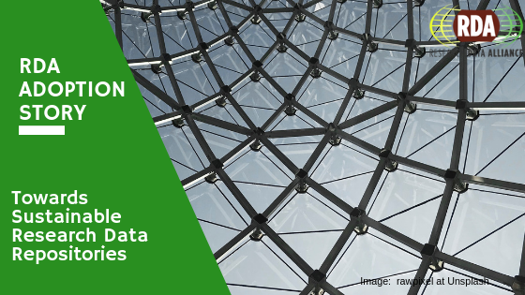
Income Streams for Data Repositories
RDA/WDS Publishing Data Cost Recovery for Data Centres IG
Recommendation package DOI: 10.5281/zenodo.46693
Impact:
SUPPORTING OUTPUT
The survey consisted of structured in-depth interviews with high-level representatives of these organisations and was focused on identifying various existing approaches to cost recovery, the range of income streams available and current and possible business models.
The principal beneficiaries of this work will be data centre managers on the one hand and research infrastructures on the other. Each of these stakeholders will gain a valuable insight into alternative options for cost recovery, substantiated by the survey results.
Category: Policy, Legal Compliance, and Capacity

Slide 57
Matrix of use cases and functional requirements for research data repository platforms
Repository Platforms for Research Data IG
Recommendation package DOI: 10.15497/rda00033
Impact:
SUPPORTING OUTPUT
Based on use cases, the matrix describes forty-four functional requirements identified for research data repository platforms and provides a score identifying relative importance. These functional requirement scores can be used to assess research data repository platforms and to prioritize functional requirements for development and adoption.
Categories: Data Management - Data Collection - Data Description - Identity, Store, and Preserve - Disseminate, Link, and Find - Policy, Legal Compliance, and Capacity

Slide 58
Member survey on bridging the gap between funders and communities – perspectives on benefits and challenges of FAIR assessments V2.0
FAIR Data Maturity Model WG
Recommendation package DOI: 10.15497/RDA00061
Impact:
SUPPORTING OUTPUT
This report provides a consolidated view of the answers collected during a survey conducted in October 2020.
It is helpful in uncovering the differences of perspectives on benefits and challenges of the FAIR assessments between funders and research communities. Although the number of respondents was limited, this can form input for further discussion for future development of FAIR assessments.
Category: Data Management

Slide 59
Persistent Identification of Instruments
Persistent Identification of Instruments WG
Recommendation package DOI: 10.5334/dsj-2020-018
Impact:
SUPPORTING OUTPUT
Provides two tested approaches for persistent identification of instruments.
Categories: Data Management - Data Description

Slide 60
Persistent Identifiers: Consolidated assertions
Recommendation package DOI: 10.15497/RDA00027
Data Fabric IG
Impact:
SUPPORTING OUTPUT
With this document GEDE is happy to help demystify PIDs, overcome confusion and create bridges between the various disciplines.
Category: Data Management

Slide 61
Principles and best practices in data versioning for all data sets big and small
Data Versioning WG
Recommendation package DOI: 10.15497/RDA00042
Impact:
SUPPORTING OUTPUT
Provides recommendations for standard practices in the versioning of research data, adding a central element to the systematic management of research data at any scale which in turn enhances reproducibility and enables the attribution of any person or organisation that contributed to the development or funding of any version of a dataset.
Categories: Data Management - Data Description - Identity, Store, and Preserve - Disseminate, Link, and Find

Slide 62
RDA & CODATA Legal Interoperability Of Research Data: Principles And Implementation Guidelines
RDA/CODATA Legal Interoperability IG
Recommendation package DOI: 10.5281/zenodo.162241
Impact:
SUPPORTING OUTPUT
The ability of the research community to share, access, and reuse data, as well as to integrate data from diverse sources for research, education, and other purposes requires effective technical, syntactic, semantic, and legal interoperability rules and practices. The Principles and guidelines produced by the RDA/CODATA Legal Interoperability Interest Group focus on legal interoperability because there tends to be misunderstanding and lack of knowledge and guidance about legal issues concerning research data generally.
The scope is limited to laws and policies pertaining to access and reuse of data, either produced by researchers themselves or used in research and other activities. It is specifically focused on the ability to integrate those data for research purposes in the context of intellectual property law.
Category: Policy, Legal Compliance, and Capacity

Slide 63
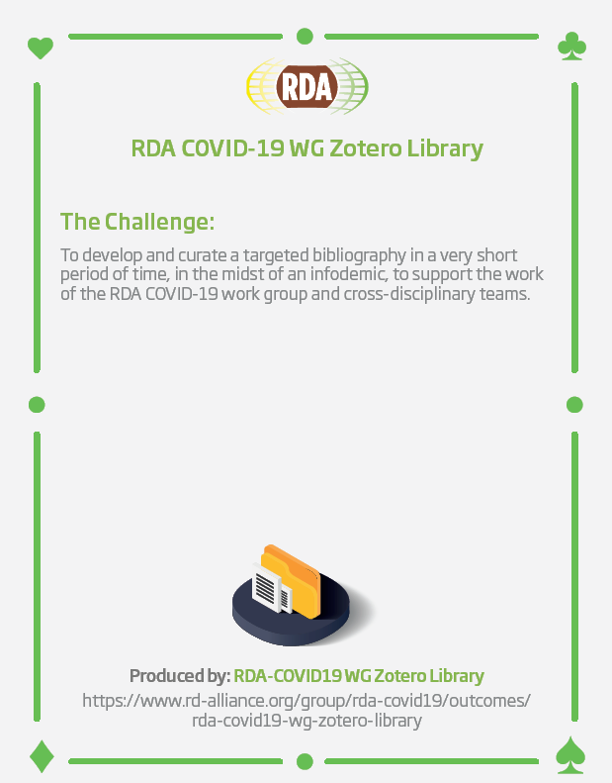
RDA COVID-19 WG Zotero Library
Recommendation package DOI: 10.15497/rda00051
RDA-COVID19
Impact:
SUPPORTING OUTPUT
The Library contains resources and references supporting the following RDA COVID-19 sub work groups: clinical, community, epidemiology, Indigenous, legal and ethics, omics, social, and software.
Categories: Data Management - Data Collection - Data Description - Identity, Store, and Preserve - Disseminate, Link, and Find - Policy, Legal Compliance, and Capacity

Slide 64
RDA Professionalising Data Stewardship - Current Models of Data Stewardship: Survey Report
Professionalising Data Stewardship IG
Recommendation package DOI: 10.15497/RDA00075
Impact:
SUPPORTING OUTPUT
The ‘RDA Professionalising Data Stewardship – Models of Data Stewardship Initial Report’ output will be of value to stakeholders seeking to develop support services and competence centres serving research producers and users of FAIR data and Open Science. The survey findings are particularly relevant to individual data stewards as well as coordinated data stewardship service provision at all levels, including institutions, national, regional, and domain-based services. The output offers insights to current data stewardship service definition and provision across the globe, but in Europe in particular, and facilitates learning from the benefits promoted, the barriers experienced, and the main lessons learned by existing data stewardship services. Alongside the publicly available survey dataset this report therefore provides a useful evidence base to further aid the professionalisation and delivery of data stewardship across the research data management community.
Category: Data Management

Slide 65
RDA Professionalising Data Stewardship - Data Stewardship Landscape Initial Report
Professionalising Data Stewardship IG
Recommendation package DOI: 10.15497/RDA00076
Impact:
SUPPORTING OUTPUT
The main take-home messages from this review are: 1) Collaborate internationally on certified training; 2) Enable researchers to share their data from the planning stage of their project and 3) Address the increased need for technical skills in data stewardship. The report offers 197 solutions compiled from literature to bridge gaps in data stewardship. The output can be used to identify and recommend learning pathways for data stewards, and to identify use cases to concretize the solutions in order to provide a valuable tool for data stewards. The results of the report could be used to contribute to the Competency Hub pages on Data Stewardship, the continuing work of the EOSC Taskforce or the creation of new educational materials for RDA task group developing curricula. The report will also give valuable information to all who are interested in developing their data stewardship skills needed to better serve the needs of researchers.
Category: Data Management

Slide 66
RDA Professionalising Data Stewardship - Data Stewardship Landscape Report Resource Matrix
Professionalising Data Stewardship IG
Recommendation package DOI: 10.15497/RDA00077
Impact:
SUPPORTING OUTPUT
This dataset includes the resources which were included in the Research Data Alliance Professionalising Data Stewardship Interest Group (RDA PDS-IG) Training Landscape sub-group report published in October 2022. The literature was structured into the following categories: data stewardship; education and training of data stewards; RDM education; training materials; data management plan templates; documents about the skills needed to support EOSC and FAIR principles; data management in the humanities, industry, life sciences, natural sciences, public institutions and the social sciences. The aim was to identify papers concerning the RDM needs of researchers and data stewards and their role in the RDM life cycle. The screening resulted in 125 papers that are used as the knowledge base for the output report.
Category: Data Management

Slide 67
RDA Professionalising Data Stewardship - Models of Data Stewardship Survey Output Data
Professionalising Data Stewardship IG
Recommendation package DOI: 10.5281/zenodo.6665306
Impact:
SUPPORTING OUTPUT
The ‘RDA Professionalising Data Stewardship – Models of Data Stewardship Survey Output Data’ output will be of value to stakeholders seeking to develop support services and competence centers serving research producers and users of FAIR data and Open Science. The data offer insights to current data stewardship service definition and provision across the globe, but in Europe in particular, and facilitate comparison and learning for individual data stewards as well as data stewardship service providers and coordinators at all levels, including institutions, national, regional, and domain-based services. Together with the publicly available “Models of Data Stewardship Initial Report” (presently under RDA community review), these data provide a useful evidence base to further aid the professionalisation and delivery of data stewardship across the research data management community.
Category: Data Management

Slide 68
Recommendations for a minimal metadata set to aid harmonised discovery of learning resources
Education and Training on Handling of Research Data IG
Recommendation package DOI: 10.15497/RDA00073
Impact:
SUPPORTING OUTPUT
The ”Recommendations for a minimal metadata set to aid harmonised discovery of learning resources” provides a core set of descriptors for learning resources especially focused on research data that is intended to help searchers for learning activities or experiences such as tutorials, webinars, curricula guides and other training materials find such content. The minimal set identifies key characteristics of learning resources that are important for content creators and adapters to include with the resources they create, and for learning resource catalogue and registry service providers, and institutions that publish learning resources on their websites to expose when they provide information about the resources in their collections. Adoption of the recommended minimal set will improve the ability of learning resource searchers to more easily find the resources they seek and to discern whether those resources might fit their needs.
Category: Data Management

Slide 69
Research Data Repository Interoperability Primer
Research Data Repository Interoperability WG
Recommendation package DOI: 10.15497/RDA00020
Impact:
SUPPORTING OUTPUT
The Research Data Repository Interoperability Primer presents a set of initial use cases, as well as an overview of standards, technologies and tools that could be components of an agreed adoptable approach to facilitating interoperability between different research data repository platforms. Main focus is on machine-machine communication with the primary goal of enabling migration and replication.
Categories: Data Description - Disseminate, Link, and Find

Slide 70
Results of an Analysis of Existing FAIR Assessment Tools
FAIR Data Maturity Model WG
Recommendation package DOI: 10.15497/RDA00035
Impact:
SUPPORTING OUTPUT
This document provides an overview of a number of existing FAIR assessment tools, listing the indicators used in these tools to assess the FAIRness of a data set. This is useful if you wish to compare existing FAIR assessment tools and the questions that are being asked.
Category: Data Management

Slide 71
Sharing COVID-19 Epidemiology Data
RDA COVID-19 Epidemiology
Recommendation package DOI: 10.15497/rda00049
Impact:
SUPPORTING OUTPUT
The recommendations and guidelines support development of an internationally harmonized specification to enable rapid reporting and integration of epidemiology and related data across domains and between jurisdictions.
The guidelines outline a data driven, coordinated global system that encompasses preparedness, early detection, and rapid response to newly emergent threats such as SARS-CoV-2 virus and the COVID-19 disease that it causes.
Categories: Data Management - Data Collection - Data Description - Identity, Store, and Preserve - Disseminate, Link, and Find - Policy, Legal Compliance, and Capacity

Slide 72
Summary of Virtual Layer Recommendations
Recommendation package DOI: 10.15497/RDA00026
Data Fabric IG
Impact:
SUPPORTING OUTPUT
A high-level conceptual framework to support Digital Object management and service development.
Category: Data Management

Slide 73
Top 10 FAIR Data & Software Things
Libraries for Research Data IG
Recommendation package DOI: 10.5281/zenodo.2555497
Impact:
SUPPORTING OUTPUT
Provides 17 topic-based, community submitted brief guides that can be used by the research community to understand how they can make their research (data and software) more FAIR (Findable, Accessible, Interoperable and Reusable).
Category: Data Management

Slide 74
Tromsø Recommendations for Citation of Research Data in Linguistics
Recommendation package DOI: 10.15497/rda00040
Linguistics Data IG
Impact:
SUPPORTING OUTPUT
Provides guidance for citing linguistic data in publications to researchers, academic publishers and resource providers.
Categories: Data Management - Data Description - Disseminate, Link, and Find

Slide 75
Use cases and identifier schemes for persistent software source code identification (V1.1)
RDA/FORCE11 Software Source Code Identification WG
Recommendation package DOI: 10.15497/RDA00053
Impact:
SUPPORTING OUTPUT
Provides an overview of the current state-of-the-art of the practice of software identification, including use cases and identifier schemes from different academic domains and in industry.
Category: Identity, Store, and Preserve

Slide 76
WDS/RDA Assessment of Data Fitness for Use WG Outputs and Recommendations
WDS/RDA Assessment of Data Fitness for Use WG
Recommendation package DOI: 10.15497/rda00034
Impact:
SUPPORTING OUTPUT
A practical process by which CoreTrustSeal certified repositories can evaluate dataset holding for their fitness for use.
Category: Identity, Store, and Preserve

Slide 77
ICT Technical Specifications
TS1 Data Foundation & Terminology Model - https://doi.org/10.15497/06825049-8CA4-40BD-BCAF-DE9F0EA2FADF
TS2 PID Information Types API- Persistent Identifier Type Registry - https://doi.org/10.15497/FDAA09D5-5ED0-403D-B97A-2675E1EBE786
TS3 Data Type Registries Model - https://doi.org/10.15497/A5BCD108-ECC4-41BE-91A7-20112FF77458
TS4 Practical Policies recommendations - https://doi.org/10.15497/83E1B3F9-7E17-484A-A466-B3E5775121CC
TS5 RDA Data Citation of Evolving Data - https://doi.org/10.15497/RDA00016
TS6 RDA Data Description Registry Interoperability Model - https://doi.org/10.15497/RDA00003
TS7 RDA CoreTrustSeal Data Repository Requirements - https://doi.org/10.15497/RDA00019
TS8 RDA RDA/WDS Workflows for Research Data Publishing Model - https://doi.org/10.15497/RDA00004
In 2017, the Research Data Alliance was approved by the European Multi-Stakeholders Platform as an organisation that can submit technical specifications / standards for approval. Leveraging the clear and transparent RDA process for producing and endorsing its “Recommendations", to date eight RDA recommendations have been approved as ICT Technical Specifications (standards).
RDA Technical Specifications https://www.rd-alliance.org/recommendations-outputs/standards

Slide 78
Adoption Stories
RDA Adoption & Implementation Stories - Tell us yours!
RDA Recommendations and Outputs take the form of technical specifications, code, policies or practices, harmonized standards or reference models. In the widest sense these aim for:
Greater data sharing, exchange, interoperability, usability and re-usability;
Greater discoverability of research data sets;
Better management, stewardship, and preservation of research data;
New data standards or harmonization of existing standards.
Become one of the next RDA adopters!
If you are interested in any of the RDA’s recommendations or would like to share your group's results with our international community, please fill the contact form at https://www.rd-alliance.org/interest-rda-recommendations or write to enquiries@rd-alliance.org.

Slide 79
Contact
RDA Global
Email - enquiries@rd-alliance.org
Web - www.rd-alliance.org
Twitter - @resdatall
LinkedIn - www.linkedin.com/in/ResearchDataAlliance
Slideshare - http://www.slideshare.net/ResearchDataAlliance
RDA Europe
Twitter - @RDA_Europe
RDA US
Email – rdaus@rda-foundation.org
Twitter - @RDA_US

