Slide 1
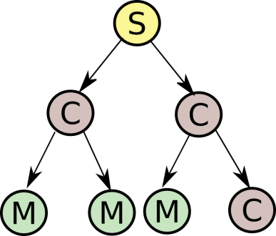
Unified management of Research Data Collections
(Research) data management beyond single objects
Not just describe collections, but enable actions on them
Create, Read, Update, Delete, List plus some others
Machine agents as primary users: built-in scalability and automation
Flexible hierarchy of Services, Collections, and Members
API specification against which tools and services can be built across community boundaries
RESTful API specification and elemental metadata model
Pilot implementations in several application areas exist
Collection storage agnostic: Able to work with multiple backends
Multiple points for custom extensions, such as ontologies, typing and specialized operations
http://dx.doi.org/10.15497/RDA00022
Create
Read
Update
Delete
List

