Slide 1
RPID: An Overview
Rob Quick (Beth Plale)
PI
Larry Lannom and Alison Babeu (Bridget Almes)
Co-PIs
Chief Technical Contacts
Yu Luo and Scott Teige

Slide 2
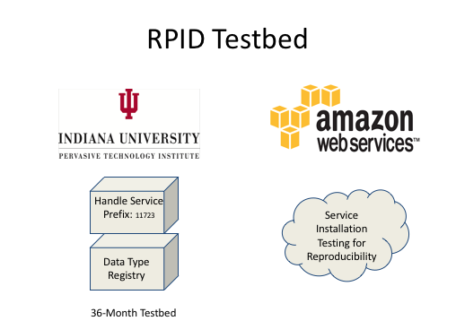
Handle Service 8.1.1
Cordra 1.0.7

Slide 3
PID makeup
RPID testbed assigns only test temporary handles:
11723.1.test, 11723.2.test, ... 11723.8.test : for internal use
11723.9.test.<proj name> : assigned to projects
DTR thus holds metadata profiles and kernel information profiles for RPID
Does not get at DTR federation, nor DTR attribute ownership

Slide 4
Handle System
Internet speed client engages in minimal decision making for efficiency
1. Q: prefix authority
Global Handle Registry
Local Handle Service IP
PID Kernel Informa-tion stored at Local Handle Server
2. Q: local handle
Local Handle
Service
Handle information + PID KI
3. Q: DTR for PID KI profile
PID Kernel Informa-tion profile stored at DTR
Data Type
Registry Service
4. Decision on PID kernel information
Profile Definition
“no”
“yes”
5. Retrieve DO
Repository Service

Slide 5
SEADTrain: publish Airbox (PM2.4 sensor) data to Azure for training purposes
IU SEADTrain discovery page http://d2i-dev.d2i.indiana.edu:8081/iusc-azure-search/search.html
Sample dataset: http://hdl.handle.net/11723/test.seadtrain.5e66ce48-236a-4af7-b3e1-8a6700d36abf
PID Kernel Information Record (snippet) {"digitalObjectType":http://hdl.handle.net/20.5000.347/rdastrawman ,"digitalObjectLocation":"https://iusc.blob.core.windows.net/0a203465-b853-4556-87c0ac172fb55674/2017_D239_9E65F90C537D.txt", "PID":"http://hdl.handle.net/11723/test.seadtrain.5e66ce48-236a-4af7-b3e1-8a6700d36abf", "etag":"2f0733b956baf24c3108fee8e9d767de“ ,"RDAKIProfileType":http://hdl.handle.net/20.5000.347/rdastrawman ,"lastModified":"2017-08-28T00:00:00Z“ ,"creationDate":"2017-08-27T00:00:00Z"}

Slide 6
In progress
Curated list of PIDs where each PID has valid kernel information and resolves to a publicly accessible data object.
Available publicly
Enables testing

