Slide 1
WG PID Information Types RDA-collab @ NIST – Nov. 13, 2014
Tobias Weigel (DKRZ / University of Hamburg)
Tim DiLauro (Data Conservancy / Johns Hopkins University)

Slide 2
PIT: Current status
RDA outcome process on the move
PID IG as mid-term contact point
also at least DKRZ due to community processes – see below...
Ongoing TR/PIT discussions
model changes, future releases, moving away from prototypic status
sustainability and responsibility
checkpoint next spring?

Slide 3
Future PIT processes
Go back into communities
Develop practical types there
Motivate an overarching community process
Have a central authority

Slide 4
Community adoption example: ESGF planning (1)
Earth System Grid Federation
Sponsored by DOE, NASA, NOAA, NSF; IS-ENES (EU); NCI (AU)
Project lead at PCMDI/LLNL
Latest developments:
Preparation for CMIP6 / IPCC AR6 (~2019)
New governance structure with community working teams
DKRZ: Teams on replication and versioning, quality control

Slide 5
Community adoption example: ESGF planning (2)
PIDs in netCDF file headers
Versioning use case
Some essential PID tools that use PITs (look-up, manage)
No full set of PITs – but community uptake of a few
Probably: TypeReg installation at DKRZ
Feedback to RDA at P5/P6
Activities ensure some mid-term maintenance of PIT outcomes

Slide 6
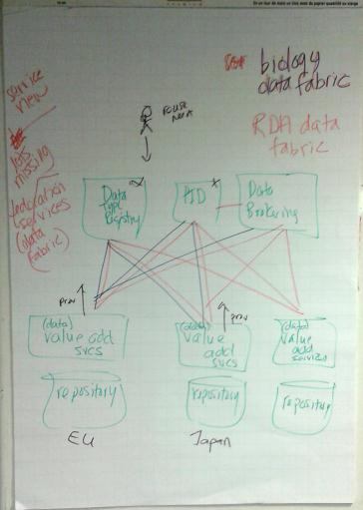
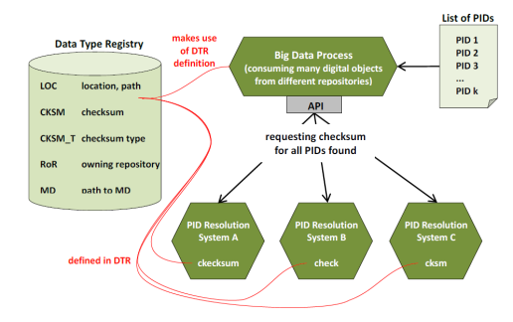
PIT and the Data Fabric
Technically: PIT API as one among others

Slide 7
Data Fabric wish list
Precisely define: what are the constraints imposed by the Data Fabric
If you do not want to have an architecture it should be clear what this means
What is the Data Fabric?
Is it a set of policies? For example, always record copy actions from A to B
If it is not about prescribing an architecture, then what else does it use to confine the possibilities of implementing something within its scope?

Slide 8
PIT Relevance
Every object in the DF should bear PITs that enable automated management
Programmable DF through registered types
For every repository, we can access these PITs
preferably via PID infrastructure providers

Slide 9
PIT and metadata
PID Information Types carry a form of metadata.
Low maintenance: static, rarely updated (only at controlled, key points in the information lifecycle)
Community-dependent, but shared building blocks
TypeReg as a key role
Criteria: PIT information is either…
rapidly available
or preserved beyond object’s lifetime

Slide 10
Thank you for your attention.
Tobias Weigel, weigel@dkrz.de
Timothy DiLauro, timmo@jhu,edu

