Slide 1
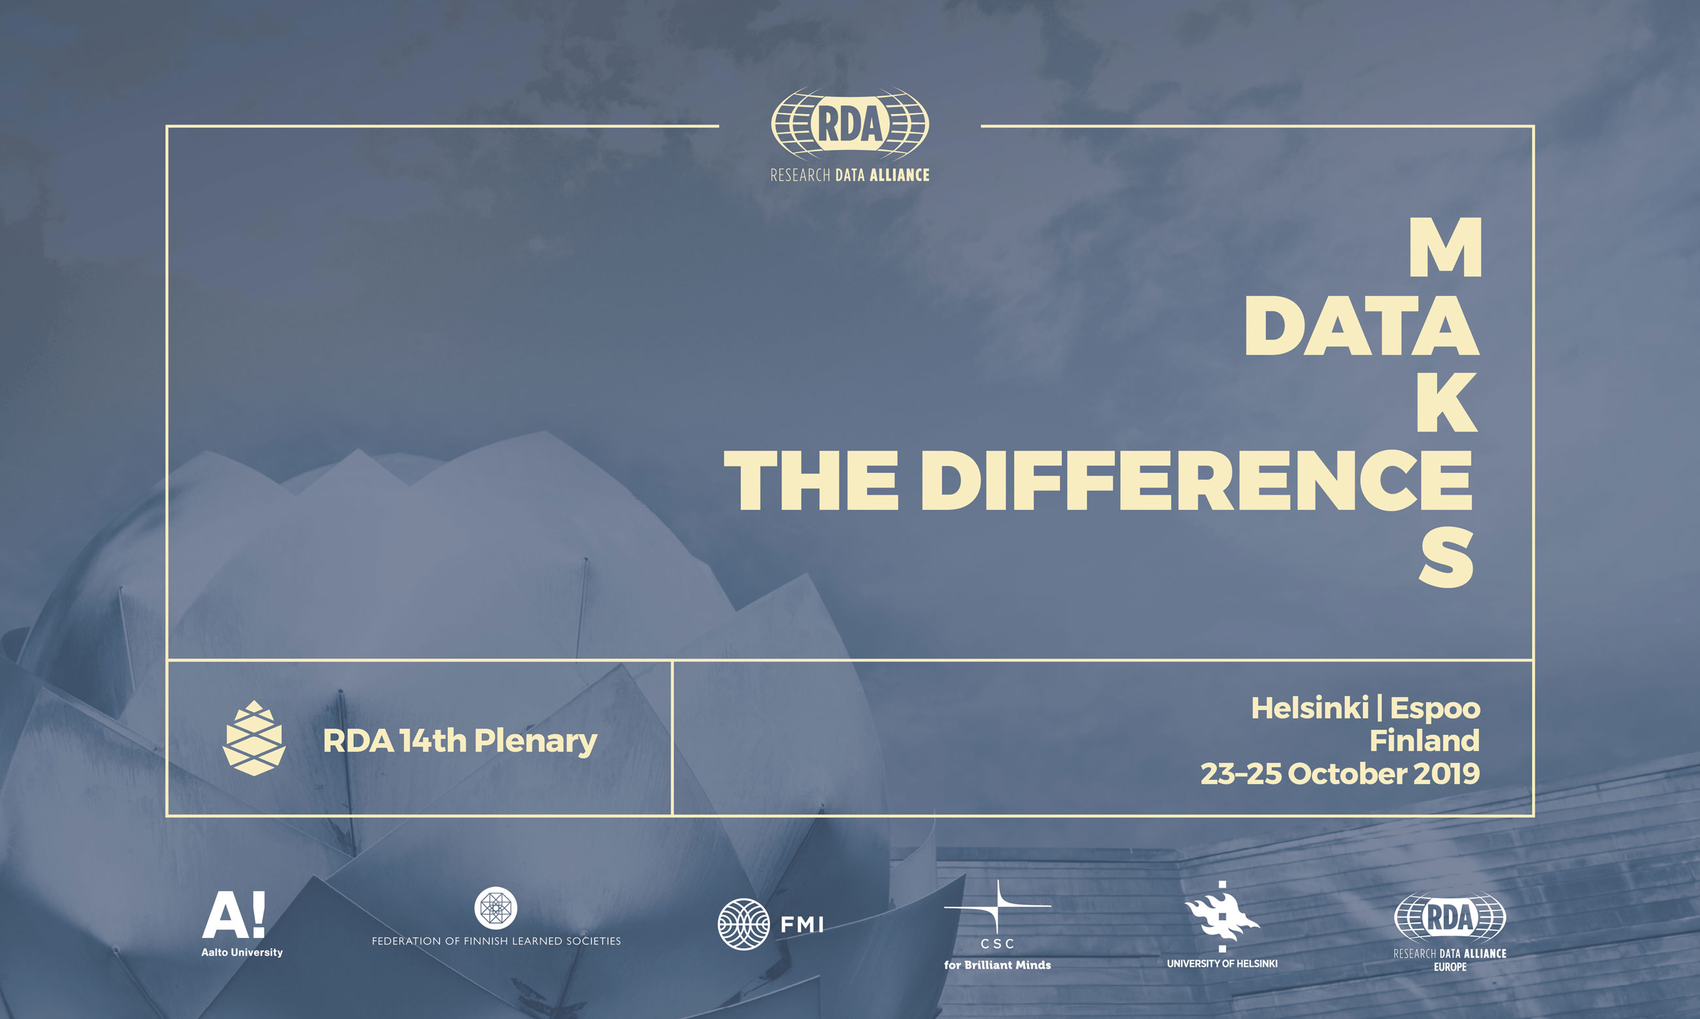
IG for Surveying Open Data Practices

Slide 2
Agenda for the IG session on
25th October 2019 9.00-10.30
Welcome by chairs: Ingeborg Meijer, David O’Brien, Kazuhiro Hayashi and Federica Rosetta
Using the Suave tool to store surveys, and discussion on how to use them and benefit from each other – Federica Rosetta & Ilya Zaslavsky (who will join us remotely)
User perspective: policy and funder relevance. external policy perspectives from Japan, and from the RDA-internal perspective
Geographical distribution and African perspective – followed by discussion. Contributions from David O'Brien and Louise Bezuidenhout

Slide 3

Update – how did we start?
10th Plenary Montreal – BoF
Co-chairs
12th Plenary Gaborone – Endorsed IG
  Publishers survey results on open data (Elsevier & Springer Nature)
  Contribution from the African Open Science Platform
  User perspectives: Japan and Austria (Hayashi & Budroni)
IG information and slides on the RDA website
  https://www.rd-alliance.org/groups/ig-surveying-open-data-practices

Slide 4
Objectives of the IG
Convene User Communities
  Participation and perspectives
  Promote dialogue among questionnaire designers and survey users
2. Develop a community-designed modular and interoperable open survey(s)
  Horizon scanning
  Engagement & recruitment
3. Determine how such open survey(s) could be implemented and results analyzed globally
  Assess available existing technical tools
  Make the modular survey(s) freely available
  Avoid duplication of efforts

Slide 5
Tools & comparison

Slide 6
A tool to store surveys
http://suave-dev.sdsc.edu/main/file=ilyaj_Open_Data_Monitor_2018_clone_.csv&views=1110101&view=bucket
Comparison Elsevier/CWTS survey 2016-2018 you can find at the Open Science Monitor website:
https://ec.europa.eu/info/research-and-innovation/strategy/goals-research-and-innovation-policy/open-science/open-science-monitor/facts-and-figures-open-research-data_en#researchers-attitude-towards-data-sharing
The State of Open Data (Digital Science and Figshare) invited to participate, released their 3rd report 23/10/19

Slide 7
Discussion - Questions
User friendliness of the tool
How to make subcategories of questions, and which one
Options for making comparisons
How to recruit surveys
Suitability to upload Surveymonkey or Qualtrics data?
Who wants to know what?

Slide 8
User:
RDA internal perspective

Slide 9
RDA internal perspective (1)
A questionnaire from the Research Data Architectures in Research Institutions IG
Your advice back in January was useful, but it’s rather been overtaken since then by feedback from RDARI IG members. In the end there wasn’t really that much overlap between the RDARI questions and those asked as part of the Leiden Data Sharing survey, so we’ve rather ended up with two different banks of response categories, although if the Surveying IG wants to add or recommend the RDARI questions/answers for future surveys, that would be great as far as I’m concerned. The RDARI survey is now open and available at https://opinio.ucl.ac.uk/s?s=63105.
Most of our response options were based on our own judgement of what seems to be sensible given the circumstances, although we did agree to use the recognized ANZSRC schema for our classifications of academic disciplines. This was felt to give a good level of granularity without being overwhelming (22 base fields of research)

Slide 10
RDA internal perspective (2)
Funders Forum Data
TU Delft did a “Quantitative assessment of research data management practices” and published the results https://zenodo.org/record/3380332
Utrecht University Library, we are working on a survey to asses data practices of the researchers at different faculties.
GO FAIR: The Convergence Matrix is a questionnaire that prompts communities to list their implementation choices and challenges when going FAIR. We are experimenting with a nice user interface and output in nanopublication (linked data) format. The tool is still in development, but once stabilised, will be openly available. We now have about 30 “communities” that have responded to the questionnaire and the first round of analyses are underway. We aim to present the results at a co-localized event in Helsinki.

Slide 11
User:
Funders perspective

Slide 12
A funder perspective from the Netherlands
Question from the Medical Research Council (ZonMw)
For (inter)national programme’s on AMR (antimicrobial resistence) a survey was issued to get insight in relevant biobanks, databases and service.
Good response rate also from outside EU/USA. Now creating permanent access to upload information on sources
Our IG should result in:
  Preventing doubling of surveys
  A network of of organisations world wide to spread the surveys and inform the right people
  Exchange of results, further ideas, en experiences (e.g. ho to make sure a survey is just a one off, only showing ‘ old ‘ information

Slide 13
User:
Policy perspective Japan

Slide 14

Current Open Science Policy in Japan
Brief Introduction of Integrated Innovation Strategy and
its implementation
Kazuhiro (Kaz) Hayash, Ui Ikeuchi
National Institute of Science and Technology Policy

Slide 15
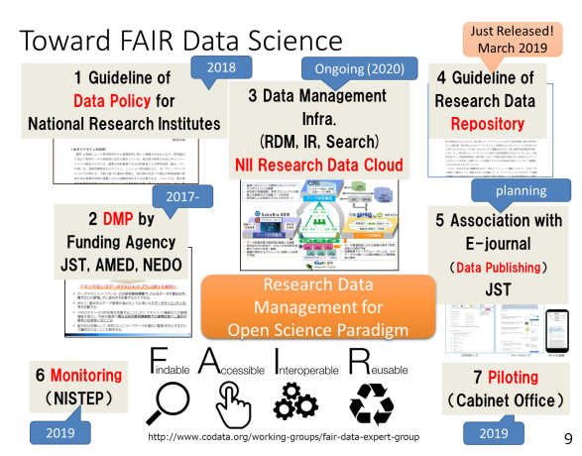
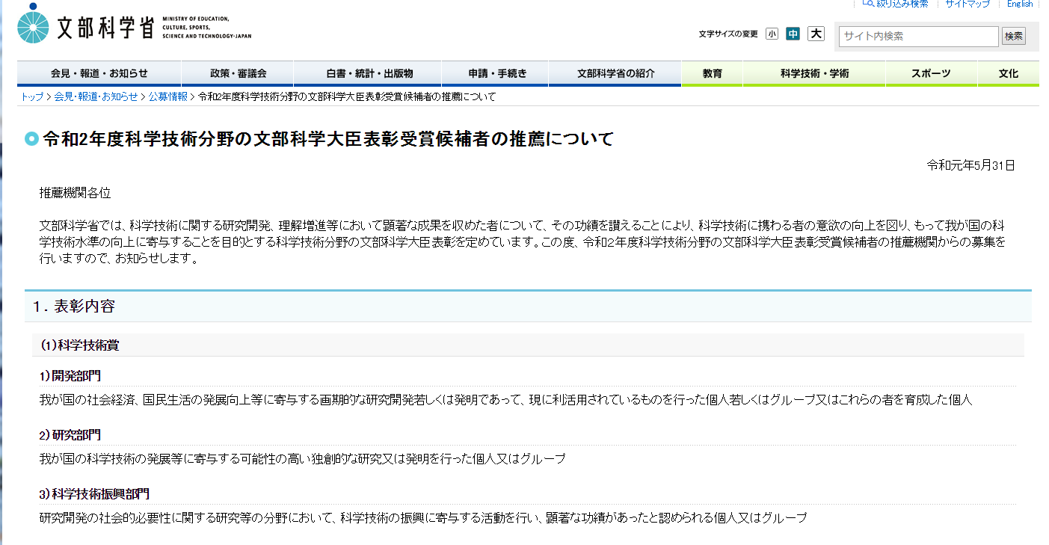
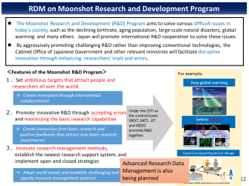
Open Science Policy in Japan
The 5th S&T Basic Plan for “Society 5.0” (2015-2020)
Integrated Innovation Strategy 2018, 2019
Source of Innovation=vast Intelligent Source
Prioritized fields
Social Data
Innovation
Academic Data
Open Science
Official Data
EBPM
IMI?
Incentive
(Award of Minister)
(Core Vocabulary)
Pilot and
International Coordination
(Moonshot)

Slide 16
Implementation

Slide 17
Relationship between Organizations for Research Data Infrastructure
Cabinet Office
Council for Science, Technology and Innovation (CSTI)
Science Council of Japan
Communication and
Collaboration
Public funds
MEXT and other Ministries
Academic community
NII*¹ Research Data Cloud
(Research Data Infrastructure System)
University and research institutes
Data publication
／Utilization
Discovery Platform
Communication and
Collaboration
Funding
Agencies
Interoperability
Research Data Infrastructure
in foreign countries
RDM*²
Platform
Publication Platform
Private firms etc.
＊1) National Institute of Informatics
＊2) Research Data Management

Slide 18
A policy perspective from Japan
Integrated Innovation Strategy
Research Data Management is a hot issue
Monitoring is included in Open Science Policy (in a broader sense)
NISTEP’s survey in 2016 helped to develop the strategy.
Conducting Survey with international contexts is important.
Document

Slide 19

Open Data Practices and Perceptions of Researchers in Japan
Research Data Alliance 14th Plenary in Helsinki
IG: Surveying Open Data Practices:
Emerging Findings, Geographic Coverage,
User Interests and Converging Questions
2019
Oct 25th
Day 3 #6
Ui Ikeuchi^{1,2}, Kazuhiro Hayashi²
¹Bunkyo University，² NISTEP

Slide 20
Outline: NISTEP surveys in 2016 & 2018
Approximately 2,000 researchers in Japan
  Universities, Public institutions, and Private companies
 | 2016 | 2018 | 2016/2018
Targets | 1,983 | 2,195 | 947
Respondents | 1,398 (70.5%) | 1,516 (69.1%) | 551 (58.2%)

Slide 21
Questionnaire design
Reviewed 20+ questionnaire and interview surveys and selected 35 questions
Reviewed 8 new global surveys and selected important questions
Add: 8 questions
Delete: 11 questions
Correct: 2 questions
2016 survey
7 sections,
35 questions
2018 survey
8 sections,
32 questions

Slide 22
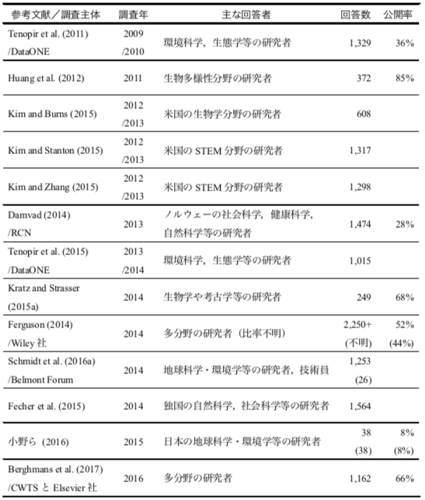
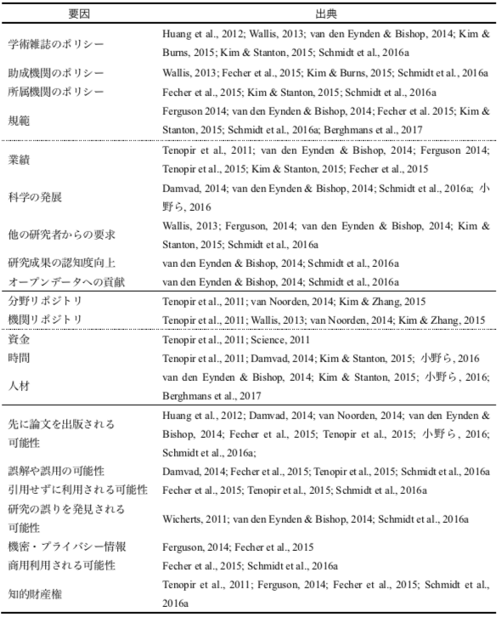
Created survey questions (2016)
Selected questions and important
factors affecting open data
Reviewed previous surveys’ results
Important factors affecting open data

Slide 23
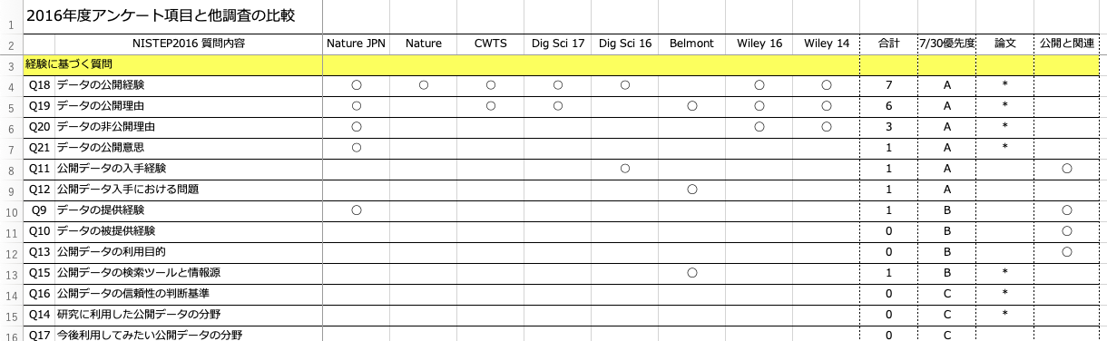
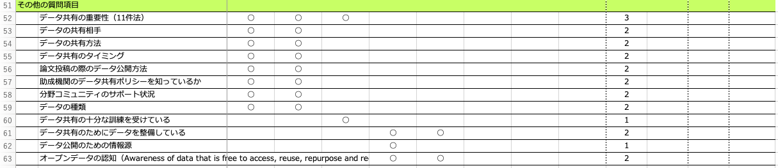
Selected important questions (2018)
Based on 2016 survey
Count & Ranked A to C
Nature, CWTS/Elsevier, Digital Science, Belmont Forum, Wiley
Not implemented in 2016 survey
：

Slide 24

Has the practice of open data spread?

Slide 25
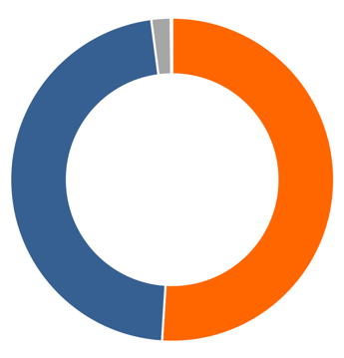
1. Open data experience
2016
(n=1,398)
2018
(n=1,516)
51.0%
51.9%
Yes
No
I don’t sure
I don’t use digital data
Open Access (OA): 70.8%→78.0% (p<.001)
Notes:
Despite many policies and discussions, the data disclosure ratio remains unchanged. On the other hand, OA increased significantly from 70% to 78%.

Slide 26


“open research data”
Interpretation varies by person
Even if we write a detailed definition, it is probably not readable
Open data definition: …………………
………………including……..excluding………for example…………………..
…………………………………………..
……………………………………………
website
Notes:
Here's how to ask about the release of research data. Different people interpret the open research data differently. However, if we write a detailed definition, probably few people read it

Slide 27
Q. Have you ever published research data in the following ways? (multiple selections)
  personal or laboratory website
  institutional repository or data archive
  subject specific repository or data archive (e.g. DDBJ, ICPSR)
  data sharing service (e.g. figshare, zenodo)
  code sharing service (e.g. GitHub)
  supplementary materials to journal articles
  academic SNS (e.g. Mendeley, ResearchGate)
  other [please specify: ]
  I have never published the data
  I don’t sure
  I don’t use digital data for my research
If respondents selected one or more from 1 to 8-> “YES”
9 to 11 can not be selected at the same time
Notes:
Therefore, we listed specific methods of open data and asked the respondents to select whether they had any experience in these ways. If they select one or more from 1 through 8, they are considered to have open data experience.

Slide 28
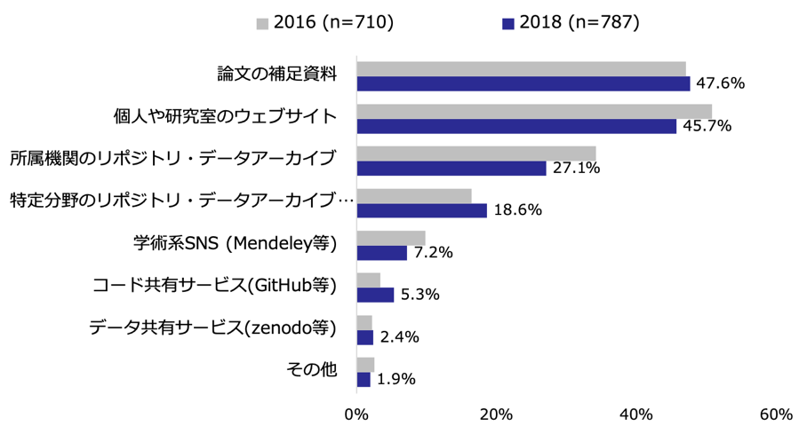
1-(3)データ公開の方法（複数回答）
Supplemental materials
Personal/lab website
Institutional repositories
Subject specific repositories
Academic SNS
Code sharing services
Data sharing services
others

Slide 29
What worries Japanese researchers?

Slide 30
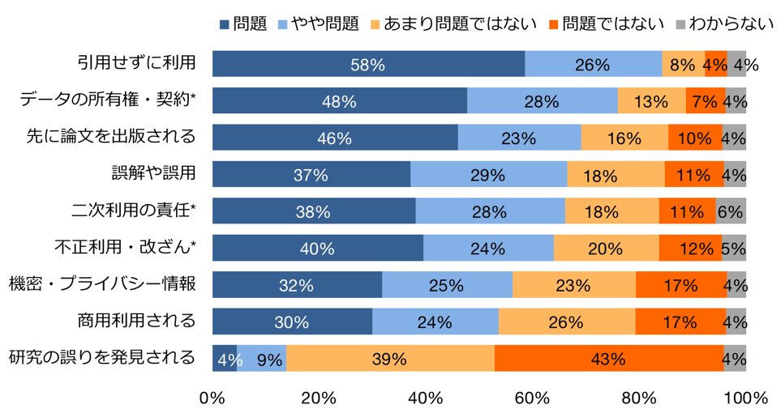
2. Concerns about open data
Important <--------> Not Important ■ I don’t sure
Use without citation
Ownership/Contract*
Lost the Priority
Misunderstanding/Misuse
Plagiarism/Falsification*
Confidential/Privacy data
Commercial use
Revealed a mistake
(n=1,513)

Slide 31

What are the incentives for open data?

Slide 32
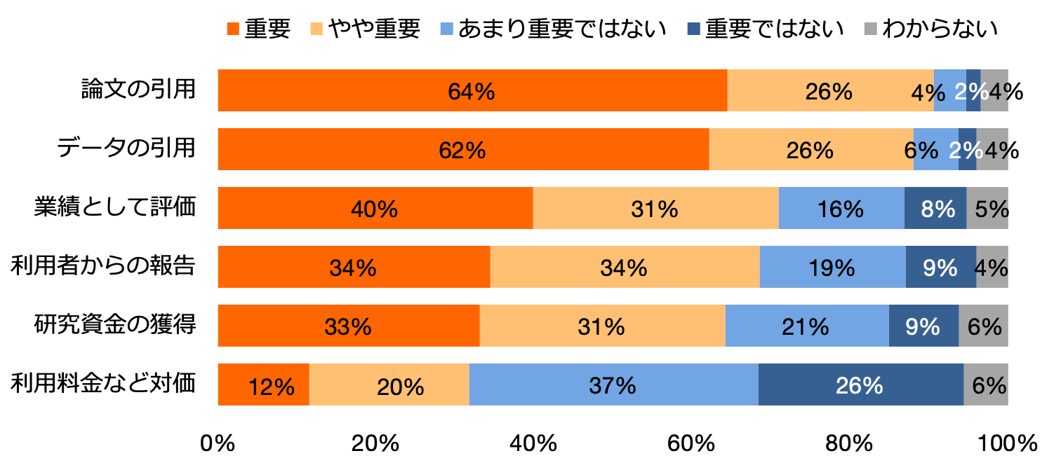
3. Importance of incentives
Important <--------> Not Important ■ I don’t sure
Article citation
Data citation
Academic rewards
Feedback from users
Research funds
Usage fee
(n=1,513)

Slide 33
Discussion – Policy relevant questions
What is a reasonable time to see change?
What policy interventions are chosen to change researcher open data practices work
What are effective policy interventions?

Slide 34
Geography of surveys
African perspective

Slide 35
Surveying Researcher Perceptions & Practices –
Who is Asking and Where the Answers are Coming From
David O’Brien (dobrien@idrc.ca) & Daniel Gregoire (dgreg040@gmail.com)
RDA Interest Group ‘Surveying Open Data Practices’
14th Plenary, Helsinki October 25, 2019

Slide 36
The evolution of open research data surveys
Who is Asking and Why
Where are the Answers Coming From
- what is the global distribution of surveys
Presentation is based on a discussion paper entitled:
“Open data surveys: how comparable are they and their policy development applications” (to be available on the RDA Interest Group site)

Slide 37
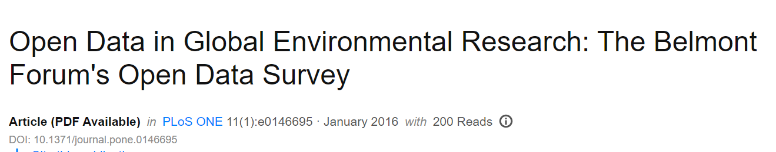
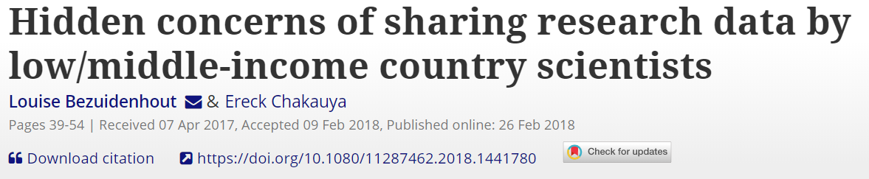
Who is Asking
(1) Research Networks / Academics
Notes:
Some examples

Slide 38

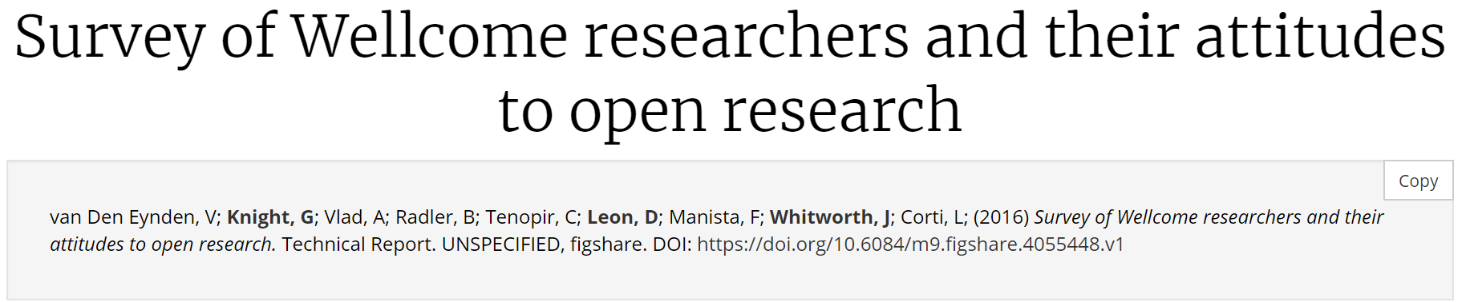
2) Research Funders
Notes:
https://dg.dk/wp-content/uploads/2017/11/Open-Access-to-Data-%E2%80%93-It%E2%80%99s-not-that-Simple.compressed.pdf

Slide 39


3) National Surveys
DOI: 10.5281/zenodo.34005

Slide 40

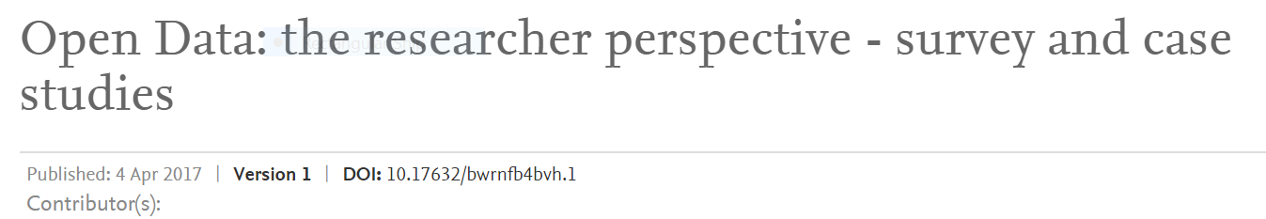
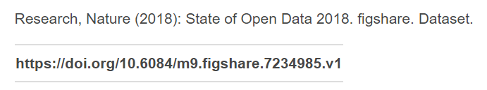
4) Academic Publishers

Slide 41
Why are they asking?
Several motivations:
Benchmark current state & monitor changes over time
Design new support services
Promote dialogue / inform stakeholder engagement
…. and there is the potential for policy analysis: using surveys to explain why changes are / are not occurring

Slide 42

Where are the Answers Coming From?
Brief overview of 10 global surveys
High-level geographical distribution
Illustrative heatmaps

Slide 43
Survey sponsor [data set citation] | Title | Topics of focus | Survey year | Publication year | # invitations | # responses | # questions
Belmont Forum [Schmidt et al 2015] | The Belmont Forum’s Open Data Survey | Identify key open data activities, best practices from a user perspective, barriers and incentives for data sharing | 2014 | 2015 | ~29,000 | 1330ª | 19
CWTS & Elsevier [Berghmans et al. 2017] | Open Data: The Researcher Perspective | Attitudes and behavior of researchers with regard to sharing their research data and using open data in their own research | 2016 | 2017 | 50,521^{b} | 1162 | 41
SpringerNature, FigShare & Digital Science [Nature Research 2016] | Open Data survey | Researcher attitudes and experiences in working with open data | 2016 | 2016 | NA | 2061 | 58
FigShare, SpringerNature, Wiley & Digital Science [Nature Research et al 2017] | State of Open Data survey 2017 | Changes over time researcher attitudes and experience working with open data | 2017 | 2017 | NA | 2351 | 95
FigShare, SpringerNature, Wiley, & Digital Science [Nature Research 2018] | State of Open Data survey 2018 | Changes over time researcher attitudes and experience working with open data | 2018 | 2018 | NA | 1872 | 56
SpringerNature [Astell et al 2018] | Practical Challenges for Researchers in Data Sharing | Data sharing challenges during publishing and recommendations for support | 2017 | 2018 | ~249,000 | 7718 | 18
Academic / Independent [Tenopir et al 2015a] | Changes in Data Sharing and Data Reuse Practices and Perceptions among Scientists Worldwide | Data sharing and reuse perceptions and practices among researchers | 2009/2010 and 2013/ 2014 | 2015 | NA | 1329 (2009/2010) 1015 (2013/2014) | 76
Wiley [Wiley 2016] | Wiley Data Sharing Survey | Understand how and why researchers make their research data publicly available | 2014 | 2016 | ~50,000 | 2558 | 22
Wiley [Wiley 2017] | Wiley Open Science Researcher Survey 2016 | Understand how and why researchers make their research data publicly available | 2016 | 2017 | ~55,000 | 4668 | 34

Slide 44
Continental Distribution of Survey Responses to 10 Global Surveys (N=24,652 )

Slide 45
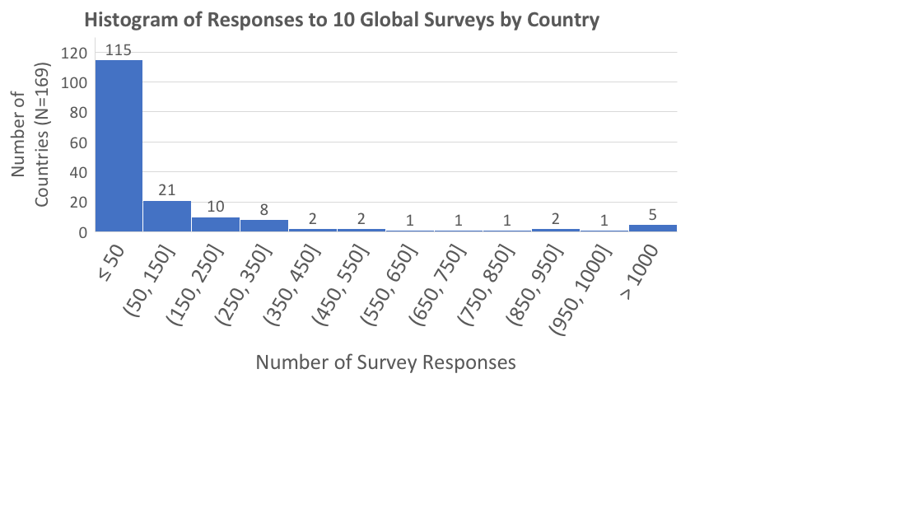

Slide 51
Concluding Observations
Last 5 years - significant investment to understand important actors in research data management and sharing
Yet…
Difficult to compare findings across surveys
Not using standardized questions (respondents / key outcomes)
Opportunity to design surveys to explain why some disciplines / countries share more than others

Slide 52
Surveying Open Data Practices
Perspectives from Africa
Louise Bezuidenhout

Slide 53
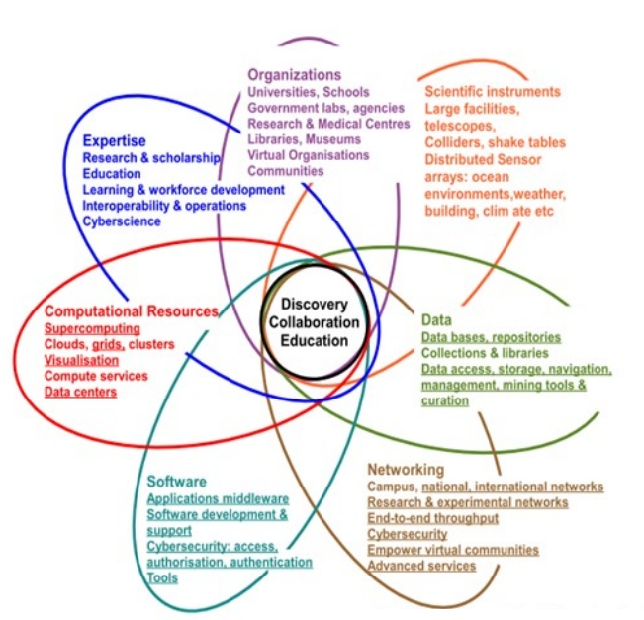


Exciting New Activities
https://www.slideshare.net/AfricanOpenSciencePl/developments-in-connected-regional-sadc-cyberinfrastructure-to-support-data-sharing-open-sciencetshiamo-motshegwa-81412672
Notes:
SADC e-Infrastructure Strategy - In support of SADC Strategic Plan on STI
R&D, Innovation, Industrialisation pillar of Digital SADC 2027 initiative

Slide 54






Research Data Initiatives (66+)
E.g. CIRAD, FAOSTAT, KAiNeT, RCMRD, CSIRSpace
E.g. AfReMaS, IODE, ODINAFRICA, SAIAB
E.g. GBIF,ReBioMa, ICRAF, CERSGIS, CGIAR, GLOSS, MASDAP, SERVIR, AMMA-CATCH, SASSCAL
E.g. H3Africa, AHRI, APHRC, GHDx, MalariaGEN
E.g. CGKP, SAEON, RESILIENCE ATLAS, WASCAL
E.g. OHADA, DICAMES
Notes:
Research more digital and data-driven
66+ data-intensive initiatives were identified by the landscape study, and mapped against the SDGs – not necessarily ‘registered’

Slide 55
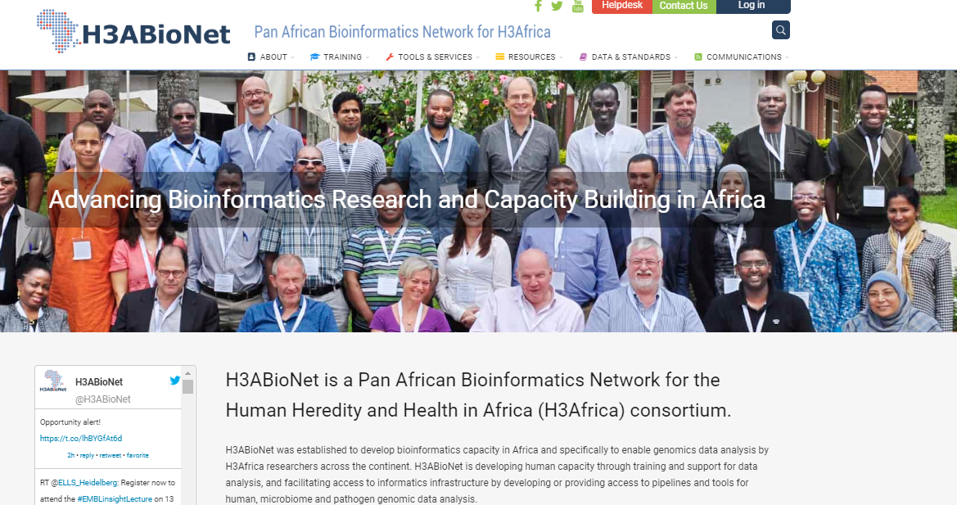
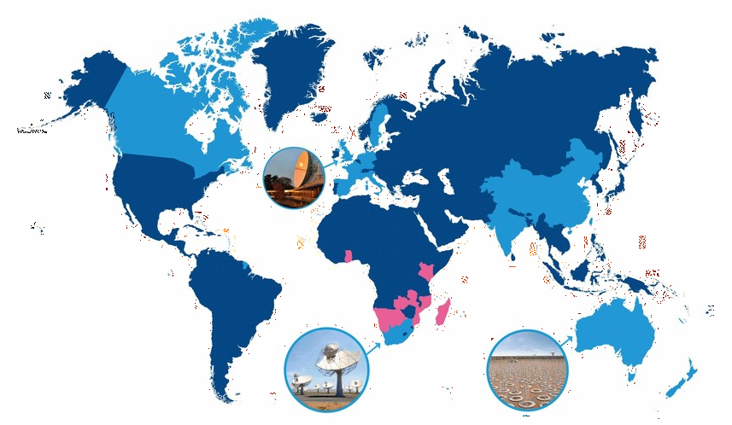

Research Networks
SKA

Slide 56
200 OA DOAJ-listed journals
174 IRs registered on OpenDOAR
34 OA policies on ROARMAP
24 data repositories registered on re3data, while study identified 66+
1 data repository assigned CoreTrustSeal
OS Activities/Initiatives
Notes:
‘Registered initiatives’ …..
200 OA DOAJ-listed journals
174 IRs registered on OpenDOAR
34 OA policies on ROARMAP
24 data repositories registered on re3data, while study identified 66+
1 data repository assigned CoreTrustSeal

Slide 57
Persistent Challenges
Low levels of organisation and funding of many science systems in Africa (UNECA 2018 Sustainable Development Report)
ICT infrastructure challenges
  Power outages
  Cloud services require expensive high-speed internet/broadband
  Outdated computers and software
  Poor use, support and funding for NRENs
Notes:
Open Science/Open Data underpinned as part of Research/Science
Therefore necessary to understand commitment of African countries to invest in science and readiness for open science/open data
Kenya & SA closest to AUs target of investing 1% of annual GDP in R&D (Kenya & SA invest 0.8%)
R&D expenditure of 24 African countries unknown

Slide 58
Persistent Challenges (2)
Data management and curation
  Only one trusted registered data repository on continent (CoreTrustSeal)
  Lack of centralised, secure data storage
  Data repositories not registered with Registry of Research Data Repositories (re3data.org)
  Data management plans not the norm, due to lack of policies/funder requirements
Low awareness/use of FOSS

Slide 59
Persistent Challenges (3)
Research cultures
  Publication-focused institutional metrics, funding systems and promotion
  Researchers want to exhaust publication possibilities before sharing data
  Lack of trust in data re-use (parachute research, scooping etc)
  Lack of support for APCs
  Lack of infrastructures to support collaboration and data sharing
  Absent, incomplete, inconsistent legislation

Slide 60
Transforming Good Will into Practice
Evident good will regarding Open Data
Transition to practice hampered by financial, regulatory and social issues
Additional challenges:
  Lack of comprehensive overview of research activities and institutions
  Lack of data on daily challenges (infrastructure etc)
  Concerns of African scientists not well understood
  Current OD infrastructure and practices designed for Global North

Slide 61
Getting to the Necessary Data
Focus beyond prominent research networks
Need to engage in qual/quant data gathering about situational challenges and concerns
Funders and governments need to be transparent about plans to address value/action gap
Need socio-economic data about research system futures
Gathering data without:
  Raising concerns about punitive action
  Reinforcing power inequalities
  Imposing values/priorities

Slide 62
Getting Data to Guide Action
Policy review and current mandated requirements
Perceptions and concerns
Daily challenges and other barriers
Need to be able to characterise challenges on national and continent-wide levels
Need to construct surveys that are comparable while taking into account specificities of African research context

Slide 63


Thank you!
Thanks to Ina Smith from the African Open Science Platform
Please feel free to contact me at louise.Bezuidenhout@insis.ox.ac.uk

Slide 64
Next

Slide 65
Next steps
Further work on tool
Further work on users perspective
Reach out to Funders IG
Further work on survey modules/questions
Further work on analysis of results

Slide 66
Thank you for your attention !
For questions, mail me … i.meijer@cwts.leidenuniv.nl
On behalf of the RDA IG for Surveying Open Data Practices.

