Slide 1
RDA FAIR Data Maturity Model
10 of June 2021
HealthyCloud FAIR method models meeting
Edit Herczog Co-chair of the RDA FAIR DMM WG

Slide 2
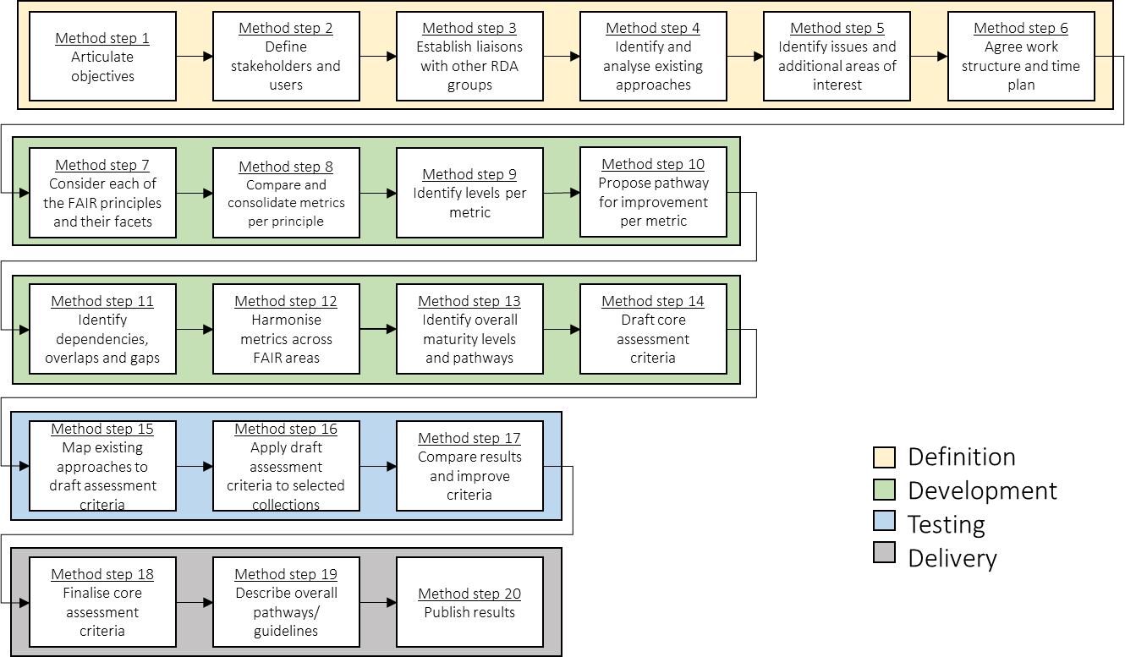
Overview of the methodology

Slide 3
Definiton

Slide 4
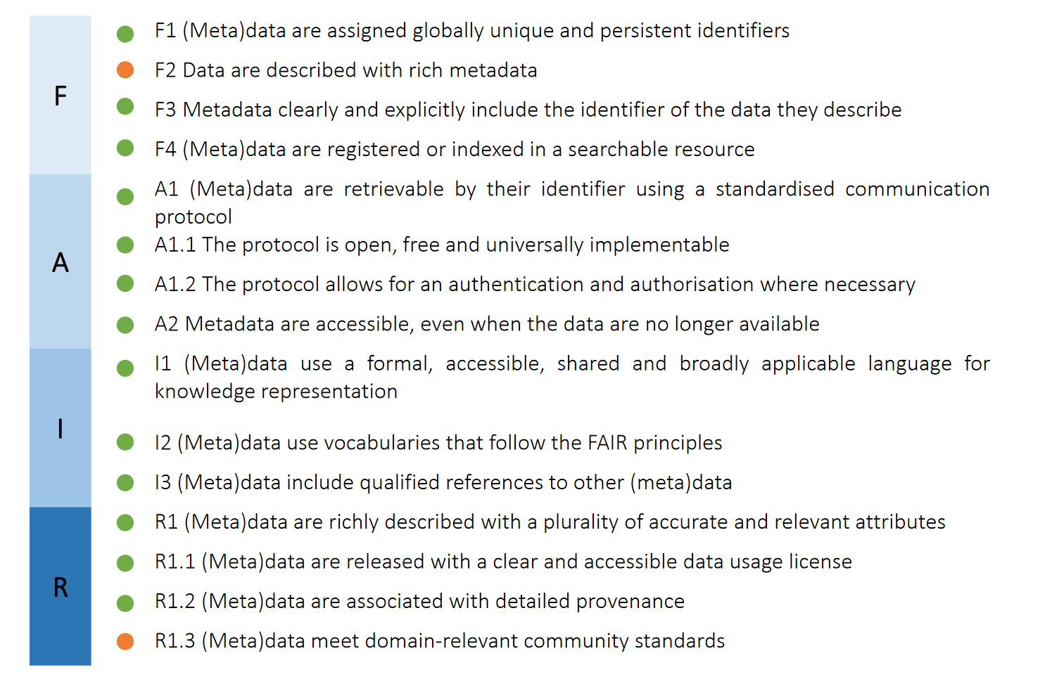
FAIR CRITERIA-s derived from the FAIR Principles
*The FDMM WG used the principles as they were agreed by the Open Science HLGR in 2017
Agreed and applicable definition
Agreed and applicable definition in the domain only

Slide 5
Development

Slide 6
The RDA FAIR DMM community approved it
Distribution of the weight of the indicators
Mandatory
Recommended
Optional
FAIR PRINCIPLES
FINDABLE
ACCESSIBLE
INTEROPERABLE
REUSABLE

Slide 7
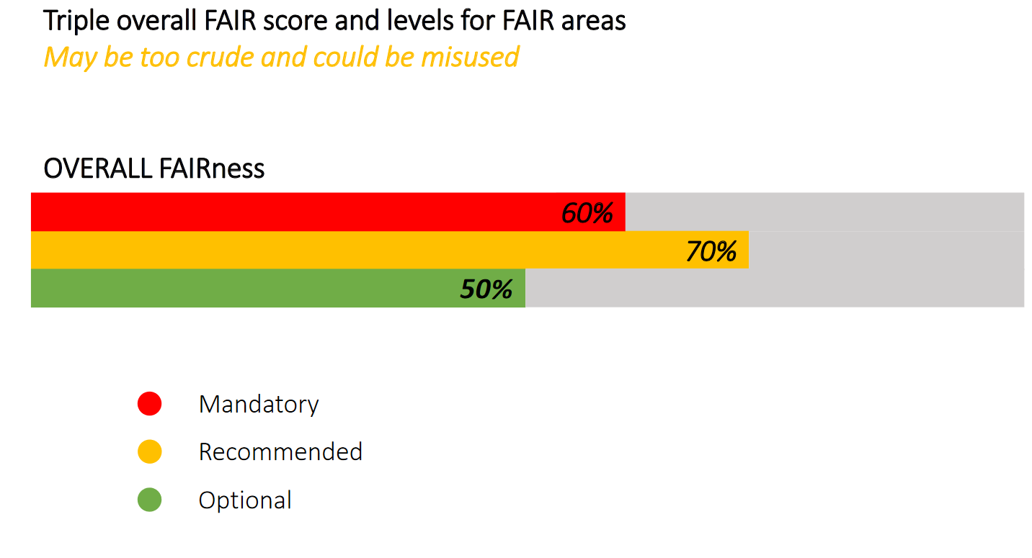

Slide 8
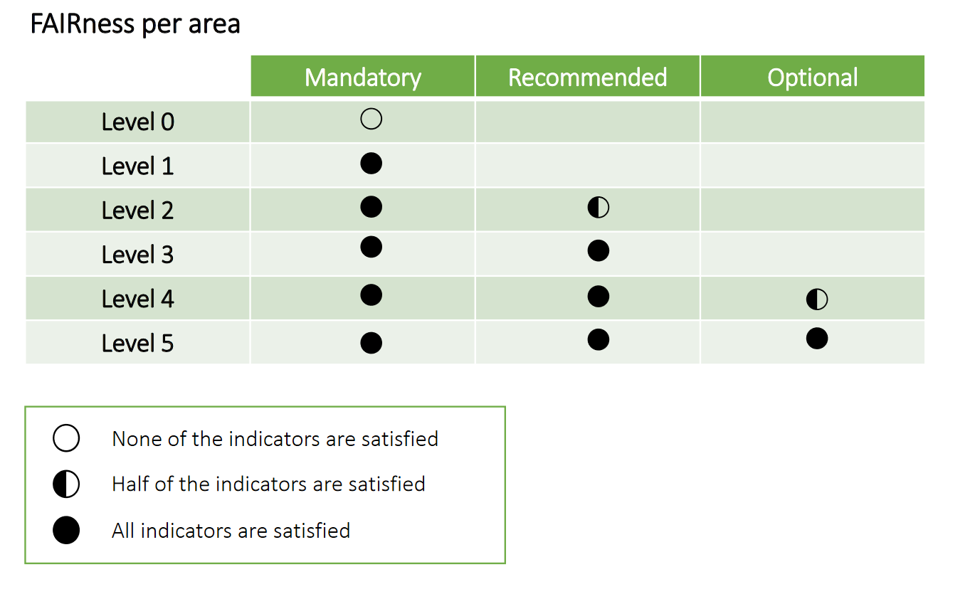
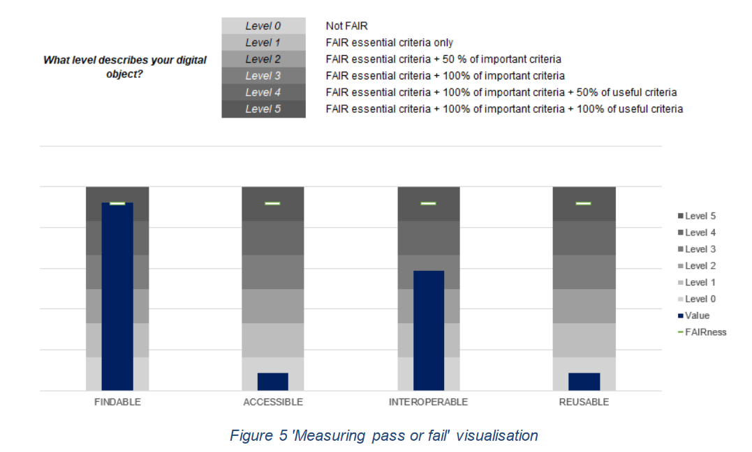
Measuring: pass or fail

Slide 9
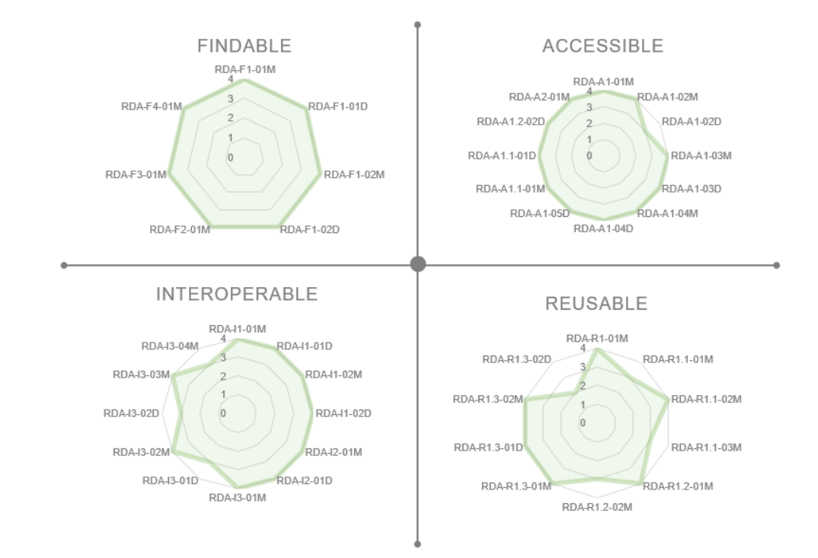
Measuring progress

Slide 10
Testing

Slide 11
Indicators | Development of final indicators
Unless otherwise agreed, the proposed changes – derived from the testing phase – will be put into action
drop indicator
5
new indicator
1
amendments
43 indicators*
combining indicators
2
rephrasing indicator
4
* after revision, the final list of indicators will be composed of 43 indicators

Slide 12
Indicators | amendements – 1
If there are no objections, the proposed changes – derived from the testing phase – will be put into action
[A1.1-02M+D] indicator tests for open-source protocol, which is not mentioned in FAIR principle A1.1.
[I2-01M+D] indicator tests for use of standard vocabularies, but principle I2 only refers to FAIR vocabularies and says nothing about ‘standard’
drop indicator
[R1.1-03M] indicator tests that licence information is in the ‘right’ element, but this is basically a quality aspect; we don’t test this for other metadata requirements either
out of scope
[R1.1-05M] indicator tests information on consent for personal data; this is not mentioned in principle R1.1 which is about licensing.
[I1-03M+D] Principle I1 does not mention 'self-describing'. Furthermore, it has been noted that the term itself is not entirely clear and could be seen to be very close to the representation being machine-understandable.

Slide 13
Indicators | amendements – 2
Unless otherwise agreed, the proposed changes – derived from the testing phase – will be put into action
[A1-0xM] new indicator alongside A1-01D for manual access to metadata; it was pointed out that there is no indicator for manual access to metadata while there is an indicator for manual access to data (A1-01D Data can be accessed manually (i.e. with human intervention))
new indicator

Slide 14
Indicators | amendements – 3
Unless otherwise agreed, the proposed changes – derived from the testing phase – will be put into action
[A1-01M] merge closely related indicators A1-01M, A1.1-03D and A1.2-01M into A1-01M with definition “Metadata contains information to enable the user to get access to the data”; in guidelines include that this can be information about access control, e.g. need to register or provide username/password.
combining indicators
[A1.2-01D, A1.2-02D] Merge these two: having separate indicators for authentication and authorisation puts undue emphasis on these aspects; they will always be evaluated together.

Slide 15
Indicators | amendements – 4
Unless otherwise agreed, the proposed changes – derived from the testing phase – will be put into action [end of April]
[R1-01M] align with wording of principle R1; not ‘sufficient metadata’ but ‘plurality of accurate and relevant attributes’.
[F2-01M] delete the mention of standard in indicator for F2 – the standard aspect is covered in R1.3 – the indicators in F2 and R1 will just focus on the amount of metadata, and R1.3 will test that metadata is standard.
rephrase indicator
[F1-02M+D] use ‘globally unique’ instead of ‘universally unique’ – to align with the principle and because it might be confusing as UUID has a very specific meaning.
[I3-02D, I3-03M, I3-04M] drop ‘sufficiently’ qualified – that’s not in the principle, only ‘qualified’

Slide 16
Testing phase | Overview & results
TO BE UPDATED
Results
13 testers
9 tests results
1 dataset
Various range of disciplines and entities
Different approaches to the scoring
Proposed resolutions & integration of the feedback in the FAIR data maturity model
Planning
Pilot testing
Full roll-out
1st and 2nd level of testing
December 2019 until March 2020
Analysis
Comments on indicators
General issues
Specific issues
Information needs

Slide 17
Testing phase |Overview
Thanks to all testers for their contribution
13 volunteers having different affiliations
Various range of disciplines and entities
Different approaches to the scoring
Discipline / Domain
Affiliation / Tool
Tester
Entity
1
Earth Science
NCEI of NOAA
Ge Peng
Dataset
2
Engineering & Technical sciences
4TU.ResearchData
Egbert Gramsbergen, Paula Martinez-Lavanchy, Madeleine de Smaele, Marta Teperek
Dataset
3
Humanities, Spatial, Health, etc.
FAIRsFAIR
Anusuriya Devaraju
Methodology
4
Human-Environment Observatories (OHMs)
DRIIHM infrastructure
Romain David & Emilie Lerigoleur
Methodology
5
Biology
ODAM information system
Romain David & Daniel Jacob
Dataset
6
Agronomic & Biomedical
Agroportal
Romain David, Clément Jonquet & Emma Amdouni
Ontology
7
ALL disciplines / domains
ARDC FAIR self-assessment tool
Kerry Levett & Nichola Burton
Methodology
8
Humanities & Social Sciences
DRI
Kathryn Cassidy & Natalie Harrower
Dataset
9
Astronomy
CDS
Françoise Genova
Dataset
Notes:
Entity: comparison against datasets, methodologies and ontologies.
Type of evaluation: manually
Compliance to the indicators: 5-level scale // Yes&No evaluation
Scoring: average of the 5 levels for each of the FAIR aspects (F,A,I and R) // aggregation per FAIR aspect and priority

Slide 18
Testing insights |Feedback
Comments on indicators
General issues
Specific issues
Information needs
There are (too) many indicators. However, others note that this level of granularity is useful, so you need to think about all the aspects
Testing the indicators provided suggestions for improving existing evaluation approaches or existing standards
Issue about distinguishing indicators for metadata separate from data, which does not work for resources with embedded metadata
Overlap between indicators (e.g. across principles F1/A1 and F2/R1) which is the result of FAIR principles not being entirely independent
Some indicators are conditional, e.g. the ones on authentication, authorisation, references and consent – if not applicable, they should not ‘count’
Several indicators require compliance with community standards, but the question is who defines them?
If data is an ontology, different set of indicators or different priorities may be needed
One tester proposes to do away with all priorities entirely

Slide 19
Testing insights |Feedback
Comments on indicators
General issues
Specific issues
Information needs
FAIR principles are aspirational and ambitious, aiming at full machine-understandability, but current practices are not well aligned at this point in time
Identification is a major issue: there are various comments, some favour identification of metadata over identification of data, others data over metadata, others see both as equally essential, but there is also a comment that having identifiers for both is not common practice
There seems to be a role for landing pages and other human-readable documentation in providing information, in addition to structured metadata
Requests for adding maturity levels > scoring
Data comes in different granularities: whole dataset or part of dataset or individual data items (e.g. observations, concepts)
Different perspectives on metadata and how it relates to data:
repository level / collection level / dataset / data item level metadata
separate metadata records or embedded metadata

Slide 20
Testing insights |Feedback
Comments on indicators
General issues
Specific issues
Information needs
There may be a need to ‘profile’ indicators for specific cases, i.e. selecting a subset of indicators, adapting priorities, following discipline-specific guidelines
Noteworthy that testers are often stricter than the priorities that the WG has defined, e.g. making essential:
machine-understandable community standards
standard, open-source protocols
machine-understandable knowledge representation
standard vocabularies
standard reuse licences

Slide 21
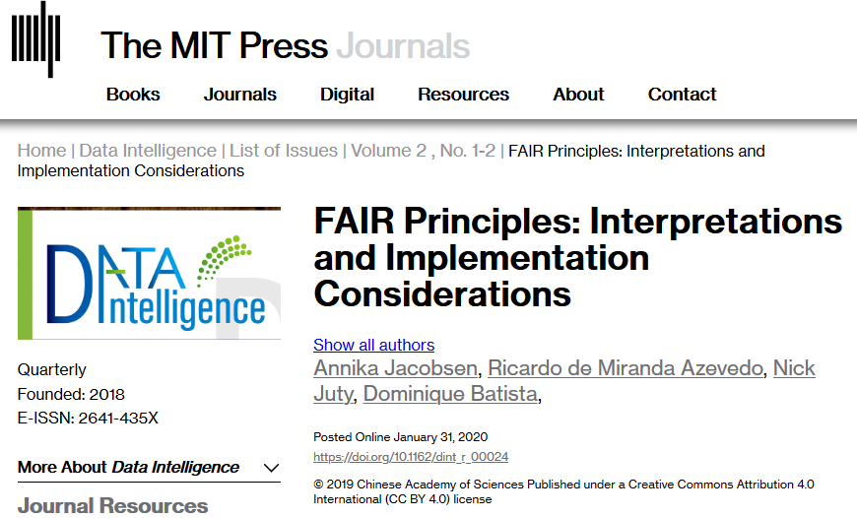
Testing insights |Feedback
Comments on indicators
General issues
Specific issues
Information needs
Need for better explanation of terms, in particular ones that are vague or subjective, e.g. ‘sufficient’
Need for better definition of terms used in FAIR principles, e.g. knowledge representation, FAIR-compliant vocabularies – to take into account https://doi.org/10.1162/dint_r_00024
Need for information on best practices that may be applied to increase FAIRness, e.g. identification, protocols, licences
These issues to be addressed in the Guidelines, using suggestions and examples provide by testers

Slide 22
Az RDA FDMM WG output

Slide 23
FAIR DMM WG turned to a maintenance WG status

Slide 24
Maintenance and governance
2020
2021
2022
Preparation for the maintenance
Maintenance and preparation for the 1st revision
1st revision of the model
Identify topics that need clarification and consensus
Address the governance and maintenance practical aspects
Develop the topics identified and propose consensus-driven solutions to optimize the model and move away from a fit-for-all to a tailored solution
Put into motion the necessary changes identified

Slide 25
Be the next to test and use the FDMM for
Self assessment
Help your choice of partner to work with
To be interoperable within and across domains by choice
FDMM needs to remain universal and global

Slide 26
Thank you!

