Slide 1
Wagging the Long Tail
Current Metadata Practices for Long Tail Research Data
Kathleen Shearer, Executive Director, COAR
Co-chair, RDA Long Tail for Research Data Interest Group
Co-chair, RDA Libraries for Research Data Interest Group

Slide 2
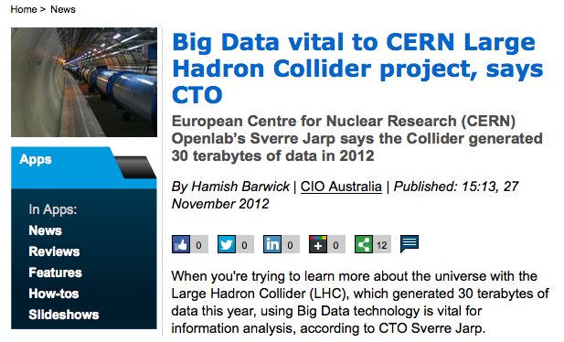
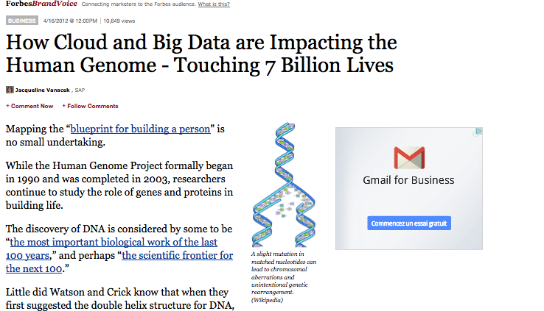
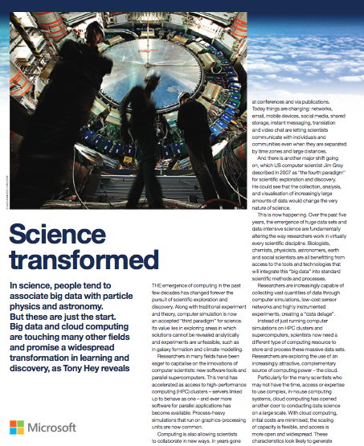
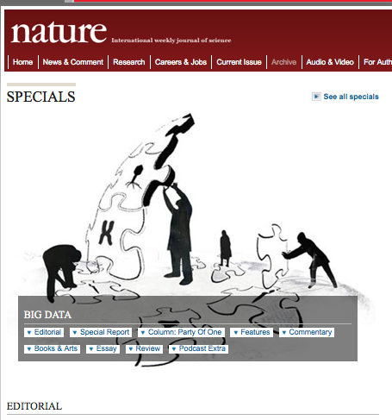
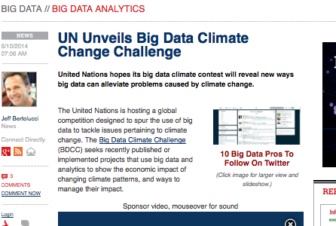
“Big data” is all the rage!
Notes:
Jim Grey’s so called “fourth paradigm” of science that talks about the scientific breakthroughs will be powered by advanced computing capabilities that help researchers manipulate and explore massive datasets.

Slide 3
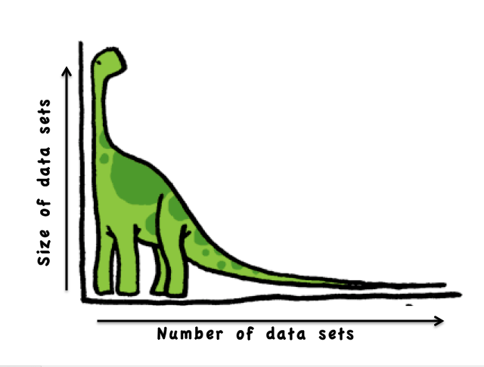
Long Tail of Research Data
But, the vast majority of data sets created through research fall into the “Long Tail”

Slide 4
The Long Tail
Head | Tail
Homogeneous | Heterogeneous
Interoperable, integrated | Non interoperable
Large | Small
Common standards | Unique standards
Central curation | Individual curation
Disciplinary repositories | Institutional, discipline, or most often, no repositories
Adapted from: Shedding Light on the Dark Data in the Long Tail of Science by P. Bryan Heidorn. 2008

Slide 5
The Long Tail
A review undertaken by Cornell University of over 200 data “packages” (files related to arXiv papers) deposited into the Cornell Data Conservancy with there were 42 different file extensions for 1837 files across six disciplines. http://blogs.cornell.edu/dsps/2013/06/14/arxiv-data-conservancy-pilot/
The Dryad Repository, which is a curated, general-purpose repository that collects and provides access to data underlying scientific publications reports a huge diversity of formats including excel, CVS, images, video, audio, html, xml, as well as “many uncommon and annoying formats”. The average size of the data package which they collect is ~50 MB. http://wiki.datadryad.org/wg/dryad/images/b/b7/2013MayVision.pdf
According to the European Commission (EC) document, Research Data e-Infrastructures: Framework for Action in H2020, “diversity is likely to remain a dominant feature of research data – diversity of formats, types, vocabularies, and computational requirements – but also of the people and communities that generate and use the data.” http://cordis.europa.eu/fp7/ict/e-infrastructure/docs/framework-for-action-in-h2020_en.pdf

Slide 6
The role of metadata
Metadata remains the glue that holds information systems together. The better you manage your metadata, the better you serve your users. (Information Management, 2013)
Metadata quality is a vital factor for electronic interoperability. (Rousidis, et al. 2014)
Good quality, accurate and current metadata renders the research data more useful and accessible over the longer term. (Australian National Data Service)

Slide 7
In the context of Long Tail data, metadata is critical for discovery

Slide 8
Survey of Discovery Metadata in Research Data in Repositories (Shearer, 2014)
Thanks to the following people for their input:
Chuck Humphrey
Stephen Marks
Najla Rettberg
Jochen Schirrwaggen
Birgit Schmidt

Slide 9
Survey of Current Practices for Discovery Metadata
Purpose: to better understand the current practices in terms of discovery metadata
Respondents: any repository collecting long tail data
Undertaken from February 15 to March 7, 2014
Recruited respondents via RDA mailing list and other research data list serves
Over 60 responses, but only 30 full responses
OBVIOUSLY not a representative sample, but an indication of which way the wind is blowing

Slide 10
Location of repository

Slide 11
Repository Platforms
What repository platform are you using?
DSpace (9) Fedora (3) EPrints (2) Islandora (2) Locally developed (2) Dataverse Fez software (open source) | Greenstone Digital Library Invenio Metacat Omeka Postgres RedBox and Mint VIVO

Slide 12
What are the descriptive metadata standards used?
Repositories using a single schema Dublin Core (9) DataCite (3) DDI Study-level metadata cf supra. ISO19115 (Geographic Information Metadata) MARC21 MODS metadata RIF-CS | Repositories using more than one schema DataCite and Dublin Core (3) Dublin Core, Darwin Core, Prism Dublin Core, EDM, ESE, QDC Dublin Core, MARC21 dc, dcterms, geo/wgs84, FOAF, own extension ontology MODS & DataCite Metadata Schema Organic.Edunet IEEE LOM

Slide 13
In your opinion, is the metadata used in the repository sufficient to ensure discoverability of the datasets?

Slide 14
In your opinion, is the metadata used in the repository sufficient to ensure discoverability of the datasets?
Yes…
The few datasets that we have appear to be easily discoverable in Google.
Compliance with OAI-PMH ensures discoverability; also integration into library search schemes.
By requiring that data to be associated with related publications, this enriches the metadata.
We aim to index metadata to aid discovery only. Metadata required to explore / reuse data will be stored with the data as a (non-indexed) object or stored in a separate, searchable database which links to the individual data objects in the repository (which may be at a sub-collection level). Data will also be found as the DOI will be included in publications related to the dataset.

Slide 15
In your opinion, is the metadata used in the repository sufficient to ensure discoverability of the datasets?
Yes, but…
Broadly speaking, and at a very high level, yes. If someone is looking for the data that supports a specific study, it is likely they will find it. However, if someone is looking for data with specific collection characteristics or other particularities then the metadata requires further enhancement.
Data are discoverable within the repository because of limited repository scale, but once harvested and made available to search alongside tens of thousands of other datasets, the metadata are insufficient
Precision is low because natural language metadata queries tend to entrain marginally relevant data sets due to weak associations in project descriptions and other broad fields.
Fine for basic discoverability - richer discipline metadata would be nice but probably not feasible at this point

Slide 16
Our conclusion: current metadata practices are sufficient for local discovery, however not for discovery through federated or external search services.
Yet, we know that most people use external services, such as Google as their main discovery tools.

Slide 17
Some concluding comments
Include DOIs and link to publications. This helps enrich existing metadata
Ensure “long tail” repository platforms can incorporate different disciplinary schemas
Splash or landing pages that describe datasets are very valuable for discovery - maybe data management plans could (eventually) be used for this?
Working with researchers at the time of data production helps to improve the quality of metadata
It will probably always be difficult to find the balance between lowering the barrier for deposit and capturing rich metadata

Slide 18
Thanks. Questions?
Kathleen Shearer
Executive Director, COAR
kathleen.shearer@coar-repositories.org
www.coar-repositories.org

