Slide 1
Data Typing BoF
RDA Plenary 7
Tokyo: March 2016
Larry Lannom
CNRI

Slide 2
Agenda: 14:30 - 16:00
14:30 - 14:45
  Introductions, Agenda Bashing
14:45 - 15:00
  Brief review of basic issues
  Results of DTR WG, RDA Recommendation
15:00 – 15:15
  Case Statement for Data Typing WG
15:15 – 15:30
  USGIN Data Type Model – Steve Richard
15:30 – 15:45
  Additional use cases, prototypes and related efforts
15:45 – 16:00
  Discussion, next steps

Slide 3
Problem: Implicit Assumptions in Data
Data sharing requires that data can be parsed, understood, and reused by people and applications other than those that created the data
How do we do this now?
  For documents – formats are enough, e.g., PDF, and then the document explains itself to humans
  This doesn’t work well with data – numbers are not self-explanatory
    What does the number 7 mean in cell B27?
Data producers may not have explicitly specified certain details in the data: measurement units, coordinate systems, variable names, etc.
Need a way to precisely characterize those assumptions such that they can be identified by humans and machines that were not closely involved in its creation

Slide 4
Goal of the DTR Effort: Explicate and Share Assumptions using Types and Type Registries
Evaluate and identify a few assumptions in data that can be codified and shared in order to…
Produce a functioning Registry system that can easily be evaluated by organizations before adoption
  Highly configurable for changing scope of captured and shared assumptions depending on the domain or organization
  Supports several Type record dissemination variations
Design for allowing federation between multiple Registry instances
The emphasis was not on
  Identifying every possible assumption and data characteristic applicable for all domains
  Technology

Slide 5
What is a Data Type?
A unique and resolvable identifier
  Which resolves to characterization of structures, conventions, semantics, and representations of data
  Serves as a shortcut for humans and machines to understand and process data
File formats and mime types have solved the ‘representation’ problem at a ‘unit’ level
Examples of problems we aim to solve with data types:
  It is a number in cell A3, but is it temperature? If so, in Celsius?
  It is a dataset consisting of location, temperature, and time, but what variable names should I look for?
  Is it all packaged as CSV or NetCDF? And as a single unit or a collection of units?
Type record structure will continue to evolve – not finished, but functioning

Slide 6
What is a Data Type Registry?
A low-level infrastructure with wide applicability to record and disseminate type records
  Not an immediate ROI application
Assigns unique and resolvable identifiers to type records
Enforces and validates common data model & expression for interoperation between multiple instances of Registries
API for machine consumption
UI for human use

Slide 7




Process Use Case
3
Users
2
Federated Set of Type Registries
1
4
ID
ID
ID
ID
4
Terms:…
Type
ID
Type
ID
I Agree
Type
Type
10100
11010
101….
Visualization
Payload
Payload
Type
Type
Payload
Payload
Rights
Payload
Payload
Data Set
Dissemination
Data Processing
Typed Data
Services
1
Client (process or people) encounters unknown data type.
2
Resolved to Type Registry.
3
Response includes type definitions, relationships, properties, and possibly service pointers. Response can be
used locally for processing, or, optionally
4
typed data or reference to typed data can be sent to service provider.

Slide 8
Discovery Use Case
2
Users
1
Federated Set of Type Registries
3
4
ID
ID
ID
ID
Type
ID
Type
ID
Type
Type
Payload
Payload
Type
Type
Payload
Payload
Payload
Payload
Repositories and Metadata Registries
1
Clients (process or people) look for types that match their criteria for data. For example, clients may look for types that match certain criteria, e.g., combine location, temperature, and date-time stamp.
2
Type Registry returns matching types.
3
Clients look up in repositories and metadata registries for data sets matching those types.
4
Appropriate typed data is returned.

Slide 9
Current State
A prototype is at: http://typeregistry.org/
Multiple adoption/evaluation projects in process
  Demos at multiple RDA plenaries
  DOI, Materials Science, DCO, EUDAT, more coming
Follow-on Data Typing WG being proposed
  BOF at P6 & now P7 (with Case Statement)
  Policies
  Federation
Notes:
http://38.100.130.12/DOIProxyHelper/index.html
http://hecot1.doregistry.org:8081/registrar/

Slide 10
What Did the DTR WG Accomplish?
Confirmation that detailed and precise data typing is a key consideration in data sharing and reuse and that a federated registry system for such types is highly desirable and needs to accommodate each community’s own requirements
Deployment of a prototype registry implementing one potential data model, against which various use cases can be tested
Involvement of multiple ongoing scientific data management efforts, across a variety of domains, in actively planning for and testing the use of data types and associated registries in their data management efforts
Integration with one additional RDA WG (Persistent Identifier Types) and at least one Interest Group (RDA/CODATA Materials Data, Infrastructure & Interoperability IG)
Development of a set of questions that require further consideration before a detailed recommendation on data typing can be issued
Notes:
http://38.100.130.12/DOIProxyHelper/index.html
http://hecot1.doregistry.org:8081/registrar/

Slide 11
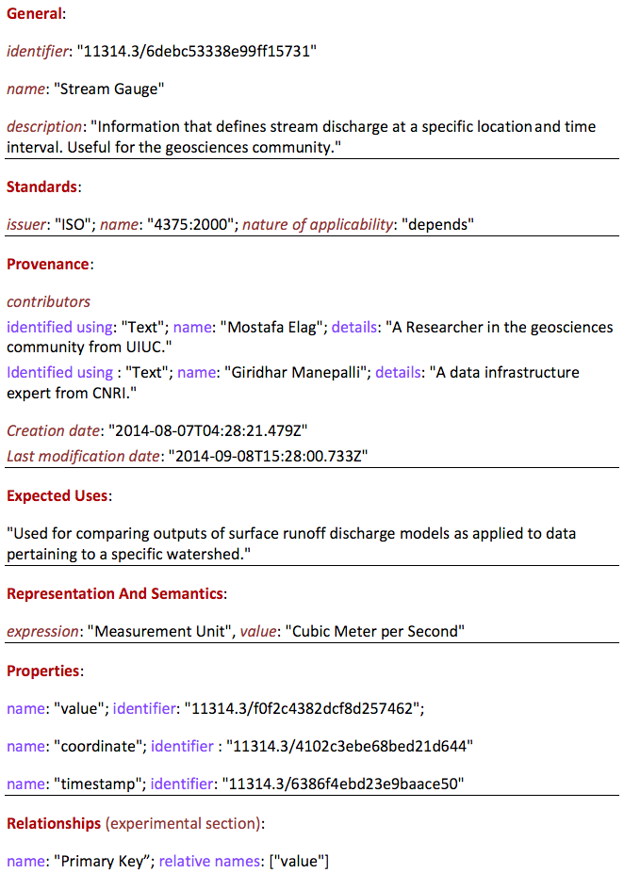
Data Type Example

Slide 12
Data Typing Working Group (DTWG)
Draft case statement sent to DTR list
  Will be submitted after P7, baring objection from this group
Proposed Co-chairs: Cox, Weigel, Lannom
Basic Workplan
  Find are common themes and analyses that data producers follow in general to produce data type records regardless of the standard they choose for representing this information.
  Identify what information should be provided to enable third parties to easily interpret their datasets. We call such guidelines “recipes”
  A core piece of a recipe is the assignment of a unique and ideally persistent identifier to a data type record. Such an identifier, aka a Data Type ID, will act as a reliable link or shortcut to associate datasets with their respective types.

Slide 13
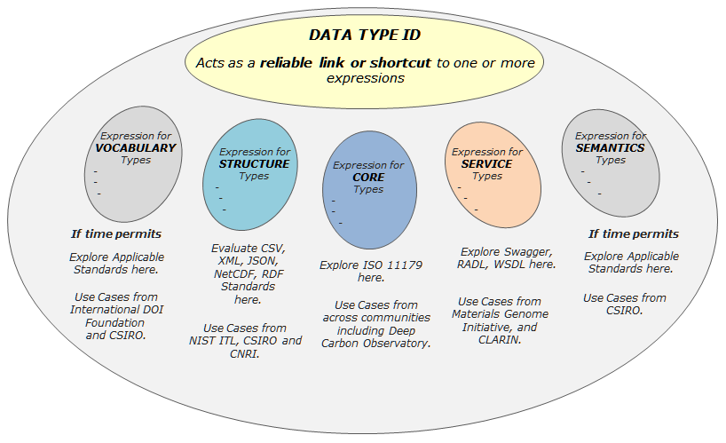
Scope, Communities, Use Cases

Slide 14
Timeframe, Deliverables, Participants
Timeframe
  18 months with a start date coinciding with WG approval.
Deliverables
  Recipes for typing data for select use cases: types for defining structure, vocabulary, and types for linking to Internet services.
    Such recipes may include the notion of primitive data types and complex data types for purposes of reusing and evolving existing data types.
  Governance policies for cross-community federation.
Select List of Institutions Participating Institutional Members
  NIST Information Technology Laboratory
  CLARIN Project Representatives
  Deep Carbon Observatory Representatives
  Materials Genome Initiative members
  Woods Hole Oceanographic Institute
  International DOI Foundation
  CSIRO Australia
  ePIC Persistent Identifier Consortium

Slide 15
  Additional use cases, prototypes and related efforts
ISGIN – Steve Richard
OKFN Data Packaging approach – Simon Cox
ePIC and PID Types – Ulrich Schwardmann

Slide 16
Next Steps
Discussion of draft Case Statement
  A few edits resulted from list discussion
  Any objections?
Submission to RDA
  Public Comment Period
  Review (TAB, OA, Council)
Approval (we hope)
Routine calls as needed
  Updates from related projects?

Slide 17
Earlier Adoptions
DCO
Materials

Slide 18





DTR in Deep Carbon Science
Stephan Zednik, Xiaogang Ma, John S. Erickson,
Patrick West, Peter Fox,
& the DCO-Data Science Team
Tetherless World Constellation
Rensselaer Polytechnic Institute
*Funded by RDA/US (NSF)
Notes:
The Deep Carbon Observatory (DCO) community is building a cyber-enabled platform for linked science, made available to the community by a multi-institutional data portal. Persistent identifiers and domain specific data types have been identified as key technological issues the portal must address. This presentation focuses on the DCO portal’s planned adoption of RDA DTR and PID methodologies and technologies as a means to address the DCO community's need for persistently identifiable and understandable data type information.

Slide 19
Outline
Background
  RDA-DTR, RDA-PIT, DCO Data Portal
  DCO research requirements
Approaches
  Integration architecture vs. self-contained architecture
  Linked Data
Nature of efforts
  Basic data type and Specific data type
  Implementation
Results and conclusions
19

Slide 20



Background
RDA - Data Type Registry (DTR) working group
  Addressed a core issue of data interoperability: to parse, understand, and reuse data retrieved from others
RDA - Persistent Identifier Information Types (PIT) working group
  Addressed the essential types of information associated with persistent identifiers (PID)
Deep Carbon Observatory (DCO) Data Portal
  Centrally-managed digital object identification, object registration, metadata management and knowledge graph curation.
  http://deepcarbon.net
20
Notes:
DCO anticipated a large number of digital object registrations, and therefore needed an appropriate mechanism to curate and reuse the registered information.

Slide 21
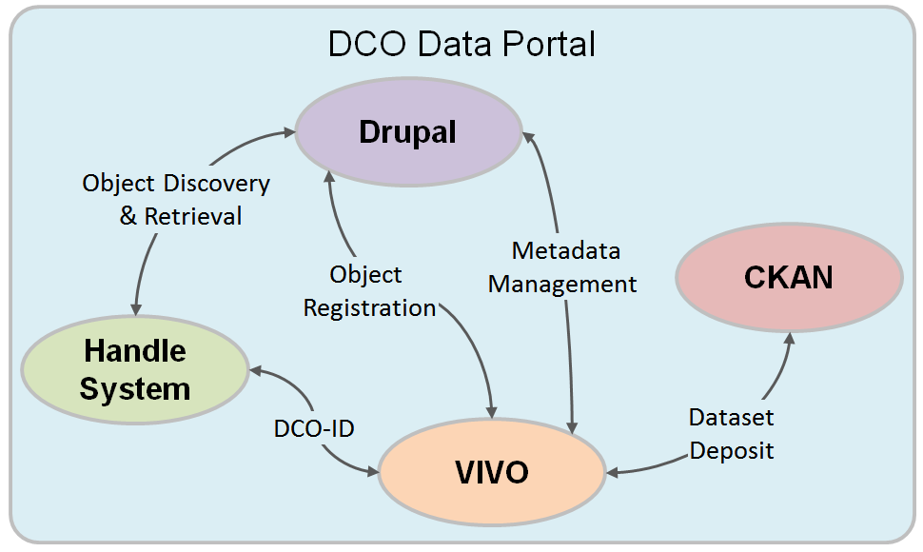
DCO Research Requirements
Each defined data type needs a stable and resolvable PID
Provide semantics - meaning and context - to the defined data types
Annotate datasets with one or more defined data types
21
DCO-ID as a mechanism of persistent identifier for both object registration and retrieval
Notes:
Each DCO-ID can help redirect to the Web profile of an object, where the detailed metadata can be found. In the DCO Data Portal each object is the instance of a class. The metadata items describing an instance are properties. All those classes and properties are organized by the DCO ontology. The classes and properties behind the instance and DCO-ID are comparable to the information types proposed in the RDA PIT works. The DCO-ID allows both humans and machines to retrieve metadata of any object deposited in the data portal.

Slide 22
Possible DCO-DTR Approaches
An integration architecture
  DCO Data Portal is built on the VIVO platform
  DTR and DCO-VIVO as separate knowledge bases
  DCO-VIVO uses DTR API to access data type information
A self-contained architecture
  To have the functionality of DTR completely within the DCO Data Portal
  Need to modify the DCO Ontology, e.g. add a class dco:DataType and collect properties associated with it
We have worked on
this approach
22

Slide 23
Data Types as Linked Data in DCO-VIVO
VIVO acts as the local data type registry
  Implements registration/creation interface
  Publishes datatype content as RDF
  Handles generation of HTML presentation
Data Type schema and records are published as Linked Data
  Assigned resolvable URI
  Encoded as RDF
  Reuse links from other RDF vocabularies
  Linkable from other RDF records
DCO-ID: persistent Handle generated for every data type record in DCO, resolves to data type URI

Slide 24
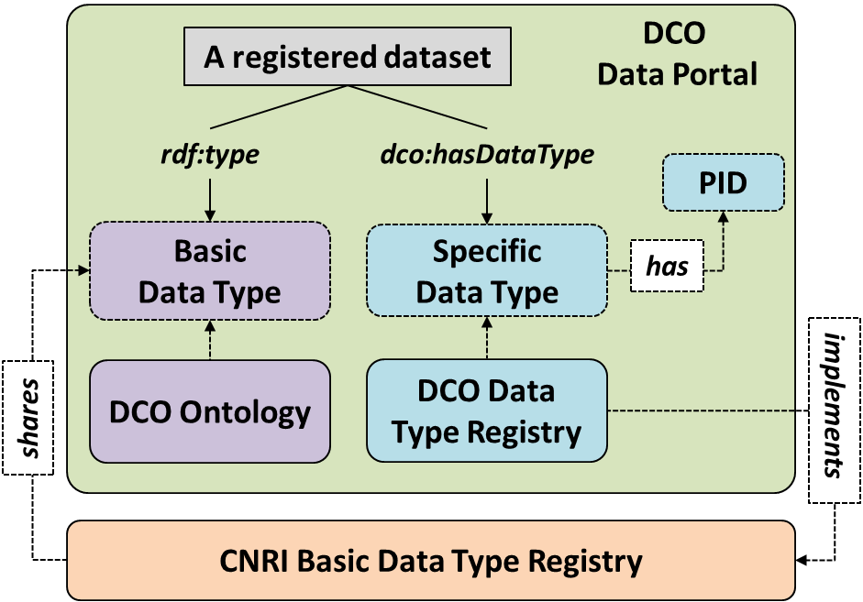
Nature of efforts
The DTR primitives are comparable to a list of BASIC DATA TYPE CLASSES in the DCO ontology, e.g. Dataset, Image, Video, Audio, etc.
A registered DCO dataset is asserted as an instance of one of those basic data type classes.
It is possible to further annotate the dataset with the SPECIFIC DATA TYPES defined within a DTR, and each data type has a unique PID.
24
Notes:
The primitives in a DTR are comparable to a list of BASIC DATA TYPE CLASSES in the DCO ontology, such as Dataset, Image, Video, and Audio, etc.
A registered DCO dataset is asserted as an instance of one of those basic data type classes.
It is possible to further annotate a registered dataset with the SPECIFIC DATA TYPES defined within a DTR, and each data type has a unique PID.

Slide 25
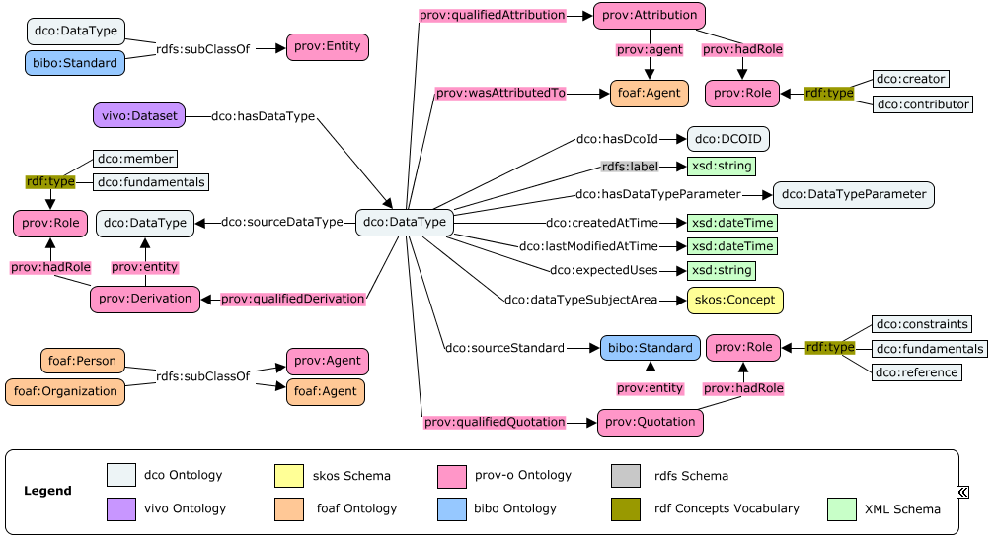
Results of data type specification
Updates to the DCO Ontology:
  A new class dco:DataType. Each specific data type is an instance of it
  An object property dco:hasDataType linking a dataset and a data type
  A collection of other classes and properties associated with dco:DataType
25

Slide 26
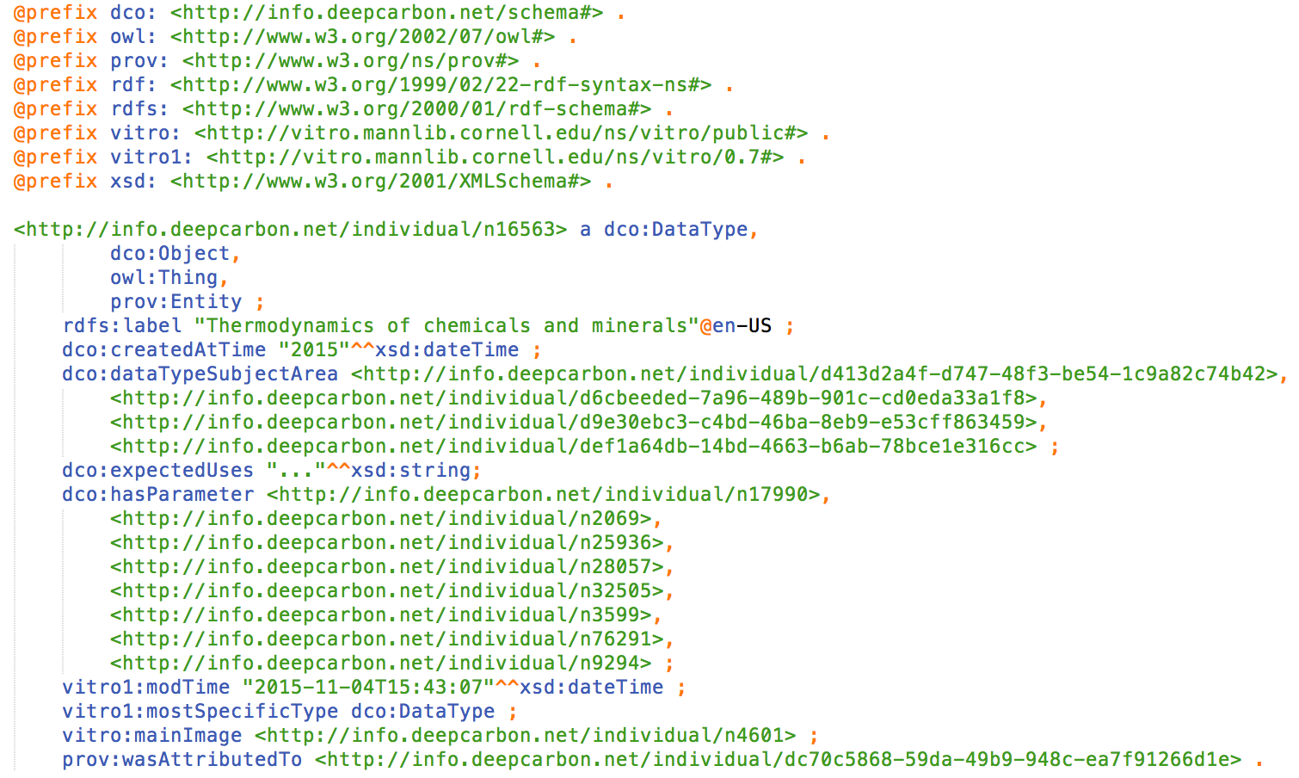
Data Type record as Linked Data

Slide 27
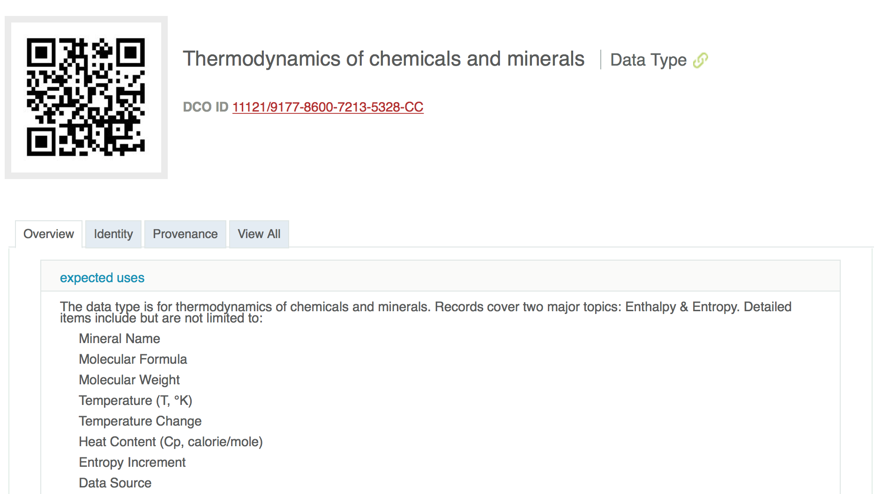
Data Type metadata pages
Resolved by Handle System to data type URI; itself used to access HTML or RDF encoding (via content negotiation)

Slide 28
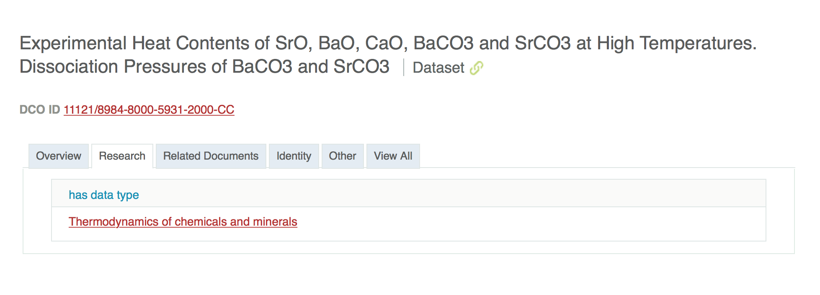
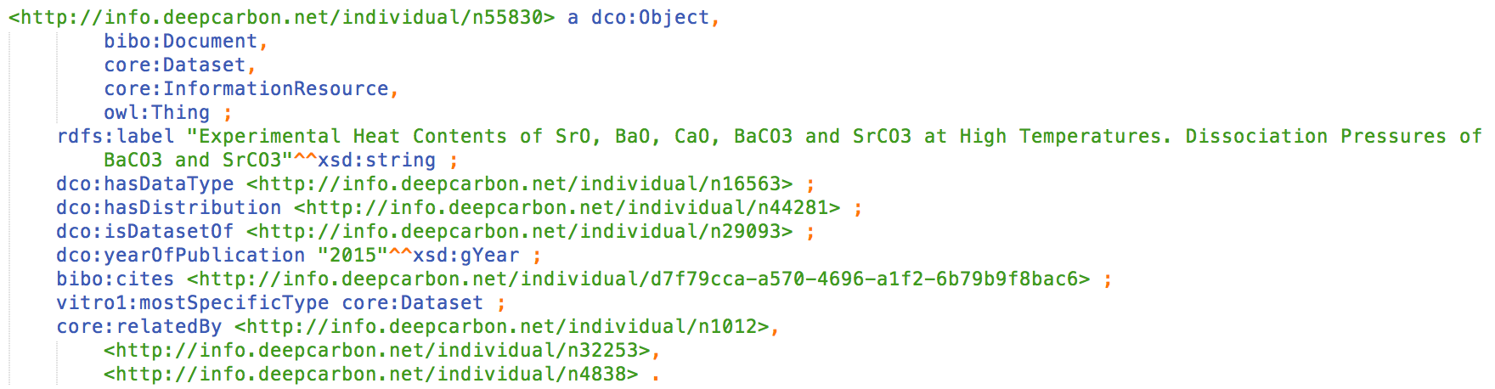
Using data types in RDF
Link to data type URI from dataset RDF

Slide 29
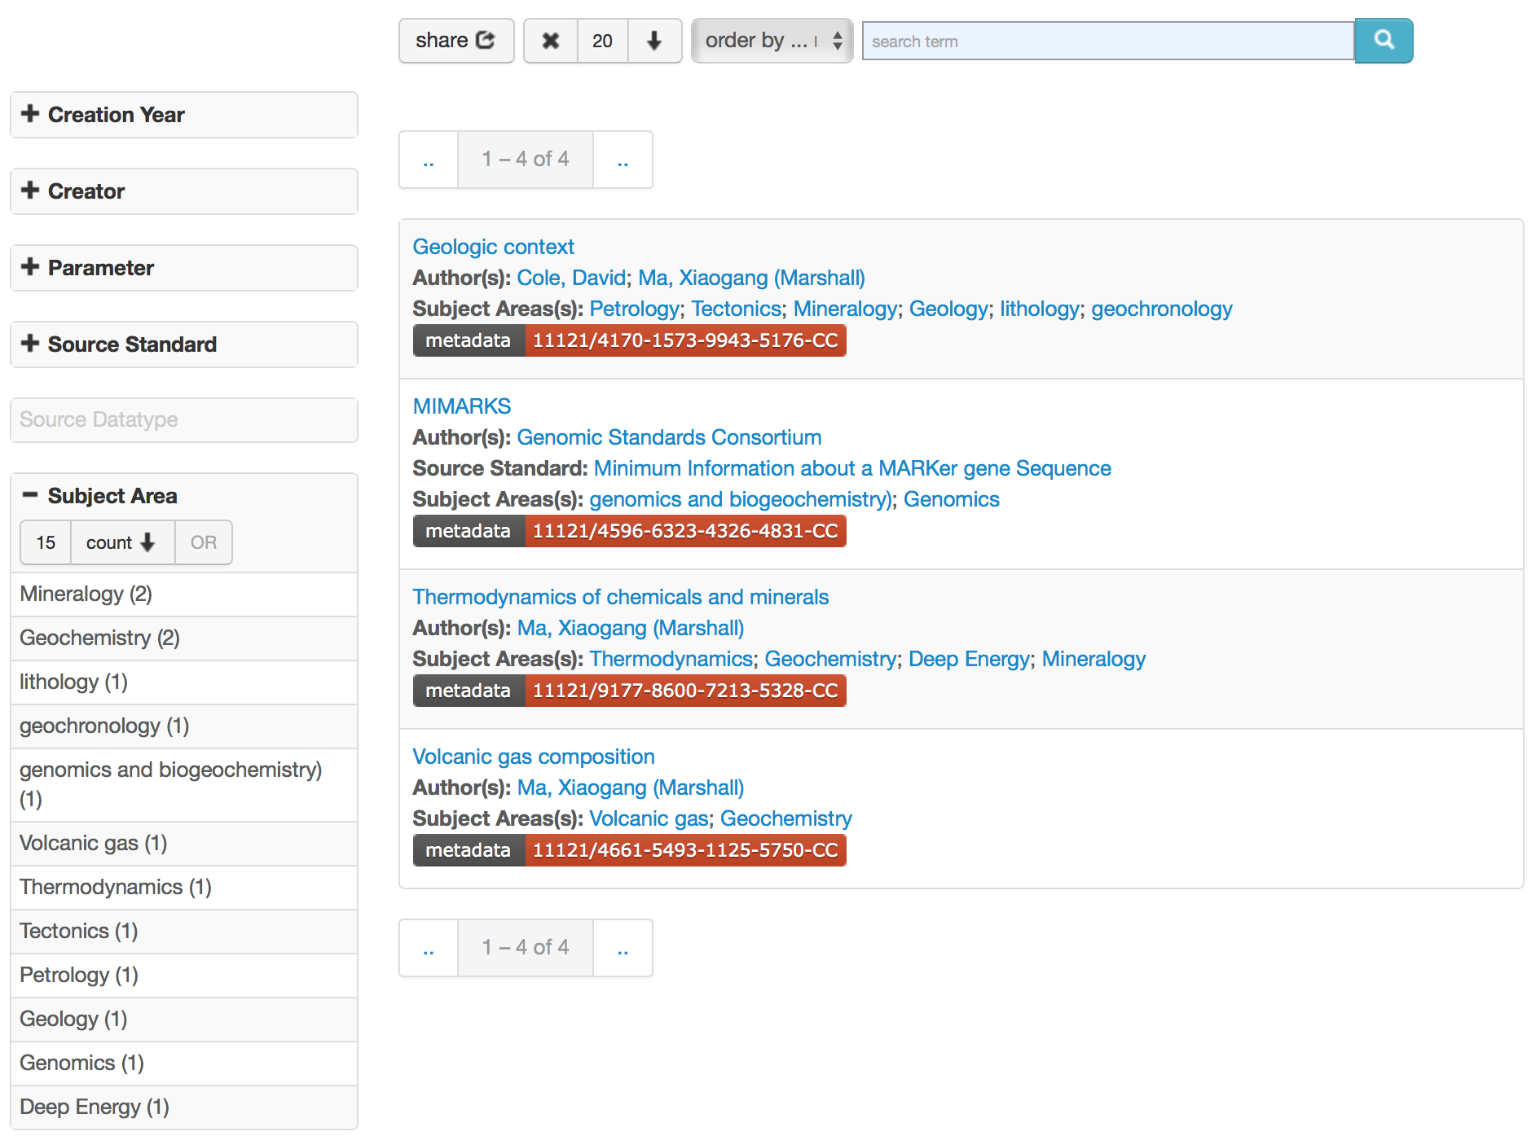
A faceted browser for registered data types
Freetext search
facets
DCO-ID
Notes:
The browser is developed using the Elastic Search tool.

Slide 30
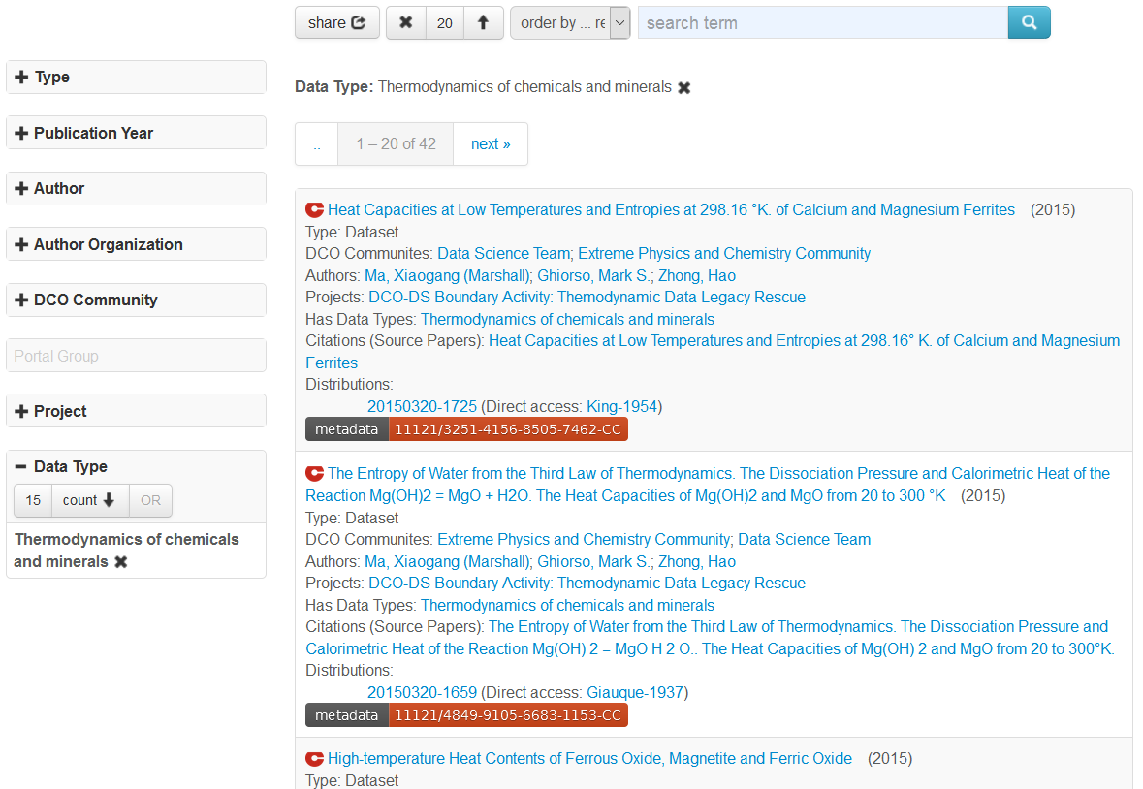
Using Data Type as a facet in DCO dataset browser
Notes:
A user can search data of interest by using records in the data type facet.

Slide 31
Notable
Data types, modeled as first-class objects and published as Linked Data, provide a very useful and efficient means of annotating datasets.
When data types are published as Linked Data
  Data type schema and instance records are resolvable
  DCO data type schema can be reused by third-parties to describe additional data types
  Data types can be easily referenced in third-party dataset annotations
  Data types can be queried using SPARQL

Slide 32
Conclusions
The methodology of RDA DTR and PIT is highly implementable, especially in the environment of the Semantic Web.
A Linked Data publishing platform provides a strong foundation for a data type registry
The technical framework in the current demonstration systems of DTR and PIT can be adapted or further extended for production uses.
Initial good researcher response (they recognize their data types)
Thank you!
32

Slide 33



NIST/RDA DTR Demonstration Application:
L. Bartolo, J. Warren MDII IG Co-Chairs
L, Lannom, T. Weigel DTR & PID WGs
JHJ Scott, R. Hanisch, Z. Trautt, S. Youssef NIST MML, ITL & ODI
A. Fillinger, Dakota Consulting G. Manepelli, A. Powell CNRI

Slide 34
Participants & Motivation
Participants
NIST MML & ITL Labs
WGs DTR & PID: CNRI & DKRZ
Dakota Consulting & Kent State University
Motivation:
– Common problem:
What kind of data have I found? What can I do with it?
– Materials Science & Engineering focus:
  Find plottable XRD data via NIST Mat’ls Resource Registry in MII’s Mat’ls Data Curator System & Mat’ls Data Repositories
  Can Data Type Registry help?

Slide 35
NIST MGI Infrastructures & RDA DTR Product
RDA
Data Type Registry
(DTR)
Repositories
NIST Materials Resource Registry (NMRR)
Mat’ls Data
Curator
System
(MDCS)
NIST Mat’ls
Data Repository
(MDR)
Data Type Registry stores & assigns PIDs to submitted data type descriptions & their relationships.
NIST Mat’ls Data Repository stores data & metadata.
Mat’ls Data Curator curates data & stores curated data & metadata.
NIST Mat’l Resource Registry harvests, stores & makes searchable metadata about resources.

Slide 36
typeregistry.org
name
description
provenance
  contributors
  creation date
  last mod date
Expected Uses
Representation and Semantics
  expression :: value :: details
Properties (build on other types)
  name
  TID of existing type
  representation and semantics
Relationship
  name :: relative names :: details
Slide prepared by John Henry Scott, MML, NIST

Slide 37
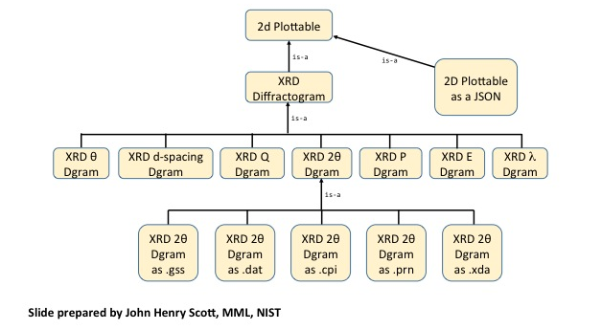
typeregistry.org
RDA Demo XRD Data Types & their relationships

Slide 38
RDA Application Use Case Video on NIST MGI site
https://mgi.nist.gov/materials-resource-registry
A user looks for Aluminum Oxide (Al²O³⁾ x-ray diffraction data
limits the search to diffractogram
DTR holds registered entries with assigned PIDs & information about the relationships for the data type, DIFFRACTOGRAM
  EXAMPLE: RDA-Demo XRD Diffractogram 11314.3/c830042334b25fc6bc68
  with multiple relationships identified
  Based on query of DTR, NMRR can discover in MDCS & MDR
  Relevant XRD diffractogram data sets
  Data conversion resource to convert data into a plottable format

