Slide 1
RDA Data Foundation and Terminology (DFT) WG: Overview
RDA Scope….
WG Scope
Core
Starter Set
DFT WG Goal:
Describe a basic, abstract (but clear) data organization model that helps systemizes the already large body of definition work on data management terms, especially as involved in RDA’s efforts.
Prepared for Collab Chairs Meeting, NIST, Nov 13-14, 2014
Gary Berg-Cross, Raphael Ritz, Peter Wittenburg
Co-Chairs DFT WG

Slide 2
DFT WG Activities & Accomplishments
Drafted 4 related Model Documents on core work;
Data Models 1: Overview – 20 + models
Data Models 2: Analysis & Synthesis
Data Models 3: Term Snapshot
Data Models 4: Use Cases- Work with other RDA WGs on use cases to illustrate data concepts
Drafted 2 page brochure
Presented draft work & held community discussions at RDA P1-P4 meetings
Participated in cross WG discussions
Developed Semantic Media Wiki Term Tool to capture initial list of terms and definitions for discussions, demo held at P3
Candidate List
Evolved to
Refined List
Tool demo at
Plenary 3

Slide 3
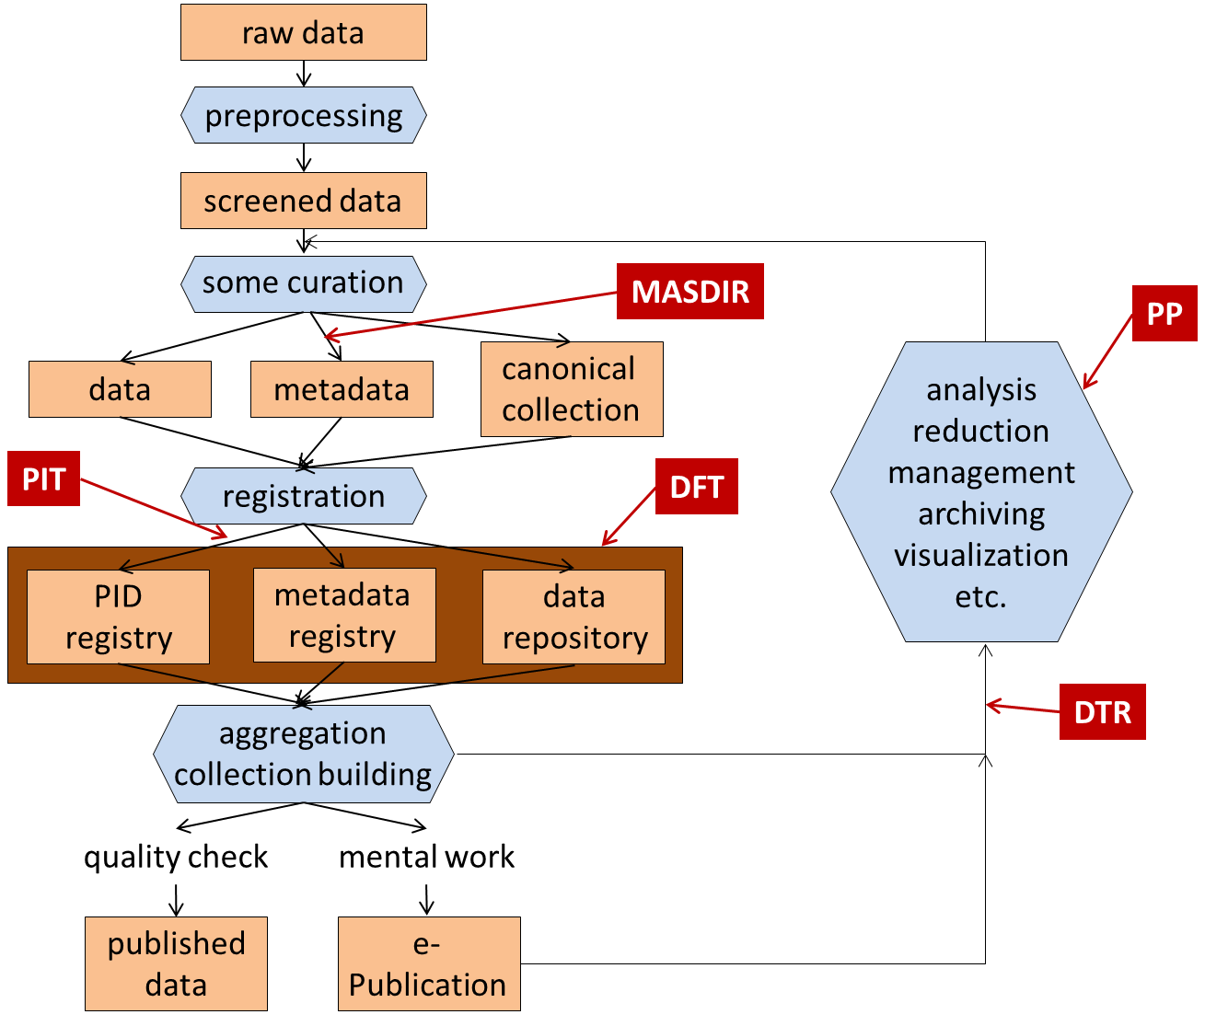
Interactions with the other Groups
Coordinated with several RDA WGs, as shown in the Figure on data concepts and relations.
Participated in Garching meeting and Chairs teleconferences.
Part of WG forum discussions
A PID record points to a metadata record and to instantiations of identical bit-streams and may store additional attributes
Processing model derived from about 125 interviews and interactions with community experts in addition to what DFT aggregated.

Slide 4
One View of DFT Scope from Process View
Policy defines this?
What elements are in a PID record
How to point to a metadata record?
What is in a metadata record at registration?
What is replication with identical vs. different bit-streams that may store additional attributes?
We have policy for a minimum metadata record?
The rest of data management and the lifecycle?
Other WGs…..

Slide 5
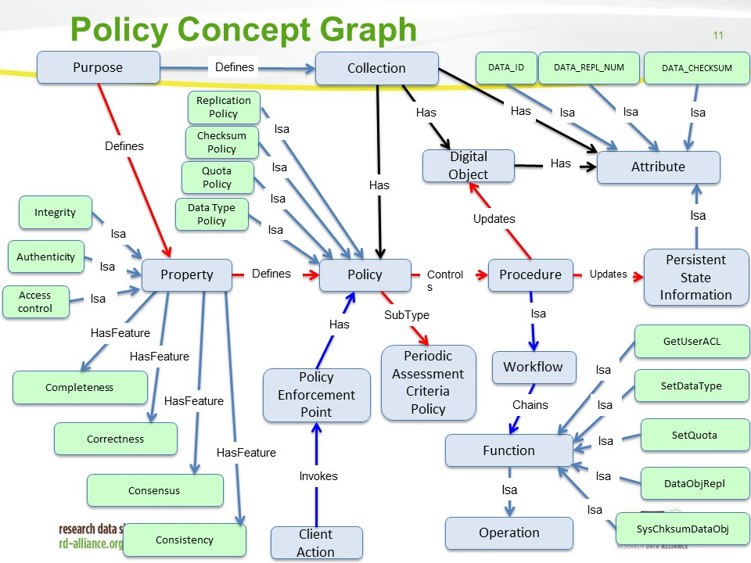

Slide 6
Practical Policy WG area examples
Contextual metadata extraction policies
This policy area focuses on metadata associated with files and collections.
The creation of provenance and descriptive metadata defines a context for interpreting the relevance of files in a collection. Depending upon the data source, there are multiple ways to provide metadata:
Extract metadata from an associated document. An example is the medical imaging format DICOM.
Extract metadata from a structured document which includes internal metadata.
Examples are FITS for astronomy, netCDF, and HDF.
Extract metadata by parsing patterns within the text within a document.
Identify a feature present within a file and label the file with the location of the feature that is present within the file.
Contextual metadata extraction
Data access control
Data backup
Data format control
Data retention
Disposition
Integrity (including replication)
Notification..
A start on minimal MD?
Key processes across the data lifecycle?
Extract metadata | Attribute_name
 | Attribute_value
 | Attribute_unit
 | Source_file
 | Source_collection

Slide 7
Basic Terms -Data Citation as Example
Term Data Citation
Definition Data Citation is the practice of providing a citation to data in a similar way that researchers routinely include a bibliographic reference to published resources.
Examples References [[References::Australian National Data Service [ANDS], [2011], Van Leunen, [1992]
Other sources: quoted from http://www.force11.org/node/4770, cited there as 'adapted from https://www.jstage.jst.go.jp/article/dsj/12/0/12_OSOM13-043/_pdf']]
Related Term: Citable Data is a type of referable data that has undergone quality assessment and can be referred to as citations in publications and as part of Research Objects.
Data Citation
A citation is a formal structured reference to another scholarly published or unpublished work.
In traditional print publishing, a “bibliographic citation” refers to a formal structured reference to another scholarly published or unpublished work.
Typically, in-text citation pointers to these structured references are either marked off with parentheses or brackets, such as “(Author, Year),” or indicated by superscript or square-bracketed numerals although in some research domains footnotes are used. Such citations of a single work may occur several times throughout the text. The full bibliographic reference to the work appears in the bibliography or reference list, often following the end of the main text, and is called a “reference” or “bibliographic reference.” Traditional print citations include “pinpointing” information, typically in the form of a page range that identifies which part of the cited work is being referenced.

Slide 8
Objectives for Completing & Adoption
Facilitate community discussion on core concepts
We are updating products based on P4 discussions with our core communities and conversations on the Wiki.
Adoption Discussion and Take Up
We expect considerable discussion over time with “adopters” and with the DF IG that will serve to plan take up between P4 and P5.
Potential adopters were encouraged at P4 to provide feedback on additional use case scenarios to illustrate what areas of work they plan on using the models and vocabulary for.
Based on feedback, some curated revisions on definitions and the overall synthesis model can be expected to finalize and stabilize the effort for submission and subsequent use.
The WG will attempt to track this up take and adoption in order to facilitate adoption and prepare for exposition at P5.
During this initial adoption period from P4 to P5 we will, for example, attempt to gather and publicize success factors and critical issues, and encourage new (and outside) adopters such as the DataNet Federation Consortium and DataONE communities to use the DFT model.

