Slide 1
Three Uses for a Technology Roadmap
Helps reach a consensus about a set of needs and the technologies required to satisfy those needs
Provides a mechanism to help forecast technology developments
Provides a framework to help plan and coordinate technology developments

Slide 2
EarthCube
“EarthCube is a community effort to promote interdisciplinary geoscience by enabling technology, organization, and culture that facilitates connectivity through standards and protocols to existing and emerging resources.”
NSF & GEOSCIENCE COMMUNITY PARTNERSHIP
Geoscience community involvement in decision-making processes

Slide 3
Early EarthCube (2012)
4 Working Groups – gathered user requirements from the geosciences community
Data, Governance
Semantics and Ontologies
Workflows
5 Concept Teams – evaluated and prototyped key technologies
Brokering
Cross-Domain Interoperability
Earth System Models
Layered Architecture
Web Services

Slide 4
EarthCube Roadmaps

Slide 5
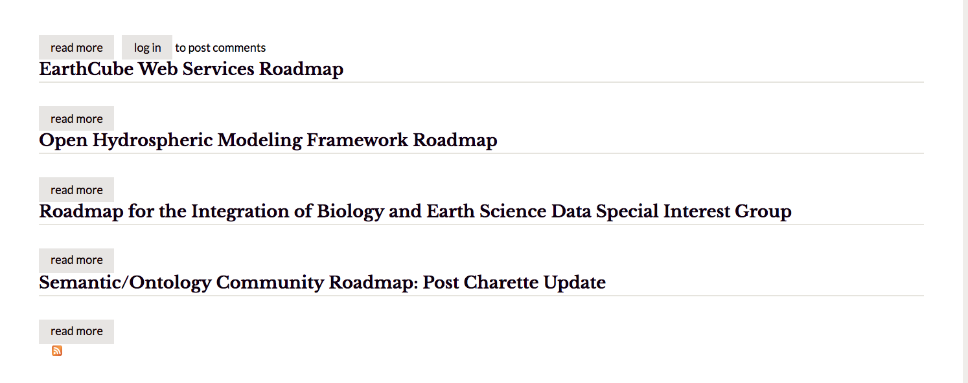
EarthCube Roadmaps

Slide 6
What Problem(s) Need to be Solved?
Many very similar sessions of varying flavor at plenaries – how to organize meeting topics?
How to make RDA easier to understand/navigate by non-RDA members?
How to identify the overlap in groups or gaps in areas covered by groups?

Slide 8
EOSC Declaration
RECOGNISING the challenges of data driven research in pursuing excellent science;
GRANTING that the vision of European Open Science is that of a research data commons, widely inclusive of all disciplines and Member States, sustainable in the long-term,
CONFIRMING that the implementation of the EOSC is a process, not a project, by its nature iterative and based on constant learning and mutual alignment;
UPHOLDING that the EOSC Summit marked the beginning and not the end of this process, one based on continuous engagement with scientific stakeholders, the signatories,
ENDORSE the following intents and will actively support their implementation in their respective capacities:

Slide 9
Data culture and FAIR data
[Data culture]
[Open access by-default]
[Skills]
[Data stewardship]
[Rewards and incentives]
[FAIR principles]
[Standards]
[FAIR Data governance]
[Implementation & transition to FAIR]
[Research data repositories]
[Accreditation/certification]
[Data Management Plans]
[Technical implementation]

Slide 10
Data culture and FAIR data (cont.)
[Technical implementation]
[Citation system]
[Common catalogues]
[Semantic layer]
[FAIR tools and services]
[Data expert organisations]
[Legal aspects]

Slide 11
Research data services and architecture
[EOSC architecture]
[Implementation]
[Legacy]
[User needs]
[Service provision]
[Service deployment]
[Thematic areas]
[Research infrastructures]
[EU-added value and coordination]
[High Performance Computing and the EOSC]
[Innovation]

Slide 12
Governance and funding
[Governance model]
[Governance framework]
[Executive board]
[Coordination structure]
[Long-term sustainability]
[Funding]
[Global aspects]

