Slide 1
Data Discovery Paradigms Interest Group Report on Activities and Outputs
Anita de Waard, Siri Jodha Singh Khalsa
Fotis Psomopoulis
Mingfang Wu

Slide 2
Purpose and planned outcomes/aims
Explore common elements and shared issues faced by those who search for data, and who build systems supporting search
Engage with broadest possible spectrum of stakeholders to investigate, report, and make recommendations regarding these issues
Notes:
User scenarios or use cases the IG wishes to address:
Data search engines are interested in developing components and practices to connect resources and results
Data repositories are interested in improving and expanding search on their platforms
Users are interested in better interfaces and fewer places to look for data
Data creators are interested in a shared set of data metrics for all search engines
Data search builders are interested in sharing knowledge and tools about ranking, relevance and content enrichment.

Slide 3
Accomplishments to date
Four Task Forces formed
Use Cases, Prototyping Tools and Test Collections
Best Practices for Making Data Findable
Relevancy Ranking
Metadata Enrichment
Three manuscripts generated, intended for publication
One submitted, one ready, one in progress
Notes:
Use Cases, Prototyping Tools and Test Collections:
Identify a set of common data search use cases, leading to a set of requirements
Meant to be useable by all data discovery services
Best Practices for Making Data Findable
Three key perspectives: Data Provider, Data Seeker, Data Repositories
Relevancy Ranking:
Choose appropriate technologies for search functionality
Sharing experiences with relevancy ranking
Metadata Enrichment:
Survey current methods and tools for auto-generating metadata
Document value of enriched metadata for improving search and automated workflows

Slide 4
Issues, challenges, problems
Members: 100; Doers: 8 – 10
3 – 6 doers per task force
Interactions with other groups minimal
Notes:
Also, no time to reach out to other groups

Slide 5
Are these issues sufficient to require modification of the outcome, schedules, scope?
No modifications needed
The TFs managed to generate outputs within the 18 mo. WG timeframe
Notes:
Congratulations, your Developing Shared Paradigms for Data Discovery IG charter has been reviewed and approved by TAB, and is being passed along to the RDA Council for final endorsement!

Slide 6
Plan for completion/progress for the coming 6-12 months
Metadata enrichment TF reinvigorated
Recent CFP elicited encouraging responses
Plan to develop survey on current practices and tools in use
Spinning up TF on optimizing discoverability by commercial search engines
Notes:
Other New activities suggested in session at RDA P10:
Cataloging and Analysing Common Data Discovery APIs;
Data Discovery for Institutional Repositories - test recommendations, explore new insights gained through using new discovery technologies;
Analysis of Search logs, possible follow-up activity for the existing relevancy ranking task force;
Collection and Analysis of Data Needs - identify what people usually want to find;

Slide 7
Relation to/coordination with other WG/IGs
Although there are obvious connections with metadata, research data collections, domain focused interoperability, etc. we have had little direct interactions
Participating in joint session at P11 w/
IG Agricultural Data
IG ELIXIR Bridging Force
WG BioSharing Registry
IG Repository Platforms for Research Data

Slide 8
Fit with the RDA mission
Discovery is central to mission of making it easier for researchers to share data
Data producers, data repositories, infrastructure developers all have roles

Slide 9
Supporting Material

Slide 10
Use Cases
Users want better interfaces and fewer places to look for data.
Data creators need guidance on improving the findability of their data.
Builders of data search engines are interested in sharing knowledge and tools to improve search services.

Slide 11
Ranked requirements from Use Cases
REQ1: Indication of data availability
REQ2: Connection of data with person, institution, pub, citations, grants
REQ3: Fully annotated data
REQ4: Filtering of data based on multiple fields at the same time
REQ5: Cross-referencing of data
REQ6: Visual analytics / inspection of data / thumbnail preview
REQ7: Sharing data in a collaborative environment
REQ8: Accompanying educational / training material
REQ9: Functionality similar to that of other established academic portals

Slide 12
Ten Recommendations for Data Repositories
REC 1: Provide a range of query interfaces to different various data search styles.
REC 2: Provide multiple access points to find data (e.g keyword, browse, facets).
REC 3: Make it easier to judge relevance, accessibility and reusability.
REC 4: Make individual metadata records readable and analysable.
REC 5: Be able to output bibliographic references.
REC 6: Provide feedback about data usage statistics.
REC 7: Be consistent with other repositories.
REC 8: Identify and aggregate records that describe the same data object.
REC 9: Make records easily indexed and searchable by major web search engines.
REC 10: Follow API search standards and community adopted vocabularies.

Slide 13
Combined outputs
Requirements derived from use cases
Recommendations for data repositories
Combined into manuscript submitted to
Library & Information Science Research

Slide 14
Best Practices for Data Seekers
Ten Simple Rules for Finding Research Data
Manuscript submitted to PLOS
Authors: Kathleen Gregory, Siri Jodha Khalsa, Bill Michener, Fotis Psomopoulos, Anita de Waard, and Mingfang Wu

Slide 15
Ten Simple Rules
Think about the data you need and why you need them.
Select the most appropriate resource.
Construct your query.
Make the repository work for you.
Refine your search.
Assess data relevance and fitness-for-use.
Save your search and data source details.
Look for data services, not just data.
Monitor the latest published data.
Give back.

Slide 16
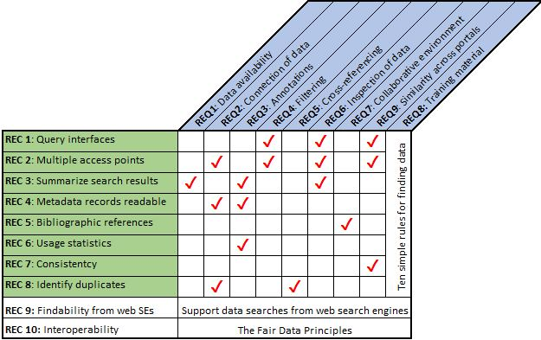
Mapping between the REQ, the REC and the Ten Rules

Slide 17
Relevancy Ranking Survey - Objectives
Help data repositories choose appropriate technologies when implementing or improving search functionality.
Capture the aspirations, successes and challenges.
Provide a forum for sharing experiences with relevancy ranking.

Slide 18
Survey Design (33 Questions)
Repository characteristics (5)
System configurations (7)
Evaluation methods and benchmarks (10)
Methods used to boost searchability to web search engines (2)
Other technologies or system configurations (5)
Wish list for future activities for the RDA relevance task force (2)

Slide 19
What’s Next?
New activities suggested in session at RDA P10:
Cataloging and Analysing Common Data Discovery APIs;
Data Discovery for Institutional Repositories - test recommendations, explore new insights gained through using new discovery technologies;
Analysis of Search logs, possible follow-up activity for the existing relevancy ranking task force;
Collection and Analysis of Data Needs - identify what people usually want to find;
Making research data more discoverable by search engines
Presentation 2 November by Natasha Noy of Google Research
Task Force in process of forming
Notes:
- Granularity, domain-specific cross-domain issues
- De-duplication of search results
- Using upper-level ontologies
- Search personalisation

